Slide 1
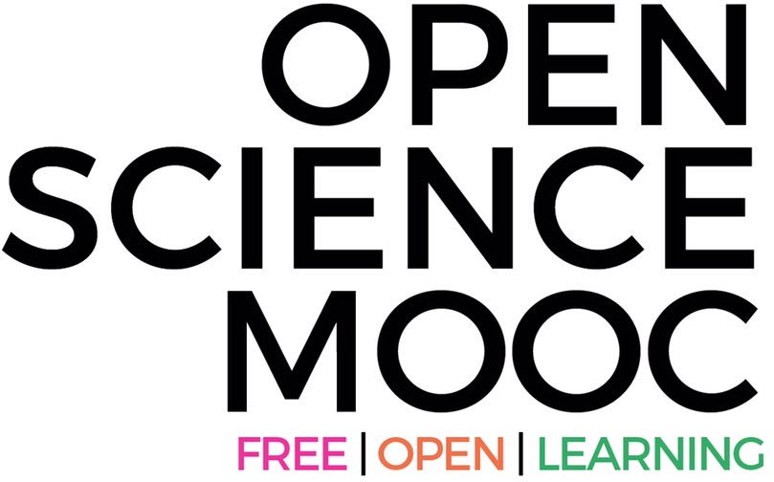
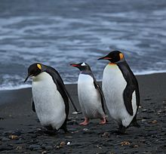
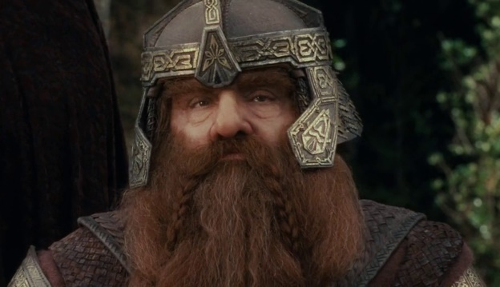
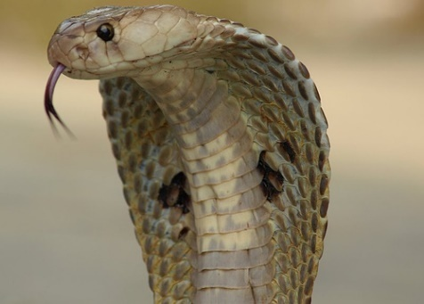
What do Penguins, Gimli, and Cobras have to do with Open Science?
Dr. Jon Tennant
@protohedgehog
https://orcid.org/0000-0001-7794-0218
Hanze Research Day, January 29 2019
Groningen, Netherlands

Slide 2
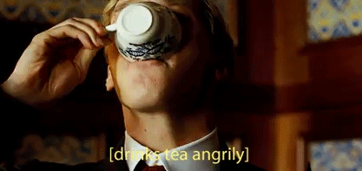
What gets me out of bed in the morning
The vast majority of scholarly research and knowledge is held hostage by private corporations.
These commercial giants are ruthless racketeers that have profit margins that exceed Apple and even ‘big oil’ (>35%).
We are not communicating research effectively, and our world is suffering as a result.
@protohedgehog

Slide 3
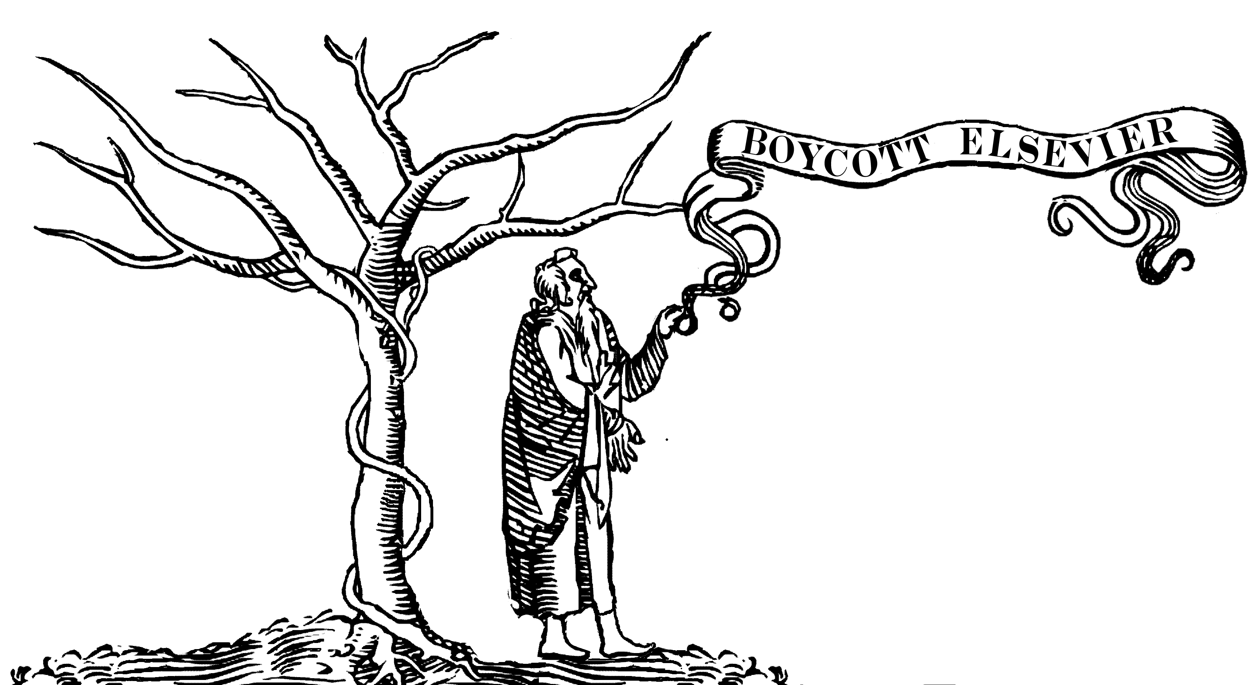
Slow and wasteful
Often irreproducible
Ruled by commercial interests
Copyright is broken
Illusion of academic freedom
Questionable research practices
Flawed evaluation processes
Lack of access, soaring costs
Closed science means people suffer
Science is not working as well as it could be
@protohedgehog

Slide 4
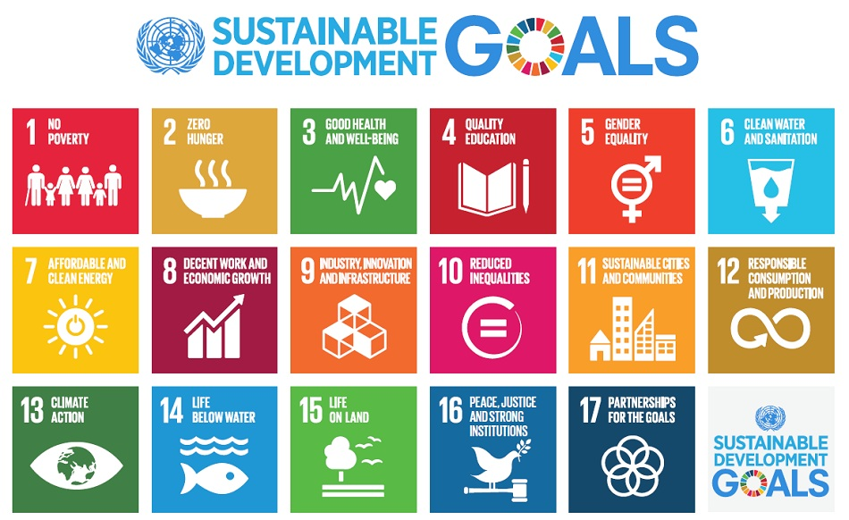
Do you believe that scientific research can help us solve these problems?
http://www.who.int/mediacentre/events/meetings/2015/un-sustainable-development-summit/en
@protohedgehog

Slide 5
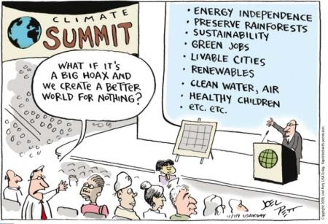
YES!
But then you also must acknowledge that by preventing access to research, we are acting against meeting these goals.
And this is what many in the present scholarly publishing industry are doing. In exchange for our money.
It’s not a bug. It‘s a feature.
@protohedgehog

Slide 6
Enter ‘Open Science’
https://www.fosteropenscience.eu/content/what-open-science-introduction
@protohedgehog

Slide 8
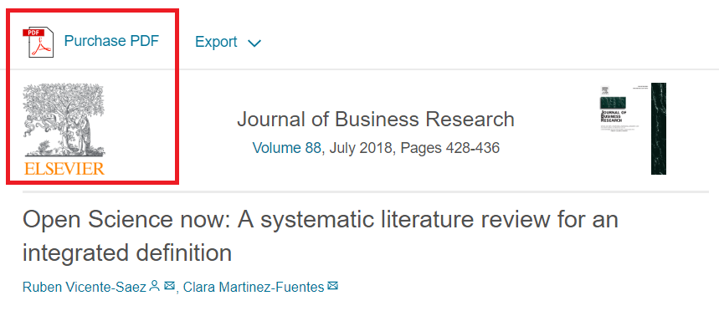
I feel like often we talk about “Open Science” as a different entity to [good] “science”.
“Open Science is transparent and accessible knowledge that is shared and developed through collaborative networks.”
“Open science describes the practice of carrying out scientific research in a completely transparent manner, and making the results of that research available to everyone. Isn’t that just ‘science’?”
THIS IS VERY BAD
THIS IS VERY GOOD
https://genomebiology.biomedcentral.com/articles/10.1186/s13059-015-0669-2
https://www.sciencedirect.com/science/article/abs/pii/S0148296317305441
@protohedgehog

Slide 9
What’s the fuss?
Because OS has become a poorly-defined process-based concept
Confused between the scientific process, and communication of results
Divorced from any human, value-based element
Treated as distinct from principles of ‘good’ science
This makes it very easy for commercial interests to co-opt (which they are)
Or to be used as a political slogan to gain brownie points (which it also is)
Or I’m just being scholarly pedantic…
@protohedgehog

Slide 10
Freedom
Fairness
Justice
Truth
Liberty
FAIR principles
TOP guidelines
Principles of Open Scholarship, by Tony Ross-Hellauer (Source, CC BY).

Slide 11
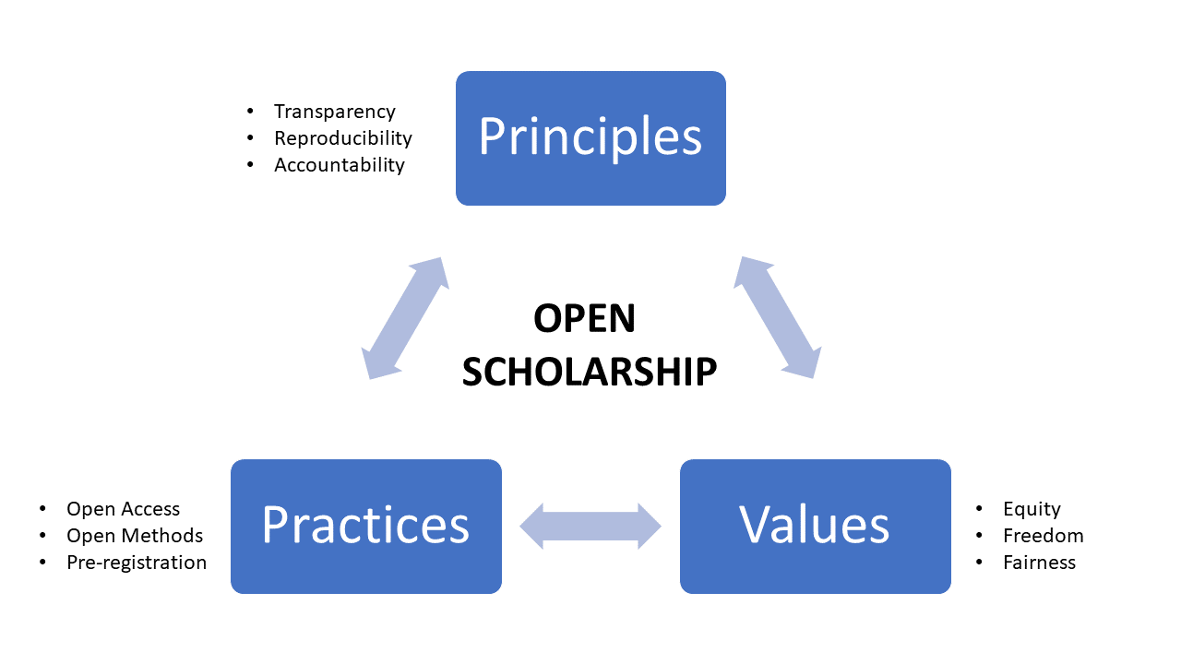
Thoughts in progress…
@protohedgehog

Slide 12
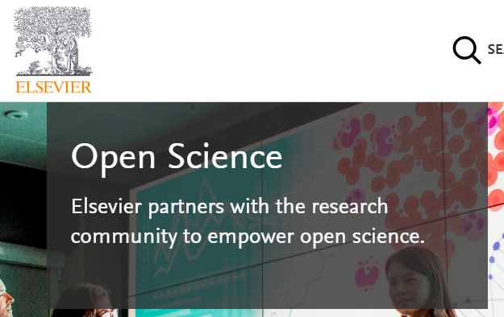
Mega-publishers are corrupting Open Science
Organisations stuck in a pre-digital mindset with a key product developed in the 17th Century.
Basically the reason why the Open Science ‘movement’ began.
Business models based on exclusion, exploitation of privilege, discrimination, extortion..
Who pay lip service to Open Science, while simultaneously subverting it to meet their own intentions.
We DO NOT share the same values and principles.
@protohedgehog

Slide 13
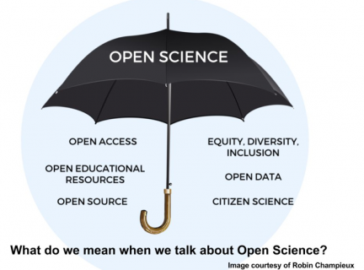
There are many ways to ‘do open science’
It’s not just about Open Access…
Many different possible solutions
No ‘one size fits all’
Can also include sharing student theses, reports, booklets, art forms, manifestations, software code, data
Whenever you commit to sharing, that’s a step towards open science
https://blogs.plos.org/neuro/2018/01/31/open-science-sharing-is-caring-but-is-privacy-theft-by-david-mehler-and-kevin-weiner/
@protohedgehog

Slide 14
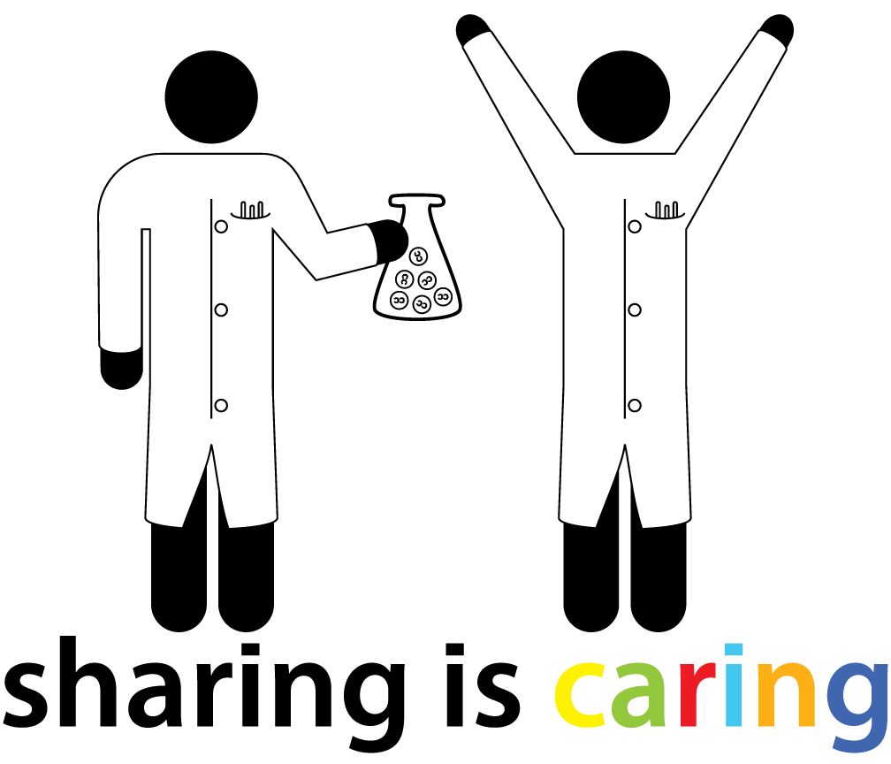
What does it take to be an ‘open scientist’?
You do not need to be a tech guru
It does not hurt to have more knowledge of the system you are working in
Especially if those skills help to enhance you as a person
And help you to get a job inside or outside of academia
But you don’t need to be an expert in every part of it to succeed
Make openness part of who you are as a person
And automatically ‘gain entry’ into the ‘open science community’
http://research.iheartanthony.com/2012/05/31/why-i-became-an-open-scientist/
@protohedgehog

Slide 15
Sounds too good to be true?
Welcome to academia!
How will you be taking your permanent head damage (PHD)?
@protohedgehog

Slide 16
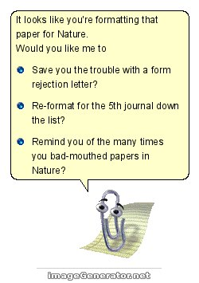
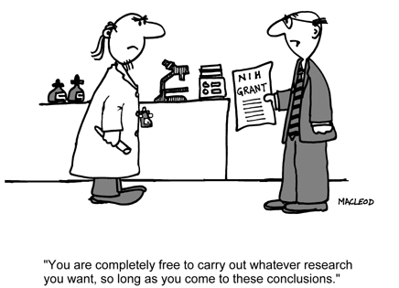
The mantra ‘publish or perish’ is dead, replaced by ‘publish and perish’ due to under-funding and competition climbing the academic career ladder.
A mentality grilled into students as soon as they start, with the view that anything beyond attaining a professorship is failure.
@protohedgehog
http://3dsbiovia.com/blog/index.php/2014/11/25/publish-perish-mentality-hurting-scientific-integrity/

Slide 17
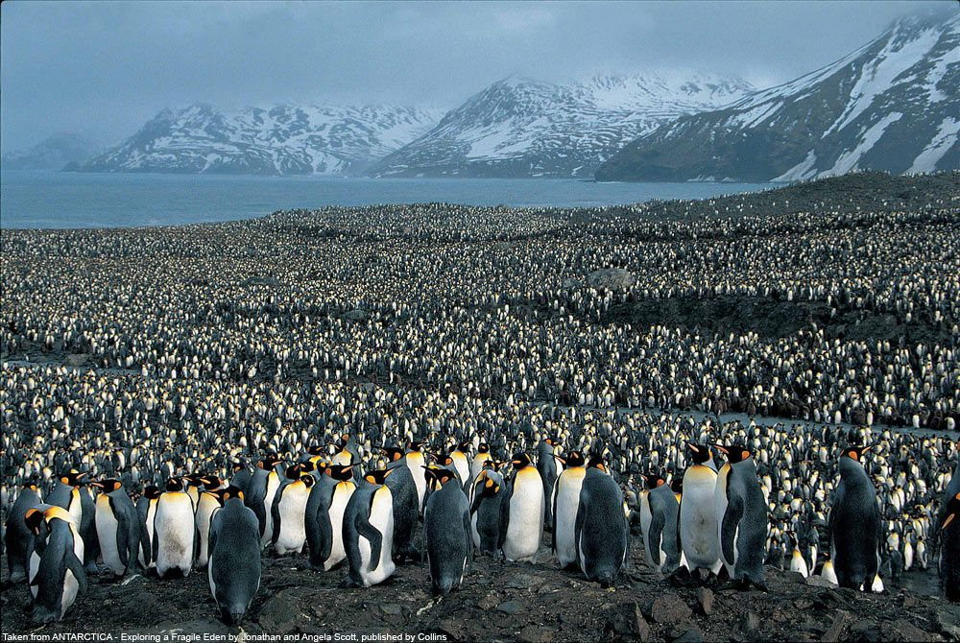
Culture change and penguins
Crowd-based physiological effects within the academy
@protohedgehog

Slide 18
Have you ever met an average academic?
50% of academics are less intelligent or knowledgeable than the average academic.
Live in a system defined by cultural inertia.
Generally slow to adapt to new technologies and practices.
Require ‘incentives’ in order to behave appropriately
What happened to doing good science? What are the incentives for that?
@protohedgehog

Slide 19
But academics are also generally terrible at making predictions...
“Open Access will never catch on.”
“Preprints will never be a thing.”
“Sharing our data won’t ever be mandatory.”
“Open peer review is fake news.”
“It doesn’t matter if research isn’t reproducible.”
“Open Science is just a fad.”
But why is this?
I wonder if they ever get tired being wrong all the time…
@protohedgehog

Slide 20
Principles in Open Research
Drivers
Barriers
Reduce publication bias.
Increase replicability.
Increase reliability of scientific record.
Make publicly funded research publicly accessible.
Make research more efficient.
Increase public trust.
Foster collaboration.
Sustainable research.
Fear of scooping or ideas being stolen.
Fear of not being credited for ideas.
Fear of errors and public humiliation.
Fear of risk to reputation.
Fear of reduced scientific quality.
Fear of information overload.
Fear of career compromise.
Fear of backlash from senior figures.
Fear of being different.
@protohedgehog

Slide 21
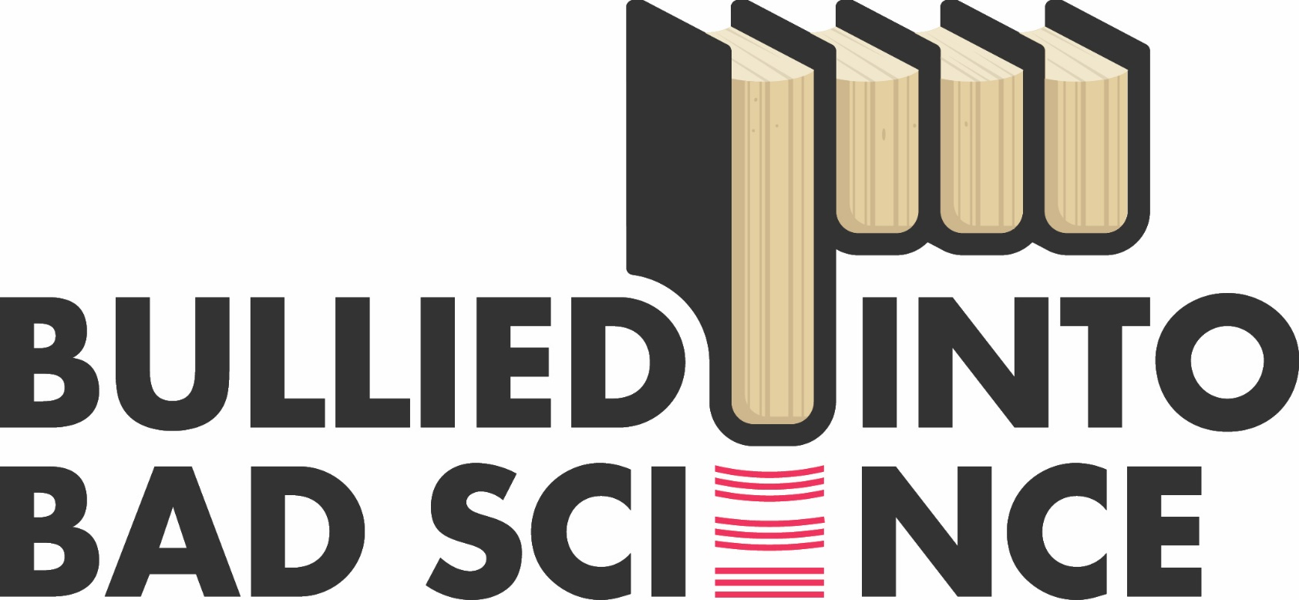
The Bullied Into Bad Science campaign is an initiative by early career researchers (ECRs) for early career researchers who aim for a fairer, more open and ethical research and publication environment.
http://bulliedintobadscience.org/
@protohedgehog

Slide 22
Complex barriers to open science*
FEAR
POWER
COMPETITION
Socio-cultural
Technological
Political
Organisational
Economic
Legal
Educational
INERTIA
*or scientific progress in general
@protohedgehog

Slide 23
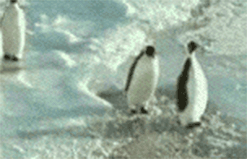
OK, but how do penguins come into this?
@protohedgehog

Slide 24
And this is the result
Your career
Open Science
SOCIAL AND TECHNICAL BARRIERS
@protohedgehog

Slide 25
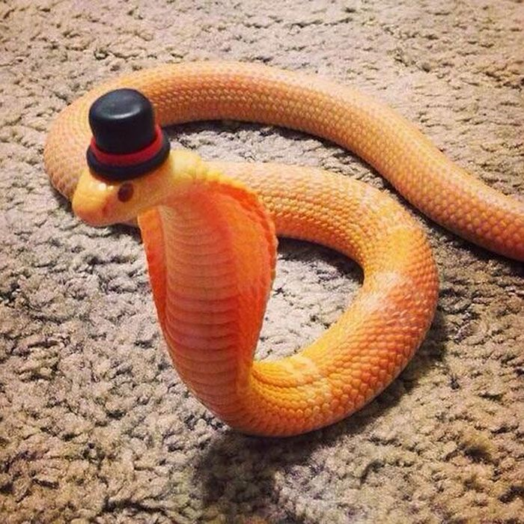
Incentives and cobras
Is a performance-driven culture dangerous for research?
@protohedgehog

Slide 26
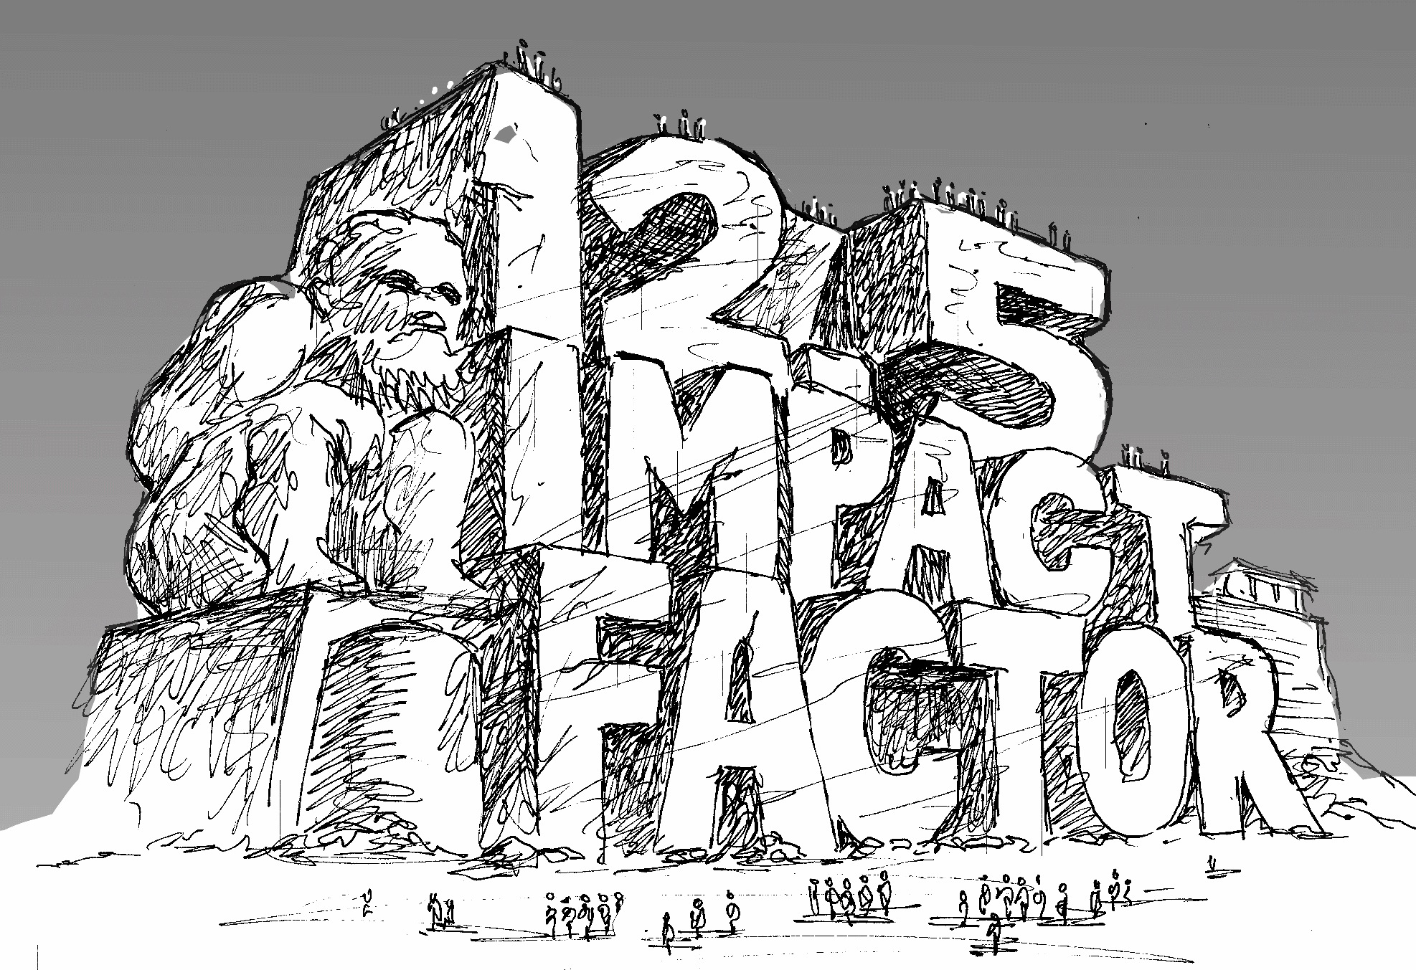
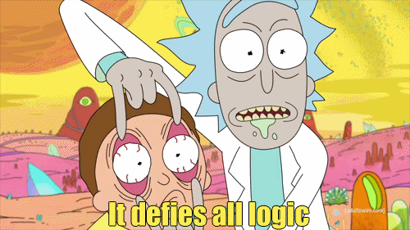
http://whyopenresearch.org/impactfactor
@protohedgehog

Slide 27
Peer review at the ‘top’ (worst) journals
Researchers are all guilty of “glam-humping”.
Impact factors mean very, very little.
About research and researchers.
Except the higher it is, the more likely it is that you committed fraud.
A profoundly non-scientific way of applying metrics for evaluation.
If you use the impact factor for anything other than it’s intended purpose, you are statistically illiterate and should have all of your quantitative research papers retracted.
http://www.nature.com/news/why-high-profile-journals-have-more-retractions-1.15951
http://journal.frontiersin.org/article/10.3389/fnhum.2013.00291/full

Slide 28
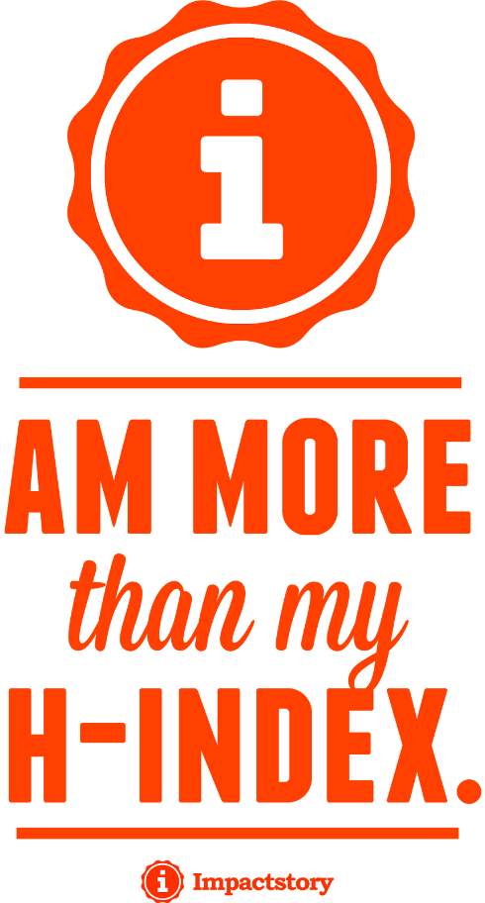
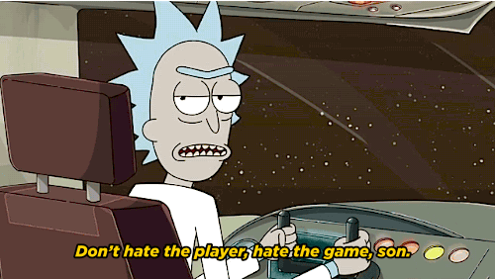
Goodhart’s Law: "When a measure becomes a target, it ceases to be a good measure.”
But all players should still be accountable for the game.
Something shockingly absent at the present.
@protohedgehog

Slide 29
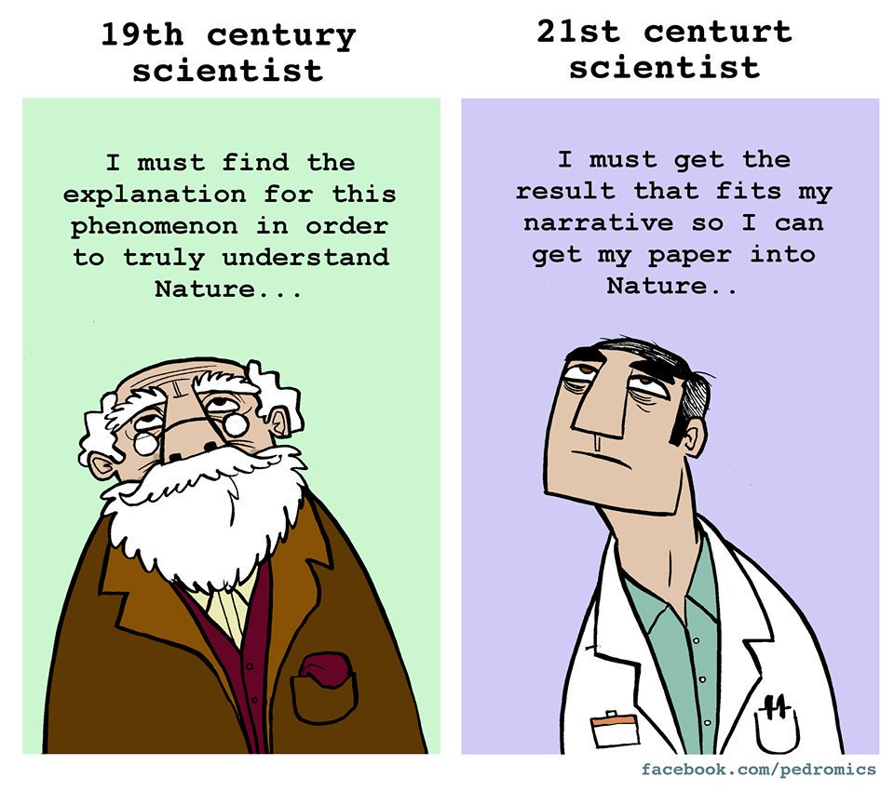
A policy change in 2010 making citations more important for research evaluation led to an increase of up to 179% in self-citations and adoption of ‘questionable research practices’.
https://www.sciencemag.org/news/2019/01/how-shine-indonesian-science-game-system
https://www.sciencedirect.com/science/article/pii/S004873331730210X
@protohedgehog

Slide 30
“I worry that the KPI-driven impact culture increasingly means that careful, meticulous and incremental science is anathema in the academy, especially for those at the early stages of their careers. There are many who are so attracted by the prospect of success that they are willing to obfuscate, mystify and perhaps falsify research to game the system and reap the plentiful rewards.”
“Most of all, I worry that instead of working towards an enlightened future, many are simply selling farmed cobras and calling it progress.”
https://www.theguardian.com/higher-education-network/2018/feb/16/performance-driven- culture-is-ruining-scientific-research?
@protohedgehog

Slide 31
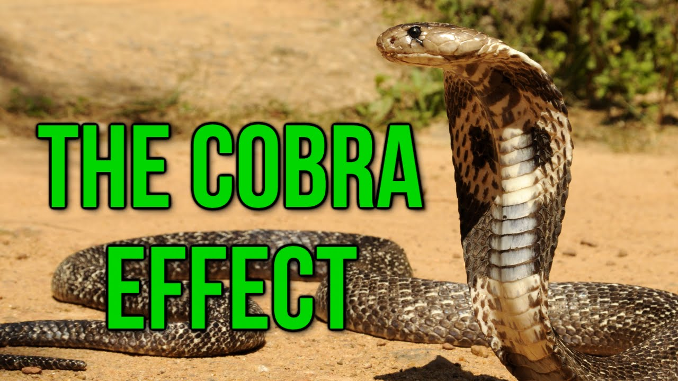
OK, but how do cobras come into this?
How incentives in complex systems can have unintended consequences which exacerbate the problem they were trying to solve.
Notes:
There is a well-known anecdote about British rule in India. In Delhi, officials were concerned that there were too many cobras. To reduce their population, people were paid for each cobra killed. When the administrators found out that some people had started to breed cobras to kill them and collect the reward, they stopped the scheme. The farmed cobras were set free, causing the population to explode.

Slide 32
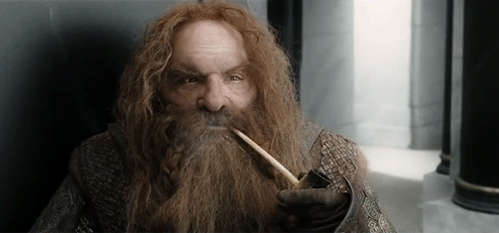
Gimli and career advancement
Because dwarves are well known for their honest career advice…
@protohedgehog

Slide 33
Your career
Open Science
SOCIAL AND TECHNICAL BARRIERS
@protohedgehog

Slide 34
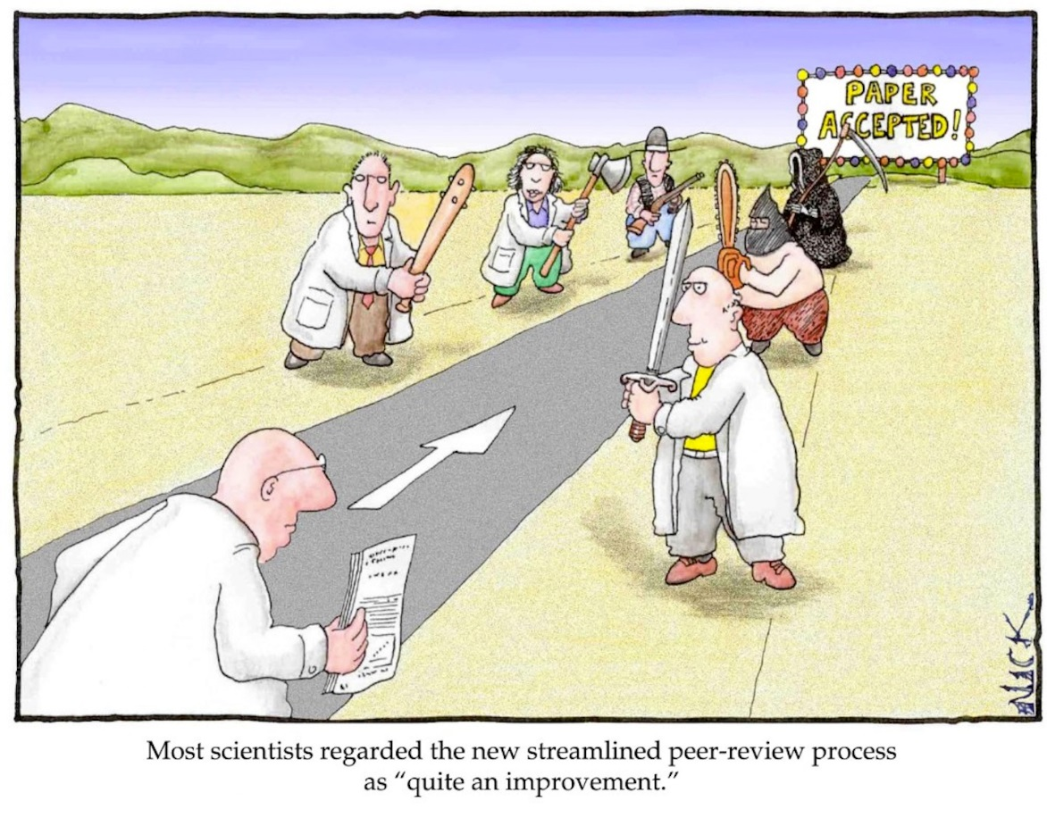
The present academic system
Those who want to create, explore, and innovate are stifled and chased out the system. The status quo lives on in perpetuity.
Research suffers.
@protohedgehog

Slide 35
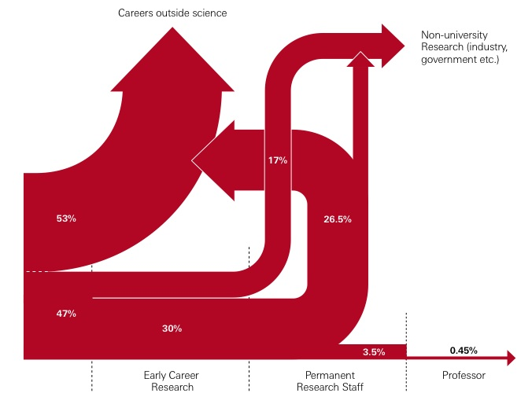
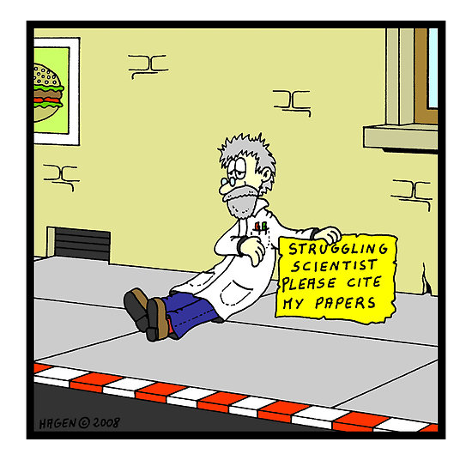
https://royalsociety.org/~/media/Royal_Society_Content/policy/publications/2010/4294970126.pdf
@protohedgehog

Slide 36
In the wise words of Gimli
“Certainty of death? Small chance of success? What are we waiting for!”
The Gimli effect: Going into a situation knowing full well that the outcome is not going to be what you want it to be
@protohedgehog

Slide 37
In other words…
Forget about playing the ‘academic game’, because you’re probably not going to have a permanent career as a researcher anyway!*
*Which is also totally okay, but let’s prepare for that then!
@protohedgehog

Slide 38
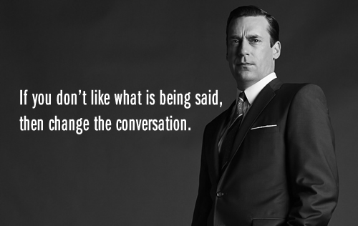
An Open Science education crisis
Can we break the cycle through training, support, and communication?
@protohedgehog

Slide 39
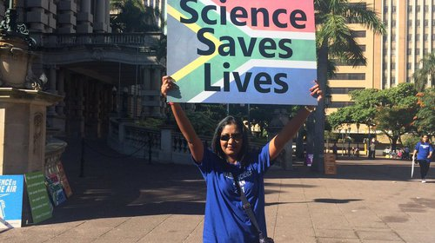
Attitudes versus practice
“60.8% of researchers do not self-archive their work even when it is free and in keeping with journal policy.”
“In a field where OA seems of practical and ethical importance for the sharing of knowledge promoting health equity, it is surprising that researchers do not make their papers available when they are legally able to do so without any cost.”
https://health-policy-systems.biomedcentral.com/articles/10.1186/s12961-017-0235-3
@protohedgehog

Slide 40
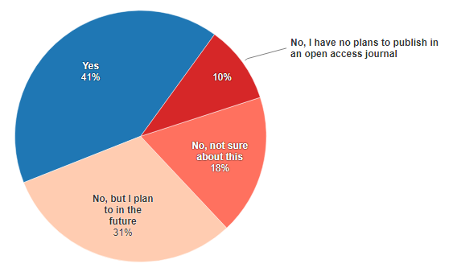
Open Access in the UK
https://www.natureindex.com/news-blog/young-researchers-preach-open-access-yet-many-dont-practice
“Researchers under 35 as well as PhD candidates, master’s students and research assistants had the least experience with open-access publishing.”
@protohedgehog

Slide 41
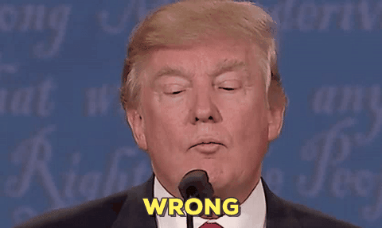
“Open Access is too expensive.”
Common view about high costs is due to a combination of monopolisation and political broadsiding and sabotage by commercial publishers.
@protohedgehog

Slide 42
It’s your work. Publish where you want. But don’t lock it up.
@protohedgehog

Slide 43
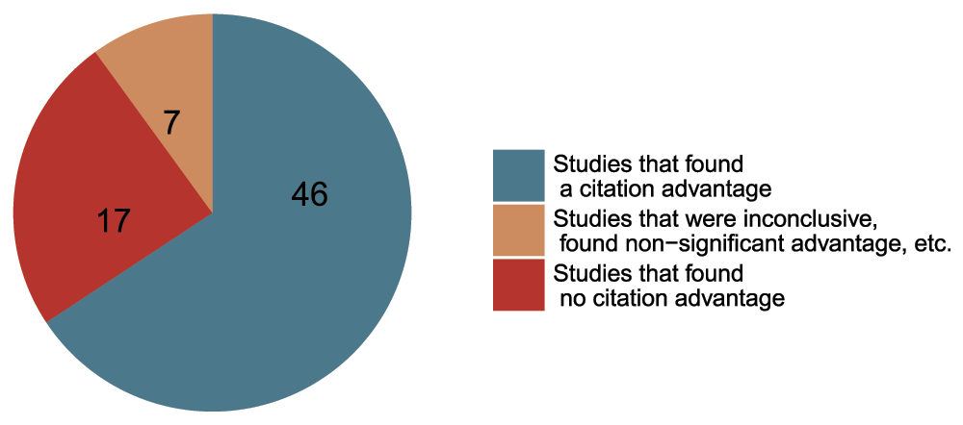
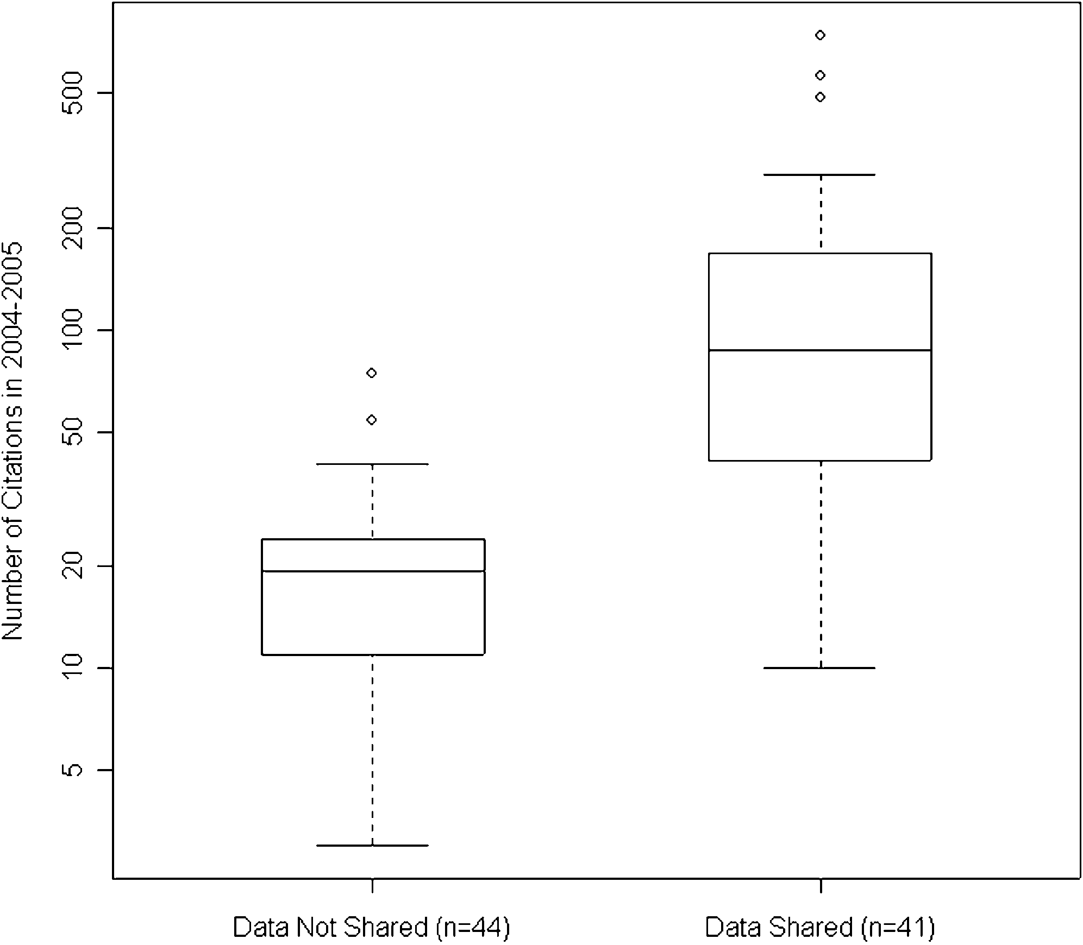
Openness is good for your work and career
Rapid communication
Greater exposure
More citations, faster
http://whyopenresearch.org
https://peerj.com/articles/175
Data from The Open Access Citation Advantage Service, SPARC Europe, accessed March 2016.
http://f1000research.com/articles/5-632/v3
@protohedgehog

Slide 44
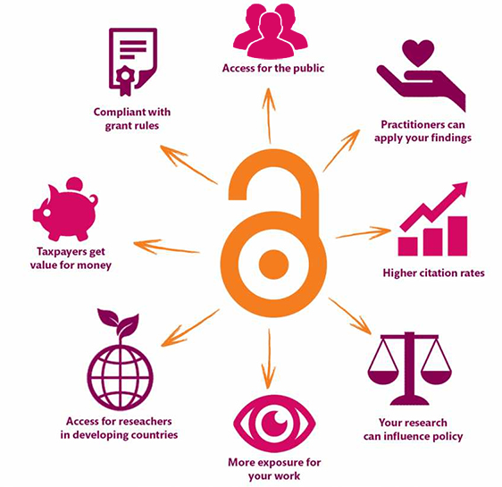
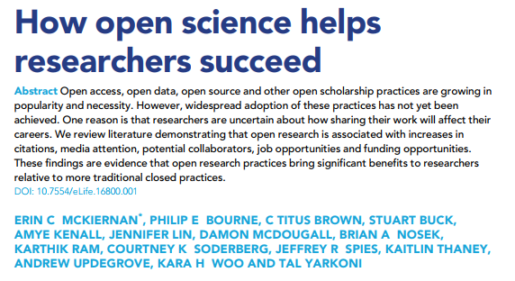
Does openness increase your social ‘impact’?
https://elifesciences.org/articles/16800
@protohedgehog
https://kib.ki.se/en/publish-analyse/open-access

Slide 45
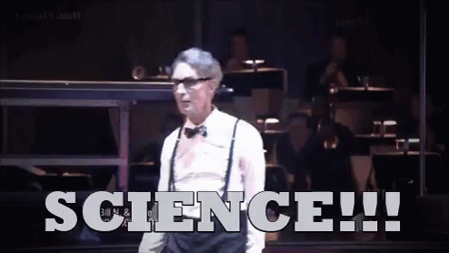
The message we should be communicating? Being more open helps YOU so much
Increases dissemination of your research.
Increases your academic profile.
Emphasises your core values.
Increases your collaborations.
Makes you a more effective researcher.
Gives you more control over your research.
@protohedgehog

Slide 46
“Open Access wins all of the arguments, all of the time.”
- OpenCon 2014

Slide 47
Your career
Open Science
SOCIAL AND TECHNICAL BARRIERS
@protohedgehog

Slide 48
OPEN SCIENCE WILL HELP YOUR CAREER IN WAYS YOU WON’T EVEN BE ABLE TO IMAGINE
Your career
Open Science
TECHNICAL BARRIERS
SOCIAL BARRIERS
EDUCATION
@protohedgehog

Slide 49
What do we need to change cultures?
Education, training, support.
Empowerment and leadership for the next generation.
Shifting power dynamics to reduce bias and abuse.
Building a global community based on strong values, sharing and collaboration.
Massive-scale engagement to re-align Open Science with current incentive structures.
@protohedgehog

Slide 50
Promising initiatives in this space
Open Science Coalition
Political and public activism
Tools, services, and infrastructure
Community engagement, training, and education
Cross-national initiatives (e.g., Plan S, SciELO, OCSDnet, DOAJ, OpenAIRE)
Joint Roadmap for Open Science Tools
Open Science MOOC and Open Scholarship Strategy
Scholarly Commons (Force11)
http://elephantinthelab.org/do-we-need-an-open-science-coalition/
@protohedgehog

Slide 51
The future
Slide courtesy of Rebecca Willen
@protohedgehog

Slide 52
The ultimate goal
Pooling knowledge and resources to create a decentralised scholarly infrastructure, with communities as the focus.
Inclusivity
Equality
Accountability
Freedom
Fairness
Justice
Truth
Rigour
Transparency
Reproducibility
SCIENCE AS A PUBLIC GOOD FOR THE BETTERMENT OF SOCIETY
#PeopleNotProfits
http://elephantinthelab.org/do-we-need-an-open-science-coalition/
@protohedgehog

Slide 53
What do Penguins, Gimli, and Cobras have to do with Open Science?
Penguins: Don’t let fear hold you back from trying new things. Be the one who leads the change.
Gimli: The academic career pipeline is very leaky, so why not diversify your skill set and be an awesome researcher. Instead of ‘publish and perish’, PUBLISH AND FLOURISH!
Cobras: Instead of farming cobras, focus on good science, and let the quality of your research speak for itself.
@protohedgehog

