Slide 1
What would scholarly publishing look like if we rebuilt it from scratch in 2019?
Dr. Jon Tennant
@protohedgehog
https://orcid.org/0000-0001-7794-0218
NFAIS 2019 Annual Conference, Virginia, USA
February 14, 2019

Slide 2
What’s the problem, exactly?
Well, this is all a matter of perspective, but they did just make a movie about it…
Paywalls, Publishers, Profits, Power, Propaganda, Plan S
https://paywallthemovie.com/
@protohedgehog

Slide 3
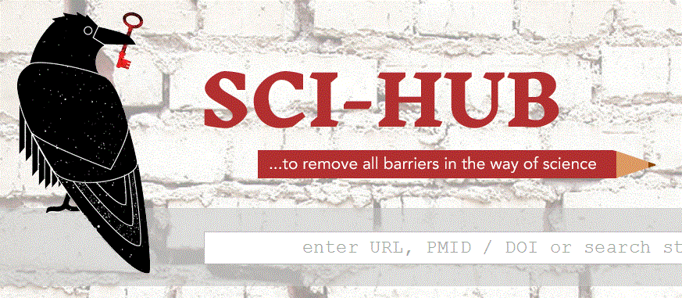
2018 was an incredible year!
Sweden, Germany, France etc. all taking a strong stand
Springer Nature failed (delayed?) IPO
EU failed (delayed?) OA platform
Elsevier and the ACS sue Sci-Hub and ResearchGate
Plan S, EU copyright reform, EOSC
Tech start-up situation feels a bit like Henry VIII’s wives…
Acquired, defunded, died, acquired, defunded, survived
@protohedgehog

Slide 4
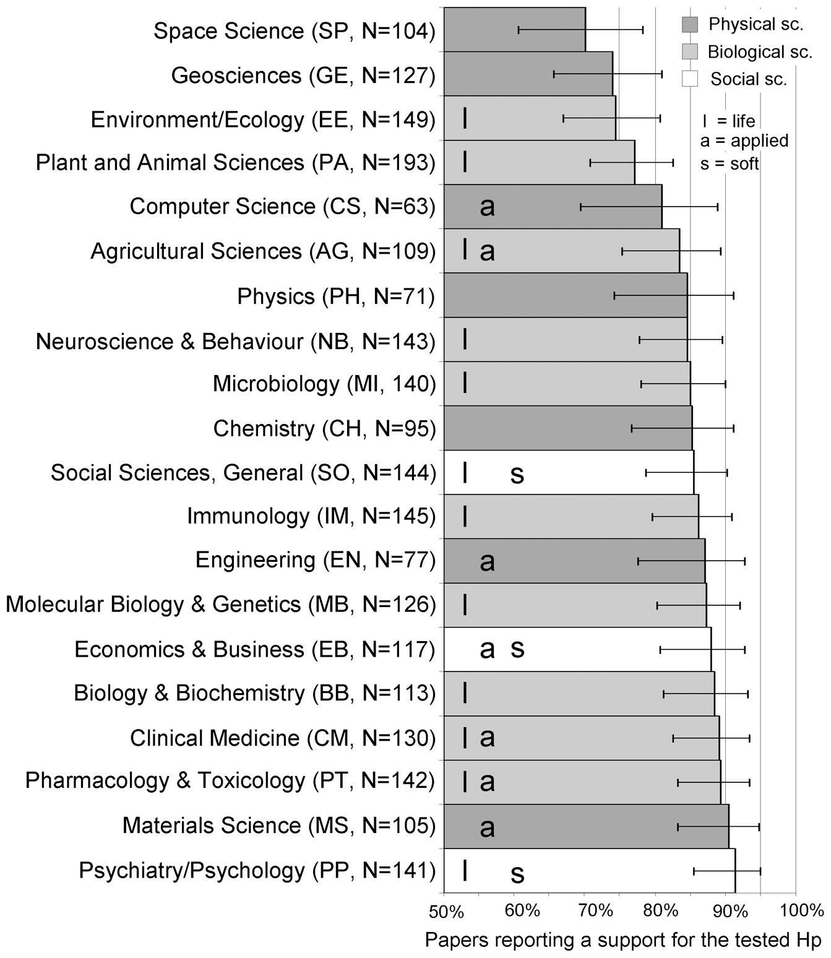
Something isn’t quite right... *
Pretty much the exact opposite of what it is supposed to look like
Prevalence suggest something is wrong at the system-level
Strong bias based on results
Things which are not in the control of researchers
Creates a very skewed record of the scholarly endeavour
Bad communication incentives?
Bad research(ers)?
Fanelli, D. (2010)
*Note differences between what English people say and what they actually mean

Slide 5
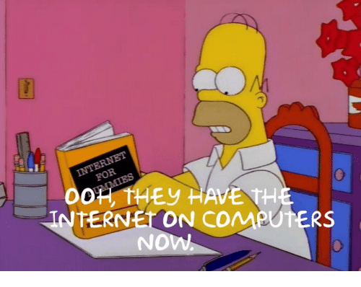
The strange current state of scholarly communication
A 19th century process applied to a 17th century communication format
Slowly adapting to Web tech from ca. 1995
WE CAN DO BETTER
@protohedgehog

Slide 6
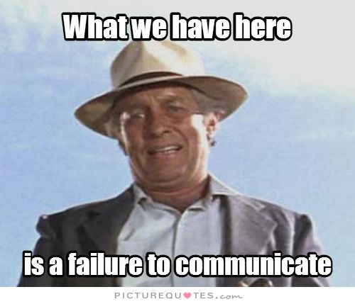
The current state of engagement
Often reminds me more of Brexit than anything else
Simply mention Sci-Hub to see what I mean
Tensions around self-interestedness versus public interest
Rhetoric, misinformation, deception, public clashes, all running rife…
@protohedgehog

Slide 7
Surprised Elsevier didn’t coin SUIT-ableTM to describe this system

Slide 8
https://twitter.com/ElsevierConnect/status/1090202327733227520
@protohedgehog
https://twitter.com/ferli90/status/1091788140564631552

Slide 9
We are often having different conversations about the same things
And talking past, rather than with, each other
https://zenodo.org/record/1472045#.XFbR_Lh7lZU
https://www.techdirt.com/articles/20170804/05454537924/elsevier-continues-to-build-monopoly-solution-all-aspects-scholarly-communication.shtml
http://knowledgegap.org/index.php/sub-projects/rent-seeking-and-financialization-of-the-academic-publishing-industry/preliminary-findings/

Slide 10
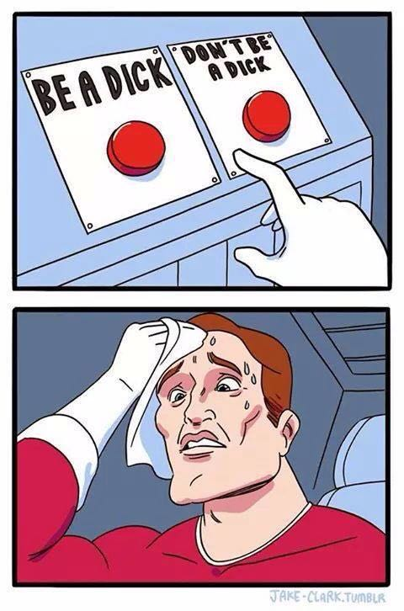
This is a super-charged space
Rapidly evolving, global impact
Complex networks of groups and interests
Creates a huge number of tensions
Scholarly communication is emotive
Sometimes, people get frustrated
Social media discussions “vary in quality”
Brave, but perhaps an ultimately doomed quest?
Assumes that there is a reconcilable middle ground
And that such a middle ground is worthy of attaining
@protohedgehog

Slide 11
Willing to criticise
Twitter
Sweet spot of progress
Closed to criticism
Open to criticism
Unwilling to criticise
@protohedgehog

Slide 12
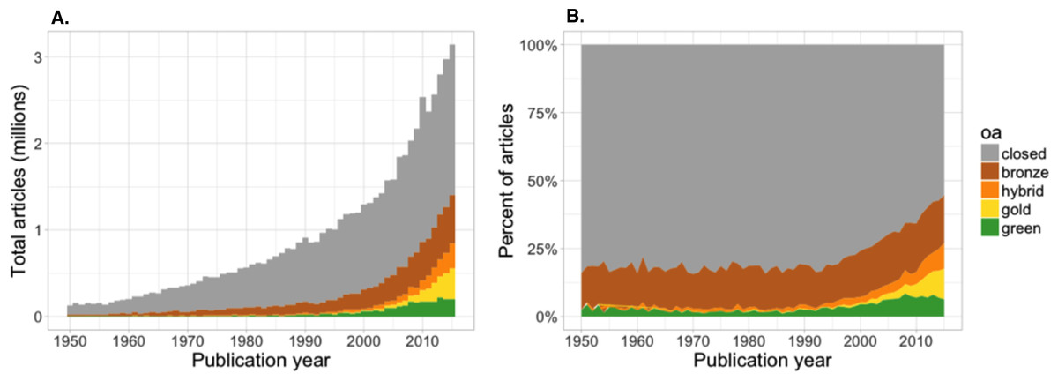
Are things getting better?
Again, this depends on your perspective
Raise your hands if you think this progress is good!
https://peerj.com/articles/4375/
@protohedgehog

Slide 13
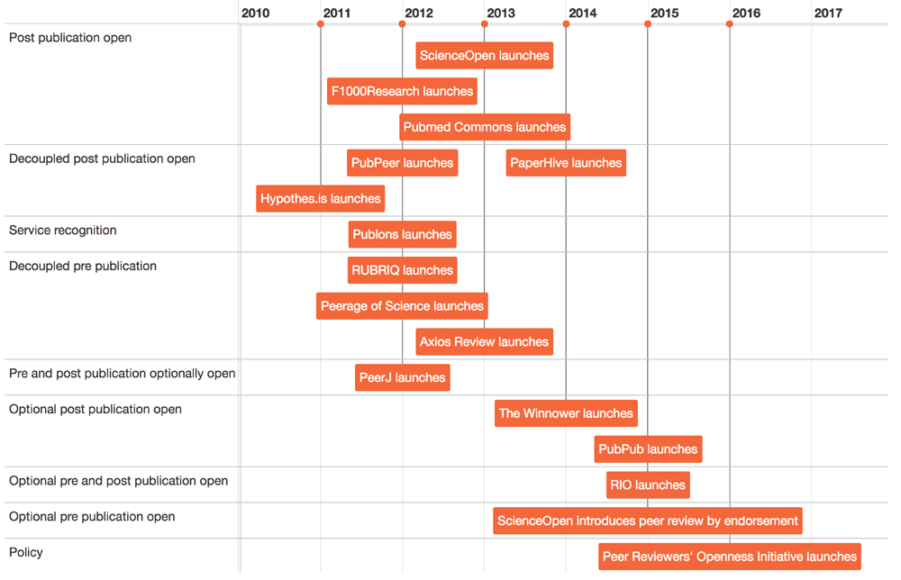
A new wave of peer review innovation
https://f1000research.com/articles/5-632/v3
People realise that the Web is actually pretty powerful.
@protohedgehog

Slide 14
This is what I called ‘constrained innovation’
Most new tools developed around a journal-based system. Therefore depend on publishers for sustenance.
Very little thought generally into long-term sustainability.
https://www.fastcompany.com/90180552/academic-publishing-is-broken-heres-how-to-redesign-it
@protohedgehog

Slide 15
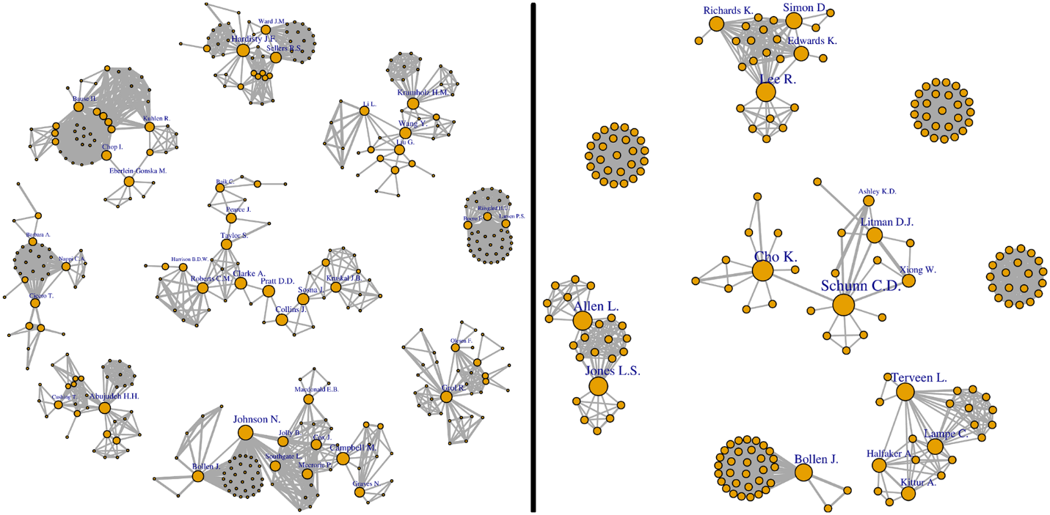
Welcome to the networked 21st century
Everywhere we are using networks to evaluate information on the Web. Why not in science?
Use the power of professional networks to evaluate/communicate scientific results.
http://journals.plos.org/plosone/article?id=10.1371/journal.pone.0193148
@protohedgehog

Slide 16
What happens if we explore our thinking
Away from the world of journals and articles
Focus on the power of networked technologies and version control
Research is continuous and should be communicated as such
Granular ‘research objects’ of all formats
Collaborative, cross-silo processes – focus on communities
@protohedgehog

Slide 17
Imagine if Wikipedia, Stack Exchange, and GitHub all had a baby together..
Low cost – ‘forkable’
Creditable
Collaborative
Instantaneous
Continuous/dynamic
Community-owned?
Inherently reproducible
Technology already exists
https://doi.org/10.1093/femsle/fny204
@protohedgehog

Slide 18
Three core aspects for success of any future ‘platform’
Quality control/moderation
Certification/reputation
Engagement incentives
HARMONY
So, how..?
http://blogs.lse.ac.uk/impactofsocialsciences/2017/09/11/we-have-the-technology-to-save-peer-review-now-it-is-up-to-our-communities-to-implement-it/
@protohedgehog

Slide 19
Quality control and moderation
https://academic.oup.com/femsle/article/365/19/fny204/5078345
@protohedgehog

Slide 20
Certification and reputation
https://academic.oup.com/femsle/article/365/19/fny204/5078345
@protohedgehog

Slide 21
Incentives for engagement
https://academic.oup.com/femsle/article/365/19/fny204/5078345
@protohedgehog

Slide 22
Yes, there is space for publishers here
No-one is denying the value-add (technical, knowledge) that publishers provide in scholarly communication
Some perhaps just want a more even playing field
Where they compete fairly as service providers
It is eminently possible to move towards open scholarship with for-profits as part of the system
But some will find it difficult if they continue to work against researchers (e.g., lock-in, those profit margins, lobbying)
Experimentation with unbundling or decoupling of services
Everything suggested previously is eminently feasible to integrate into existing systems
@protohedgehog

Slide 23
Future challenges (1)
Working models exist already that show publishing can be better as a process (evidence)
Simultaneous uptake of new models across the whole scholarly ecosystem (time)
Interoperability between specific and diverse communities (technology)
Increasing the recognition of more than just research papers across the board (evaluation)
Getting all key participants interested (engagement)
GitHub: https://github.com/OpenScienceMOOC
Website: https://opensciencemooc.eu
Twitter: @OpenScienceMOOC
Email: info@opensciencemooc.eu
@protohedgehog

Slide 24
Future challenges (2)
A shift to digital norms to reflect adoption of Web-based processes
Co-ordinating strategic and stepwise changes towards ‘open science’
Understanding the changing roles of editors, librarians, publishers…
How to reconcile changes across/between disciplines/communities with different norms, practices, and biases
Resolving the major tensions that exist between actors (with civility)
This list could go on and on…
@protohedgehog

Slide 25
The ultimate goal
Pooling knowledge and resources to create a decentralised scholarly infrastructure based on strong values and principles of Open Scholarship, and with communities as the focus.
Inclusivity
Equality
Accountability
Freedom
Fairness
Justice
Truth
Rigour
Transparency
Reproducibility
SCIENCE AS A PUBLIC GOOD FOR THE BETTERMENT OF SOCIETY
http://elephantinthelab.org/do-we-need-an-open-science-coalition/
@protohedgehog

Slide 26
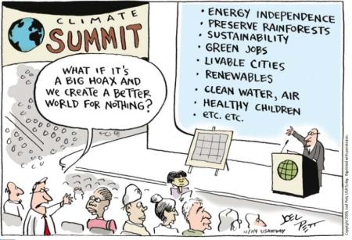
A question to ponder: Instead of ‘What might the future of scholarly communication look like?’, what about ‘Who do we want to include in the future of scholarly communication?’
@protohedgehog

