Slide 1
Power, preprints, and publishers - shifting research cultures towards Open Scholarship
Dr. Jon Tennant
@protohedgehog
Hello Fellow Lecture, University Library of Southern Denmark, January 15, 2019
https://orcid.org/0000-0001-7794-0218

Slide 2
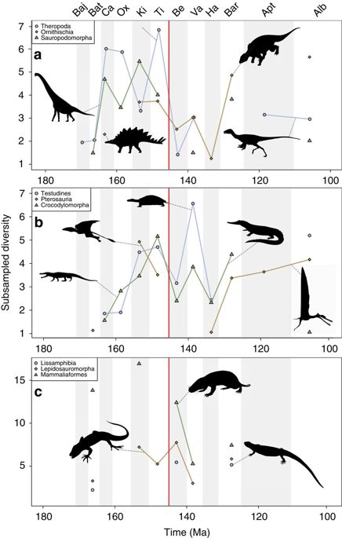
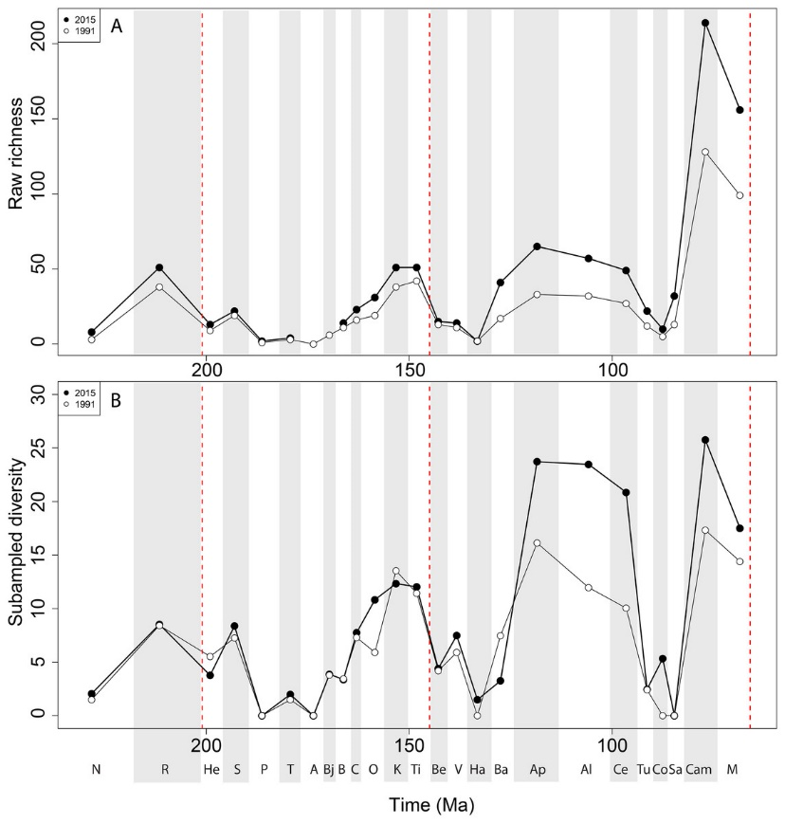
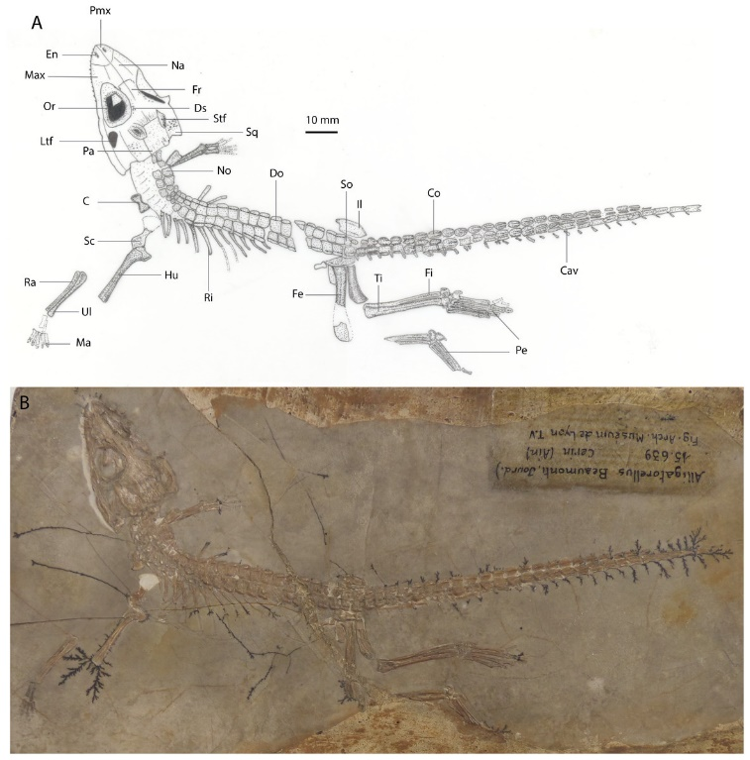
How did I get here? The early days
https://onlinelibrary.wiley.com/doi/full/10.1111/zoj.12400
https://peerj.com/articles/4417/
https://www.nature.com/articles/ncomms12737
https://peerj.com/articles/599/

Slide 3
How did I get here? The middle years
https://f1000research.com/articles/5-632/v3
https://doi.org/10.1093/femsle/fny204
https://open-scholarship-strategy.github.io/site/
https://f1000research.com/articles/6-1151/v3
@protohedgehog

Slide 4
How did I get here? Going rogue
https://osf.io/preprints/bitss/796tu/
https://bit.ly/2PPjwRK
https://zenodo.org/record/1472045#.W9MmR
https://zenodo.org/record/1889378#.XDWt7M3gpPY

Slide 5
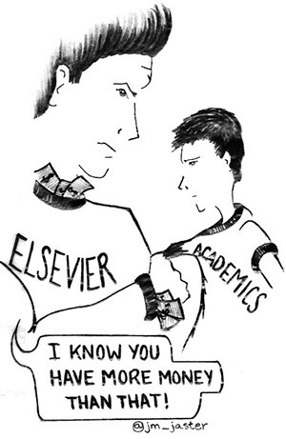
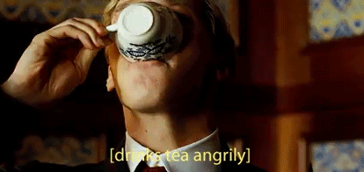
What gets me out of bed in the morning
The vast majority of scholarly research and knowledge is held hostage by private corporations.
This disadvantages everyone on this planet, except for those in the wealthiest, elite research institutes.
These commercial giants are ruthless racketeers that have profit margins that exceed Apple and even ‘big oil’ (>35%).
We are not communicating research effectively, and our world is suffering as a result.
@protohedgehog

Slide 6
A global research ‘crisis’
https://paywallthemovie.com/
There are four major ‘crises’:
Access – Most research still paywalled to most people
Reproducibility – Much research fails basic reproducibility tests
Serials – The ridiculous price increases of journals
Evaluation – The metric that shall not be named
@protohedgehog

Slide 7
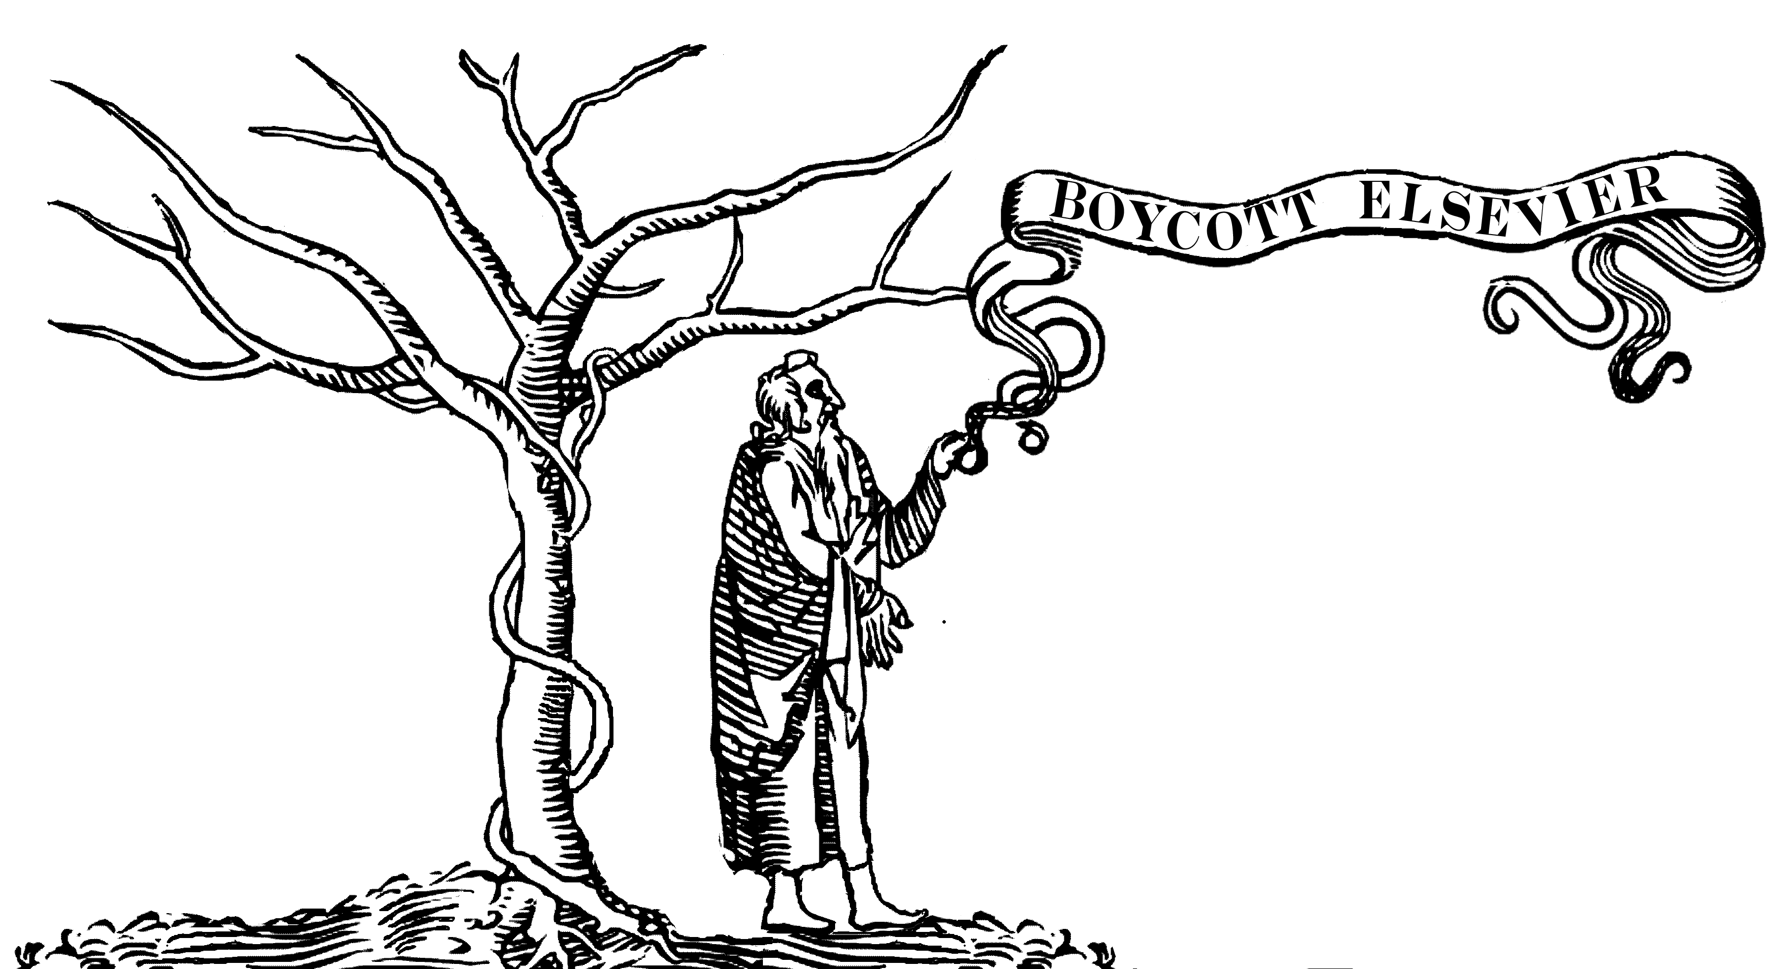
Why Open Research?
Slow and wasteful
Ruled by commercial interests
Copyright is broken
The four crises
Illusion of academic freedom
Questionable research practices
Closed science means people suffer
Science is not working as well as it could be
@protohedgehog

Slide 8
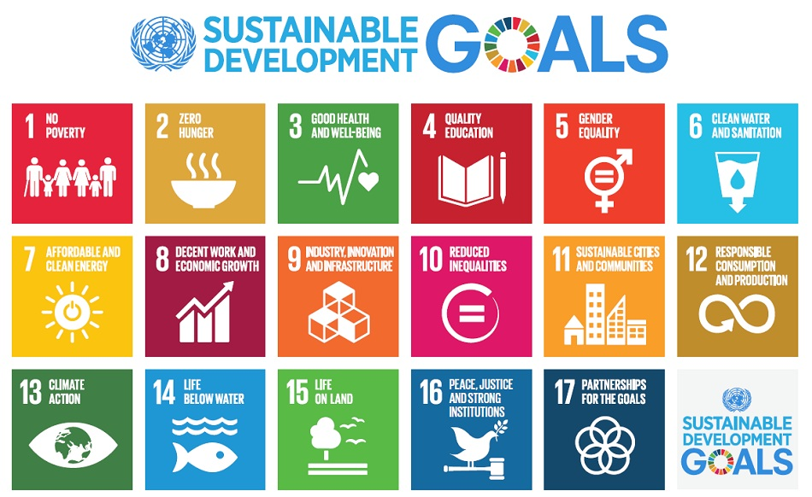
Do you believe that scientific research can help us solve these problems?
http://www.who.int/mediacentre/events/meetings/2015/un-sustainable-development-summit/en
@protohedgehog

Slide 9
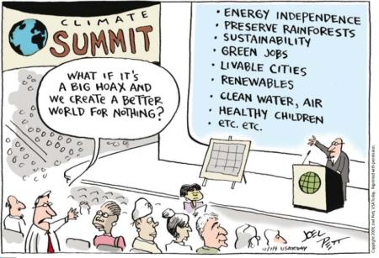
YES!
But then you also must acknowledge that by preventing access to research, we are acting against meeting these goals.
And this is what many in the present scholarly publishing industry are doing. In exchange for our money.
It’s not a bug. It‘s a feature.
@protohedgehog

Slide 10
For researchers, getting published is like going to a restaurant, bringing all of your own ingredients, cooking the meal yourself, and then being charged $40 for a waiter to bring it out on a plate for you.
You are the provider, the product, and the consumer.
@protohedgehog

Slide 11
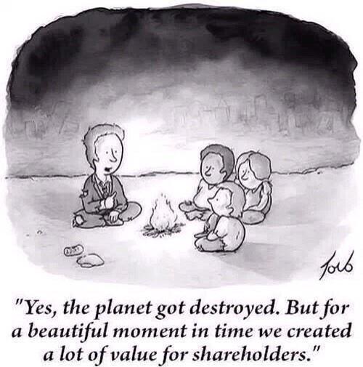
Why Open Research now?
Things are getting worse
Co-option of Open Science
Private interests strengthening
Ownership of scholarly infrastructure
We have to act now, as a global community and take control of [Open] Research.
@protohedgehog

Slide 12
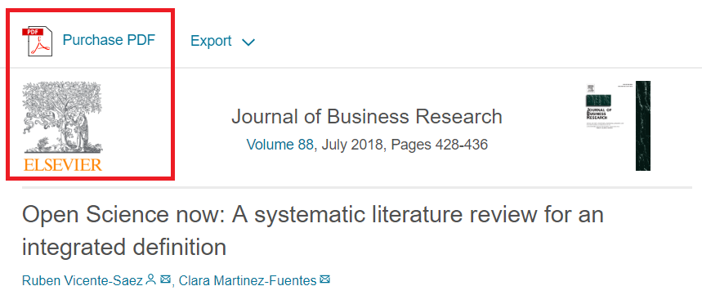
I feel like often we talk about “Open Science” as a different entity to [good] “science”.
“Open Science is transparent and accessible knowledge that is shared and developed through collaborative networks.”
“Open science describes the practice of carrying out scientific research in a completely transparent manner, and making the results of that research available to everyone. Isn’t that just ‘science’?”
THIS IS VERY BAD
THIS IS VERY GOOD
https://genomebiology.biomedcentral.com/articles/10.1186/s13059-015-0669-2
https://www.sciencedirect.com/science/article/abs/pii/S0148296317305441
@protohedgehog

Slide 13
What’s the fuss?
Because OS has become a poorly-defined process- based concept
Confused between the scientific process, and communication of results
Divorced from any human, value-based element
Treated as distinct from principles of ‘good’ science
This makes it very easy AGAIN for commercial interests to co-opt (which they are)
Or to be used as a political slogan to gain brownie points (which it also is)
@protohedgehog

Slide 14
Freedom
Fairness
Justice
Truth
Liberty
FAIR principles
TOP guidelines
Principles of Open Scholarship, by Tony Ross-Hellauer (Source, CC BY).

Slide 15
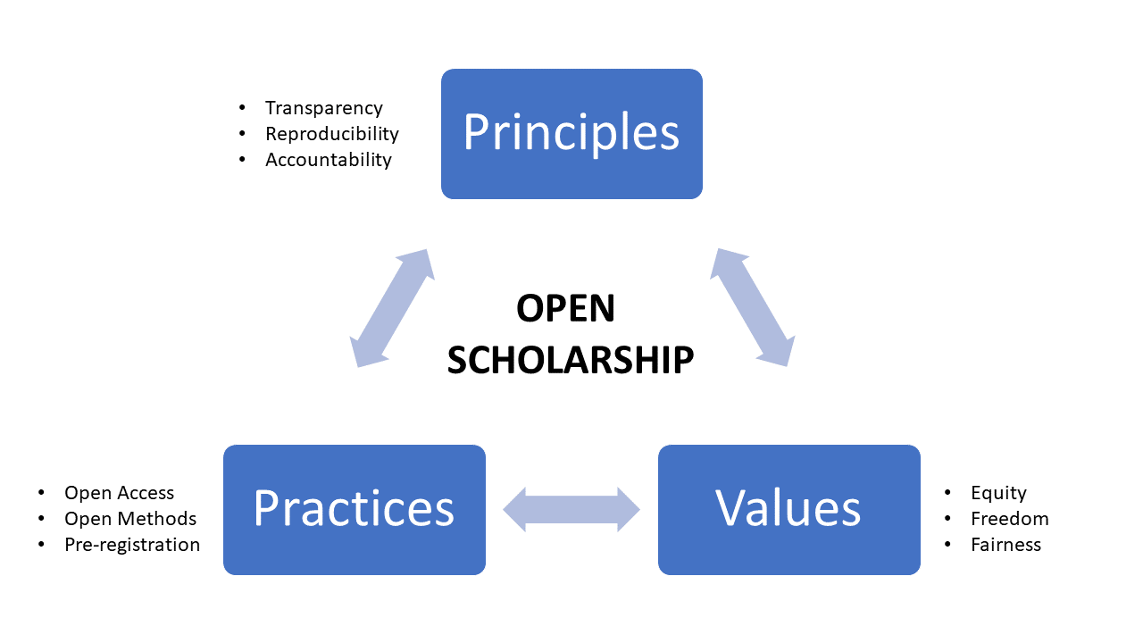
In progress…
@protohedgehog

Slide 16
Ask the audience
For you, is Open Science:
A process? An ideal? A vision? A principle? A club? A political agenda? A fad? A distraction? Exclusive?
People have called it all of these at one point or another…
@protohedgehog

Slide 17
Is Open Science a ‘movement’?
“..a group of people working together to advance their shared political, social, or artistic ideas.”
Movements have a direction.
Movements have shared goals.
Movements are defined by commonality.
Who is defining these for Open Science?
Who is leading this movement?
What happens if you’re ‘outside’ this movement?
What happens when a ‘movement’ can’t answer these questions..?
@protohedgehog

Slide 18
Open Science, democracy and power

Slide 19
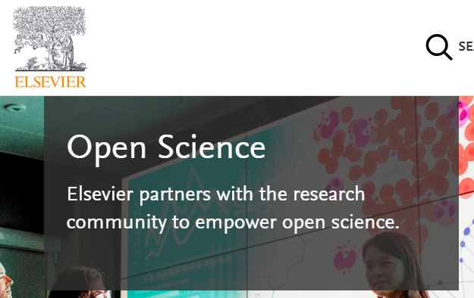
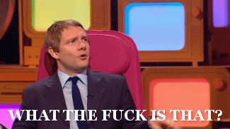
Mega-publishers are corrupting Open Science
Organisations stuck in a pre-digital mindset with a key product developed in the 17th Century.
Basically the reason why the Open Science ‘movement’ began.
Business models based on exclusion, exploitation of privilege, discrimination, extortion..
Who pay lip service to Open Science, while simultaneously subverting it to meet their own intentions.
We DO NOT share the same values and principles.
@protohedgehog

Slide 20
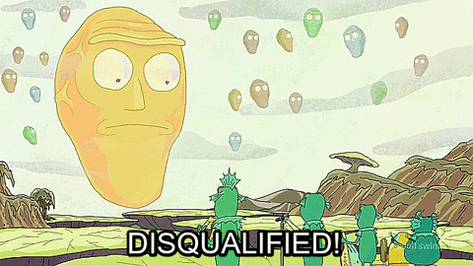
Springer Nature abusing power for profits
Page 99 of the Springer Nature IPO* prospectus:
“We also aim at increasing APCs by increasing the value we offer to authors through improving the impact factor and reputation of our existing journals.”
https://www.timeshighereducation.com/blog/springer-nature-committed-being-part-open-access-movement
https://www.timeshighereducation.com/blog/linking-impact-factor-open-access-charges-creates-more-inequality-academic-publishing
*failed…
@protohedgehog

Slide 21
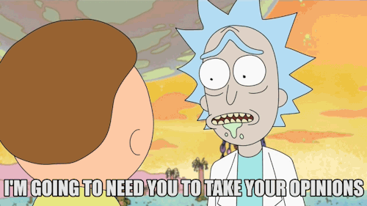
Recent events have been a bit odd…
Now with 1100 supporting signatures!!
Elsevier and the Lisbon Council get miffed and respond..
http://fossilsandshit.com/response-to-president-paul-hofheinz-of-the-lisbon-council-regarding-elsevier-and-the-open-science-monitor/
@protohedgehog

Slide 22
Cough
Dated 28th August
https://zenodo.org/record/1405079#.W5dYdej7RPY
@protohedgehog

Slide 23
They responded! And exactly as we expected.
But they failed to adequately address the explicit role of Elsevier, the inherent COIs, the incredible data biases
But now at least there is an ‘advisory group’ overseeing the whole process
#WIN
Their response is being annotated here for a counter-reply:
https://docdrop.org/pdf/Annex-to-letter-to-Jon-Tennant-1--BbPfR.pdf/
https://zenodo.org/record/1443395?#.W724P2j7RPY
@protohedgehog

Slide 24
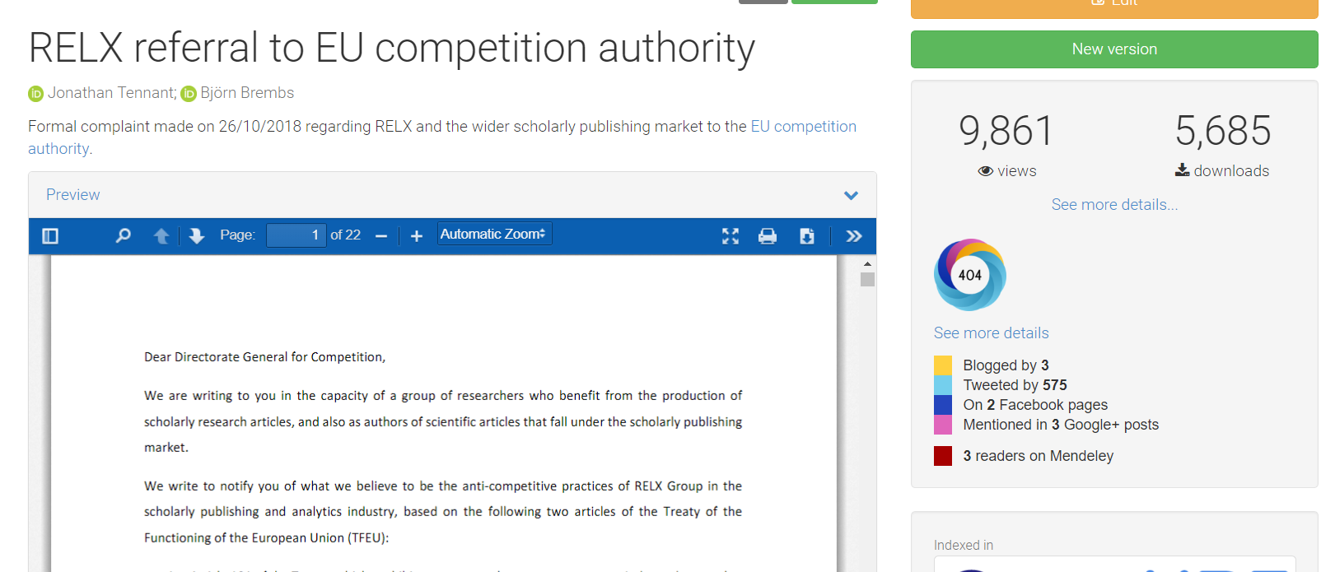
And while they were busy dealing with that..
Altmetric score not found
https://zenodo.org/record/1472045#.W98HkZP0lPY
@protohedgehog

Slide 25
Then the EUA got involved
https://www.eua.eu/news/188:scholarly-publishing-eua-asks-european-commission-to-investigate-lack-of-competition.html
@protohedgehog

Slide 26
‘Abusive’ practices of scholarly publishers
1. High degree of concentration of ownership
2. A sector with oligopolistic structures
3. No transparency in pricing
4. Large profits based on public funds
5. Calls for open access without positive effect on pricing
6. Asymmetry in negotiating power
7. Trend towards vendor lock-in
8. No sign of improvement in competition
@protohedgehog

Slide 27
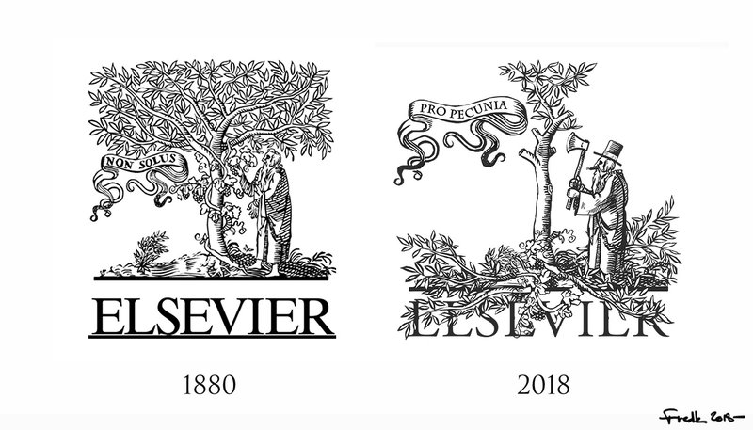
Activating unions to challenge this
David Edwards, General Secretary of EI: “Higher education and research are fundamental social rights, and as such must be exempt from commercialization by third parties which are interested only in making profit, not in promoting access to knowledge. We have to democratize knowledge if we want to achieve social justice through quality education for all. EI and its more than 32 million members are fighting to that end day in and day out.”
https://www.ei-ie.org/en/detail/16061/elsevier-putting-a-price-on-knowledge
#democratiseknowledge
@protohedgehog

Slide 28
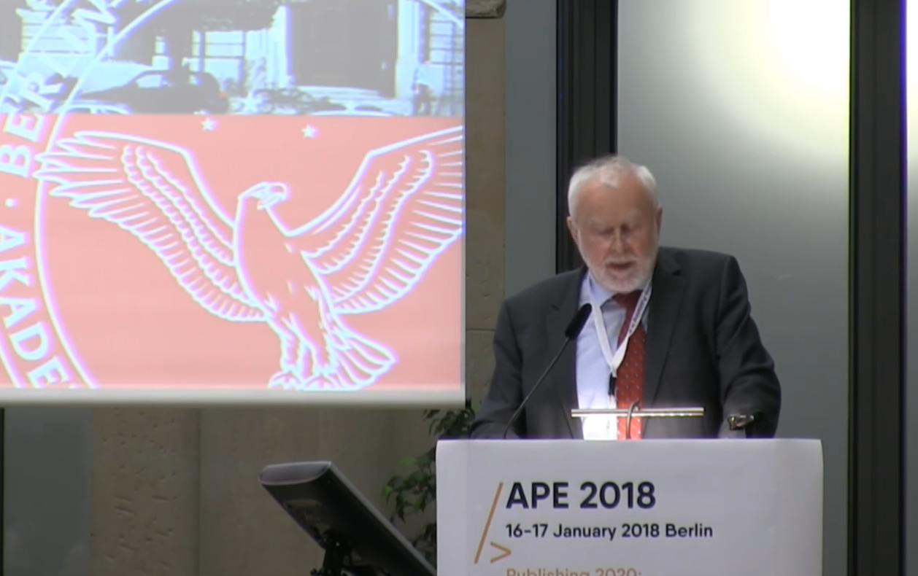
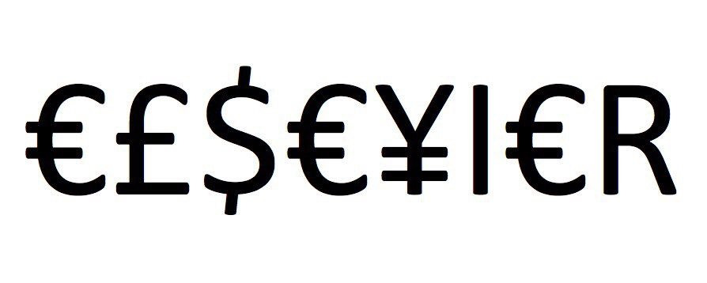
Germany versus Elsevier
“One big publisher stated: if your country stops subscribing to our journals, science in your country will be set back significantly. I responded […] it is interesting to hear such a threat from a producer of envelopes who does not have any idea of the contents.”
Martin Grötschel, President of the Berlin-Brandenburg Academy of Sciences and Humanities
#HERO
#villain
@protohedgehog

Slide 29
And now ‘Plan S’
Has revealed the shocking nature and tone of this debate
Misinformation, lies, rhetoric
Much discussion on social media has been, just, ugh…
Massive under-appreciation of the history, wider contexts, and potential for reform
Has ultimately been very divisive in creating pro- and anti- camps
Definitely activated more people to become involved, but…
More debate does not mean a higher quality of debate
@protohedgehog

Slide 30
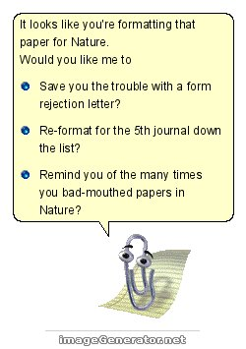
Power and culture change
The mantra ‘publish or perish’ is dead, replaced by ‘publish and perish’ due to under-funding and competitiveness in climbing the academic career ladder.
A mentality grilled into students as soon as they start, with the view that anything beyond attaining a professorship is failure.
And then we wonder why mental health problems are so rampant for researchers…
@protohedgehog

Slide 31
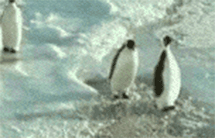
Have you ever met an average academic?
50% of academics are less intelligent than the average academic.
A system defined by cultural inertia.
Slow to adapt to new technologies and practices.
What happened to doing good science? What are the incentives for that?
We are all penguins.
@protohedgehog

Slide 32
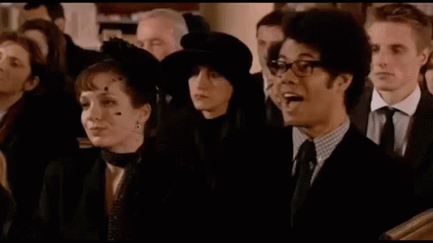
But academics are also generally terrible at making predictions...
“Open Access will never catch on.”
“Preprints will never be a thing.”
“Sharing our data won’t ever be mandatory.”
“Open peer review is fake news.”
“It doesn’t matter if research isn’t reproducible.”
“Open Science is just a fad.”
I wonder if they ever get tired being wrong all the time…
@protohedgehog

Slide 33
Principles in Open Research
Drivers
Barriers
Reduce publication bias.
Increase replicability.
Increase reliability of scientific record.
Make publicly funded research publicly accessible.
Make research more efficient.
Increase public trust.
Foster collaboration.
Sustainable research.
Fear of scooping or ideas being stolen.
Fear of not being credited for ideas.
Fear of errors and public humiliation.
Fear of risk to reputation.
Fear of reduced scientific quality.
Fear of information overload.
Fear of career compromise.
Fear of backlash from senior figures.
Fear of being different.
@protohedgehog

Slide 34
Your career
Open Science
SOCIAL AND TECHNICAL BARRIERS
@protohedgehog

Slide 35
The Bullied Into Bad Science campaign is an initiative by early career researchers (ECRs) for early career researchers who aim for a fairer, more open and ethical research and publication environment.
http://bulliedintobadscience.org/
@protohedgehog

Slide 36
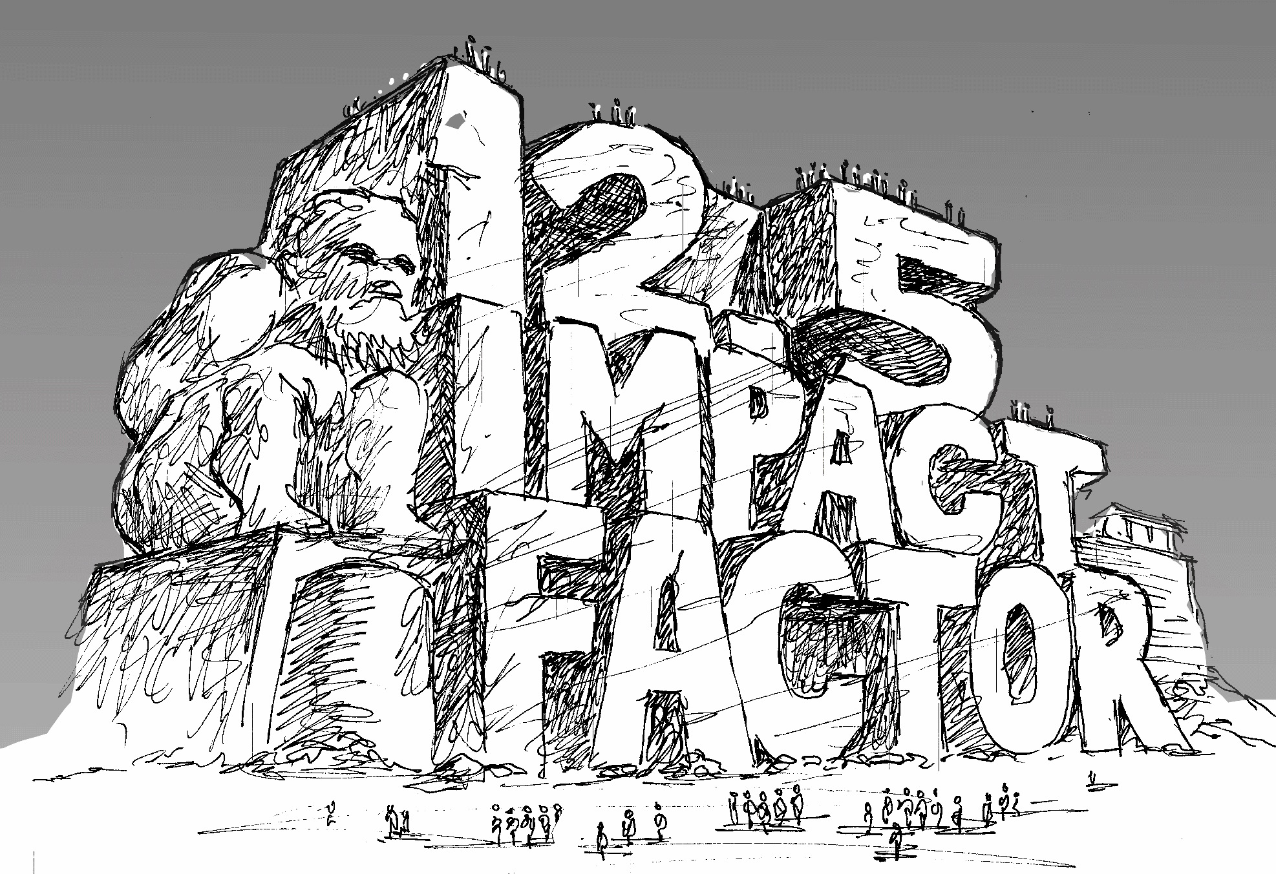
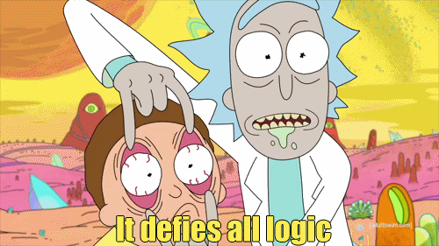
http://whyopenresearch.org/impactfactor
@protohedgehog

Slide 37
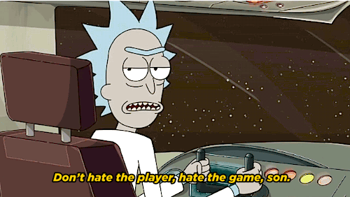
Goodhart’s Law: "When a measure becomes a target, it ceases to be a good measure.”
But all players should still be accountable for the game.
Something shockingly absent at the present.
https://www.sciencemag.org/news/2019/01/how-shine-indonesian-science-game-system
@protohedgehog

Slide 38
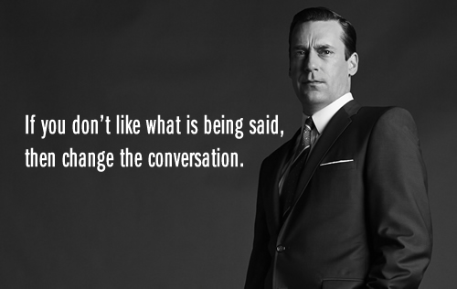
AN OPEN SCIENCE EDUCATION CRISIS
Can we break the cycle through training, support, and communication?
@protohedgehog

Slide 39
Attitudes versus practice
“60.8% of researchers do not self-archive their work even when it is free and in keeping with journal policy.”
“In a field where OA seems of practical and ethical importance for the sharing of knowledge promoting health equity, it is surprising that researchers do not make their papers available when they are legally able to do so without any cost.”
https://health-policy-systems.biomedcentral.com/articles/10.1186/s12961-017-0235-3
@protohedgehog

Slide 40
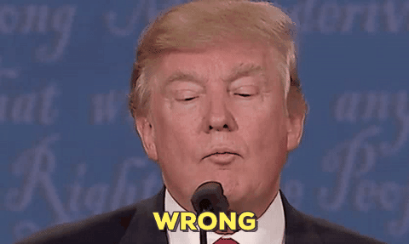
“Open Access is too expensive.”
Common view about high costs is due to a combination of monopolisation and political broadsiding and sabotage by commercial publishers.
@protohedgehog

Slide 41
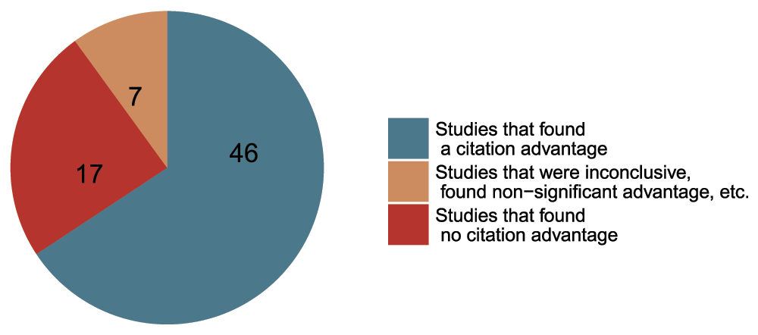
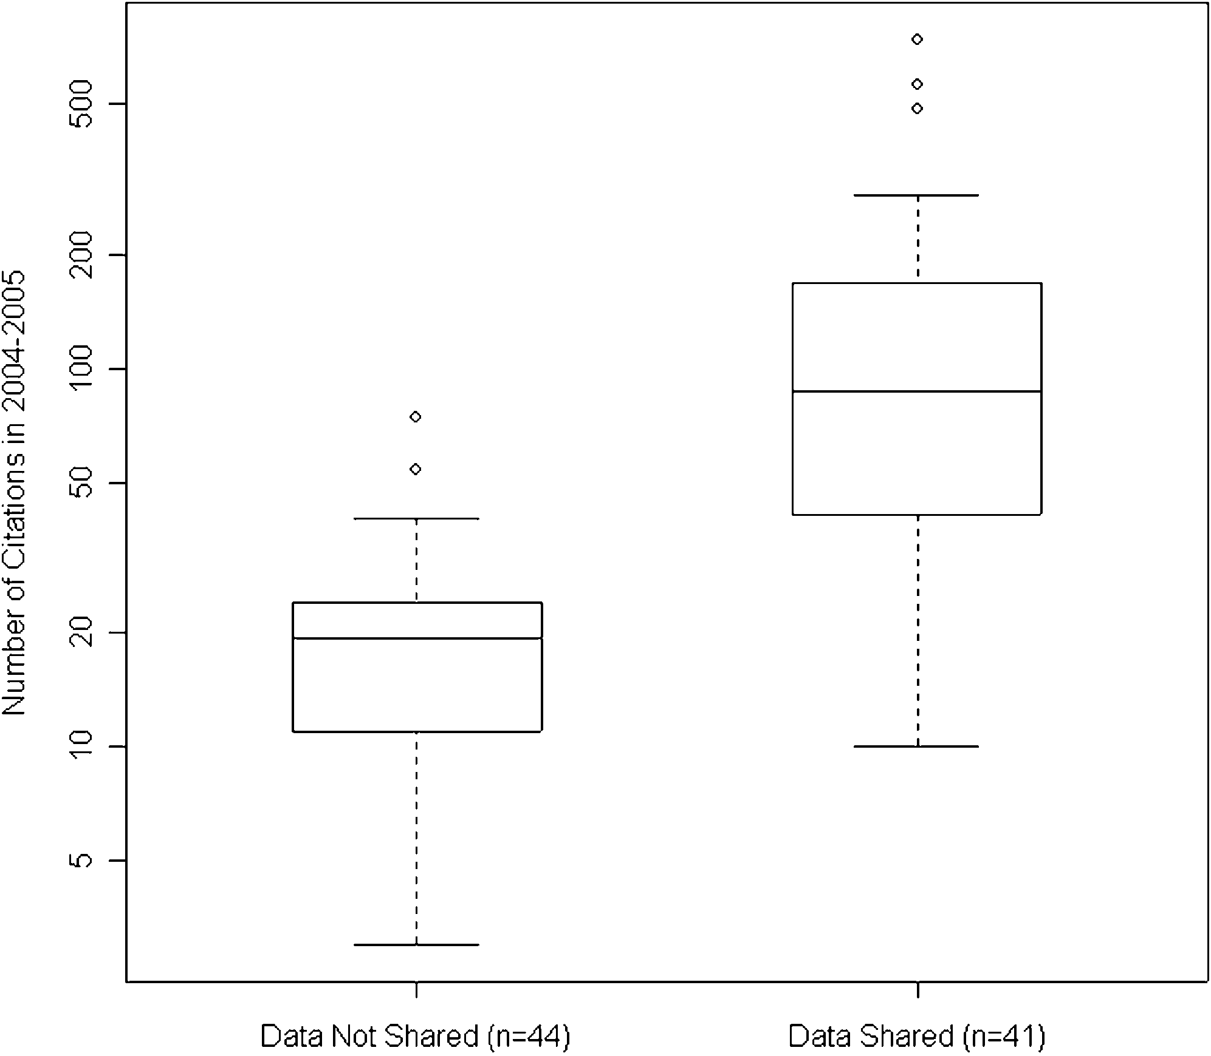
Openness is good for your work and career
Rapid communication
Greater exposure
More citations, faster
http://whyopenresearch.org
https://peerj.com/articles/175
Data from The Open Access Citation Advantage Service, SPARC Europe, accessed March 2016.
http://f1000research.com/articles/5-632/v3
@protohedgehog

Slide 42
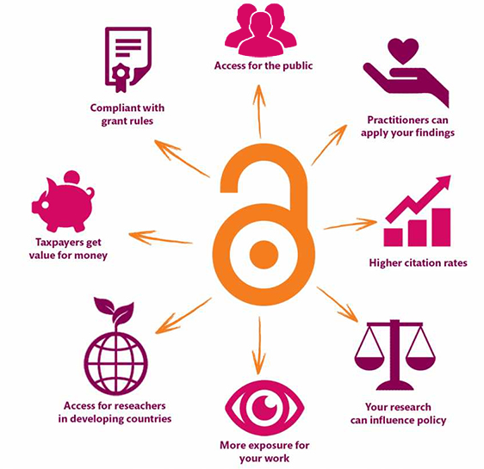
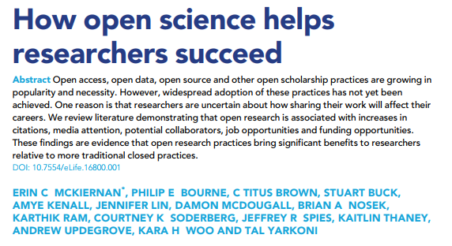
Openness is better for EVERYONE
https://elifesciences.org/articles/16800
@protohedgehog
https://kib.ki.se/en/publish-analyse/open-access

Slide 43
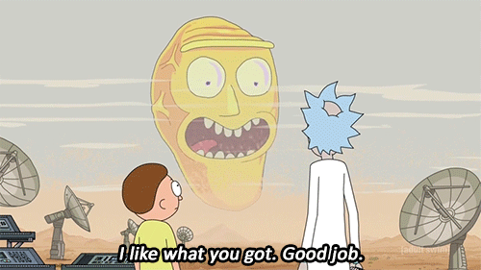
We should be in a position where we are able to influence our academic system, not be stifled by the current actors in it.
Tim Berners-Lee: “We are not talking to Facebook and Google about whether or not to introduce a complete change where all their business models are completely upended overnight. We are not asking their permission.”
(cc Robert-Jan Smits and co...)
https://www.fastcompany.com/90243936/exclusive-tim-berners-lee-tells-us-his-radical-new-plan-to-upend-the-world-wide-web
@protohedgehog

Slide 44
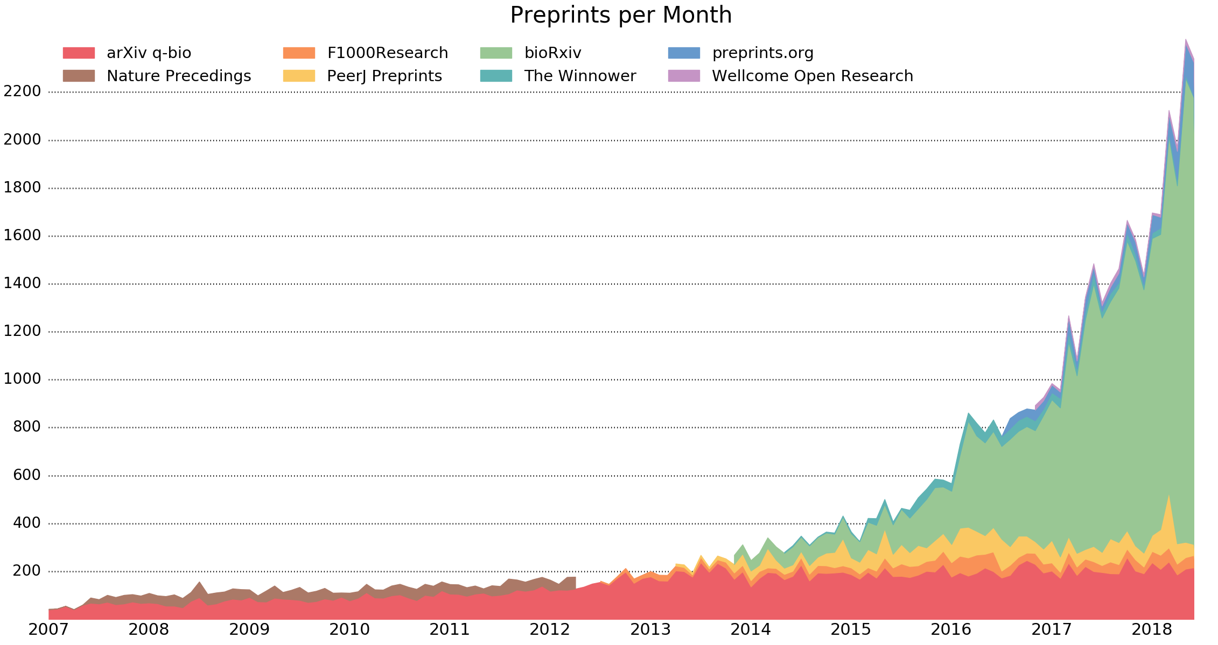
Exponential growth of preprints
http://www.prepubmed.org/monthly_stats/
@protohedgehog

Slide 45
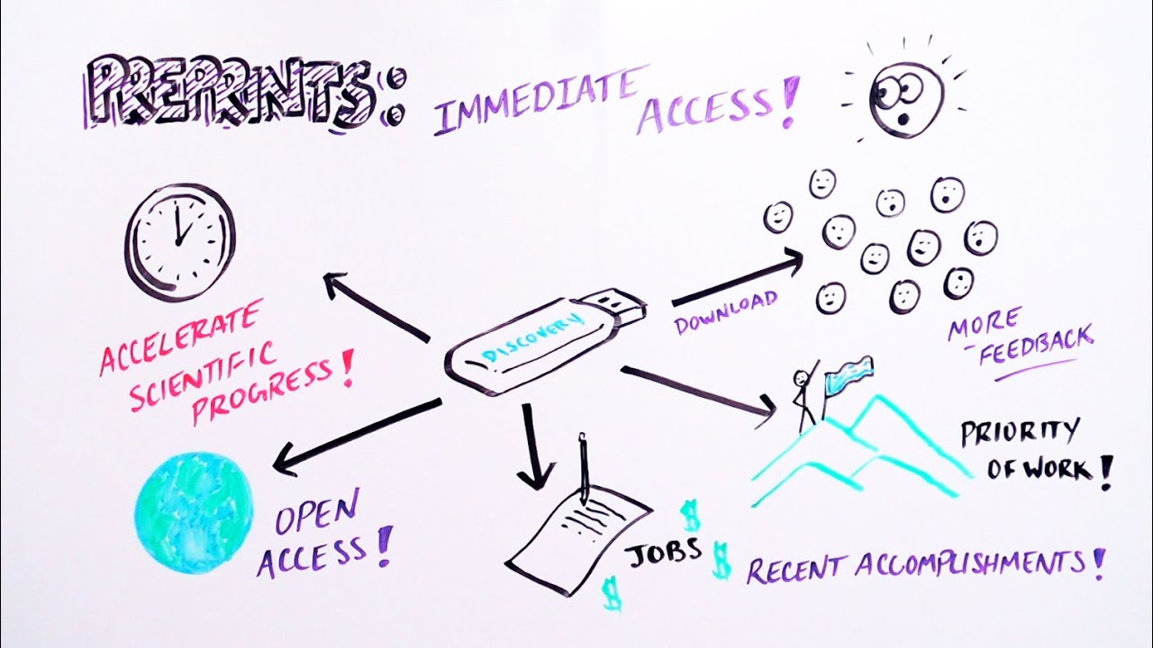
Implications of preprints
Journal-independent
Force you to read and judge based on the actual content
All power is retained by researchers
Justification of journals to prove their value once science communication is decoupled from them
What happens when peer review is finally decoupled from journals?
https://www.youtube.com/watch?v=2zMgY8Dx9co
@protohedgehog

Slide 46
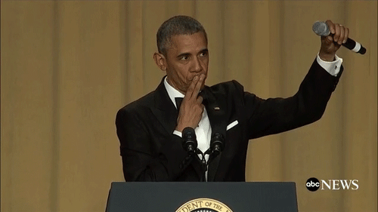
What about ‘green’ OA and ‘postprints’?
Many publishers seem to be TERRIFIED of them
Restrictive licensing
Lengthy embargo periods
Make it as complicated as possible to ‘comply’
I do not understand why we let publishers impose these things
A bittersweet irony
Embargoes are explicit statements about how little value publishers add to the whole process, with respect to how much they charge
If a peer reviewed Word document is so threatening to their business model, they have big problems
http://fossilsandshit.com/a-challenge-to-publishers-to-justify-embargo-periods/
@protohedgehog

Slide 47
It’s your work. Publish where you want. But don’t lock it up.
@protohedgehog

Slide 48
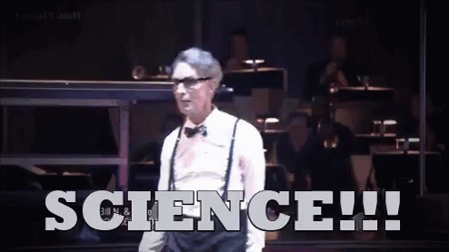
The message we should be communicating? Being more open helps YOU so much
Increases dissemination of your research.
Increases your academic profile.
Emphasises your core values.
Increases your collaborations.
Makes you a more effective researcher.
Gives you more control over your research.
@protohedgehog

Slide 49
Your career
Open Science
SOCIAL AND TECHNICAL BARRIERS
@protohedgehog

Slide 50
Your career
Open Science
TECHNICAL BARRIERS
SOCIAL BARRIERS
EDUCATION
@protohedgehog

Slide 51
What can we all achieve if we stand together?
We need to stand together as a unified global community to make sure that we are acting in the best interests of the public, not corporate gains.
#PeopleNotProfits
https://letsallstandtogether.wordpress.com/
@protohedgehog

Slide 52
What do we need to change cultures?
Education, training, support.
Empowerment and leadership for the next generation.
Shifting power dynamics to reduce bias and abuse.
Building a global community based on strong values, sharing and collaboration.
Massive-scale engagement to re-align Open Science with current incentive structures.
@protohedgehog

Slide 53
Welcome to the Open Science MOOC!
To help make ‘Open’ the default setting for all global research.
We want to help create a welcoming and supporting community, with good tools, teachers, and role-models, and built upon a solid values-based foundation of freedom and equitable access to research.
@protohedgehog

Slide 54
The way we do research has changed for good
We now have new expectations
Transparency
Not secrecy
Collaborative
Not solo
Continuous
Not discretised
@protohedgehog

Slide 55
We should be training ourselves
Sustained community engagement across disciplines
Being active both politically and at a community level
Rethinking our mindset (academic vs scientist)
Changing the defective incentive system
@protohedgehog

Slide 56
Open for re-use
@protohedgehog

Slide 57
@protohedgehog
https://eliademy.com/catalog/oer/module-5-open-research-software-and-open-source.html

Slide 58
How do we get to where we want?
Imagine a future defined by the values and principles of Open Science:
Freely available public good
Rigorous and reproducible
Open to ALL
Isn’t that just GOOD science?
@protohedgehog

Slide 59
The current state of scholarly communication?
A 19th century process applied to a 17th century communication format
Slowly but surely adapting to web technologies from 1995
WE CAN DO BETTER
@protohedgehog

Slide 60
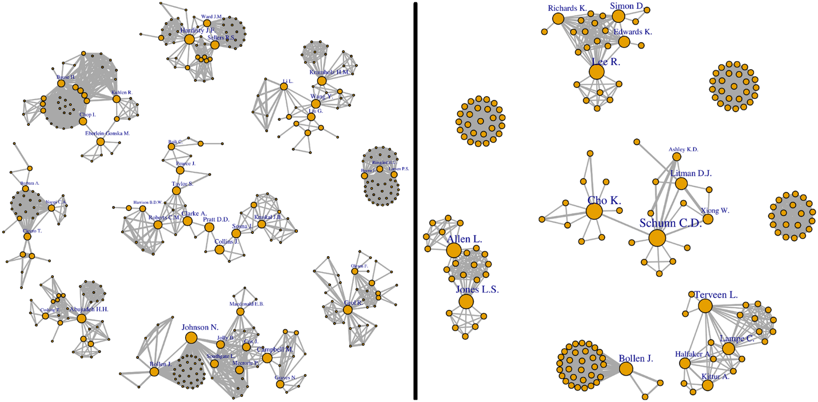
Welcome to the networked 21st century
Everywhere we are using networks to evaluate information on the Web. Why not in science? Use the power of professional networks to evaluate scientific results.
http://journals.plos.org/plosone/article?id=10.1371/journal.pone.0193148
@protohedgehog

Slide 61
Three core aspects for success of any future ‘platform’
Quality control/moderation
Certification/reputation
Engagement incentives
HARMONY
So, how..?
http://blogs.lse.ac.uk/impactofsocialsciences/2017/09/11/we-have-the-technology-to-save-peer-review-now-it-is-up-to-our-communities-to-implement-it/
@protohedgehog

Slide 62
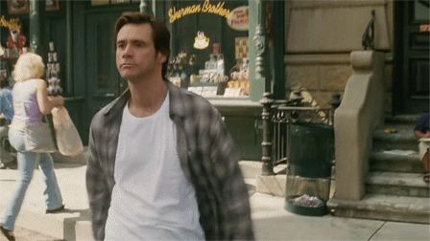
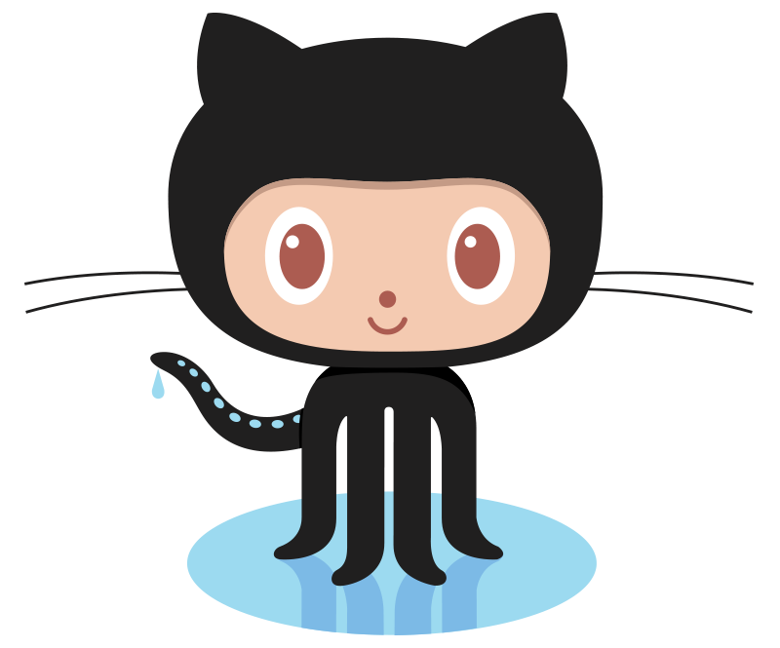
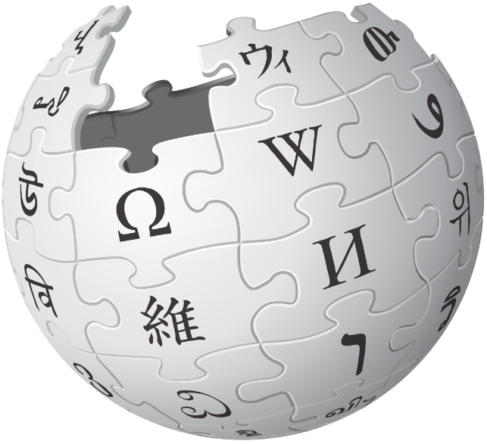
We have the tools to blow things wide open
Low cost
Creditable
Collaborative
Instant
Community-owned
Inherently reproducible
https://doi.org/10.1093/femsle/fny204
@protohedgehog

Slide 63
Promising initiatives in this space
Open Science Coalition
Political and public activism
Tools, services, and infrastructure
Community engagement, training, and education
Open Scholarship Initiative
Cross-national initiatives (e.g., Plan S, SciELO, OCSDnet, DOAJ, OpenAIRE)
Joint Roadmap for Open Science Tools
Open Science MOOC and Open Scholarship Strategy
Scholarly Commons (Force11)
http://elephantinthelab.org/do-we-need-an-open-science-coalition/
@protohedgehog

Slide 64
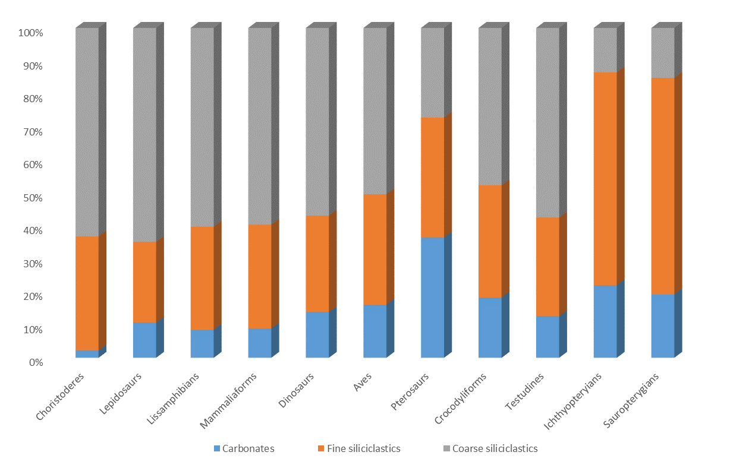
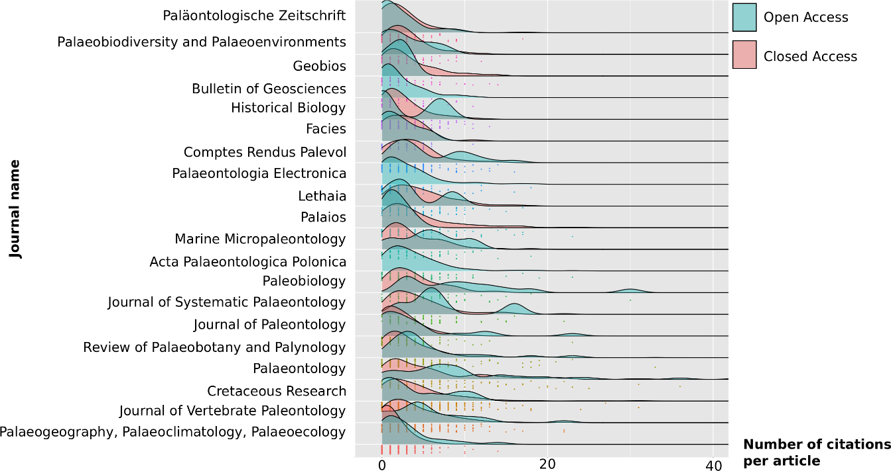
Things I’m working on - Fossils
https://paleorxiv.org/
Submitted
https://meta-paleo.github.io/

Slide 65
Things I’m working on - Other
Accepted!
In prep.
Also a value proposition for what ‘open science’ is
https://eliademy.com/catalog/oer/module-5-open-research-software-and-open-source.html

Slide 66
The future
Slide courtesy of Rebecca Willen
@protohedgehog

Slide 67
The ultimate goal
Pooling knowledge and resources to create a decentralised scholarly infrastructure, with communities as the focus.
Inclusivity
Equality
Accountability
Freedom
Fairness
Justice
Truth
Rigour
Transparency
Reproducibility
SCIENCE AS A PUBLIC GOOD FOR THE BETTERMENT OF SOCIETY
#PeopleNotProfits
http://elephantinthelab.org/do-we-need-an-open-science-coalition/
@protohedgehog

Slide 68
Thanks!
GitHub: https://github.com/OpenScienceMOOC
Website: https://opensciencemooc.eu
Twitter: @OpenScienceMOOC
Email: info@opensciencemooc.eu
@protohedgehog

