Slide 1


Reproducibility: Or, How I Learned to Stop Worrying and Love Open Science
Dr. Jon Tennant
Institute for Globally Distributed Open Research and Education (IGDORE)
@protohedgehog
https://orcid.org/0000-0001-7794-0218
VIS 2018, Berlin, Germany

Slide 2

We are in the midst of a global scientific ‘crisis’
There are four major ‘crises’: Access, Reproducibility, Serials, Evaluation
#ARSEcrisis
https://paywallthemovie.com/
@protohedgehog

Slide 3
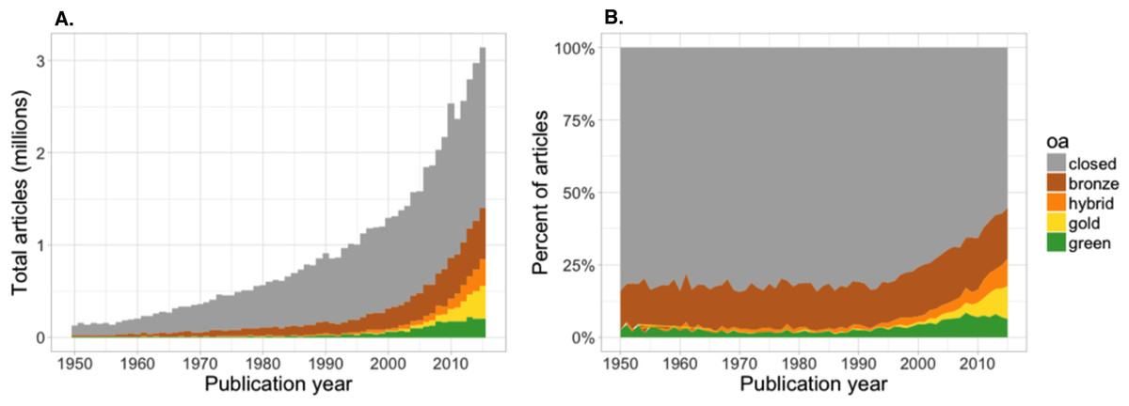
1. The Access Crisis
A graphical visualisation
of how bad this is
Most scholarly research remains inaccessible to most people on this planet
“We estimate that at least 28% of the scholarly literature is OA (19M in total) and that this proportion is growing, driven particularly by growth in Gold and Hybrid.” – Piwowar et al., 2018.
https://peerj.com/articles/4375/
@protohedgehog

Slide 4
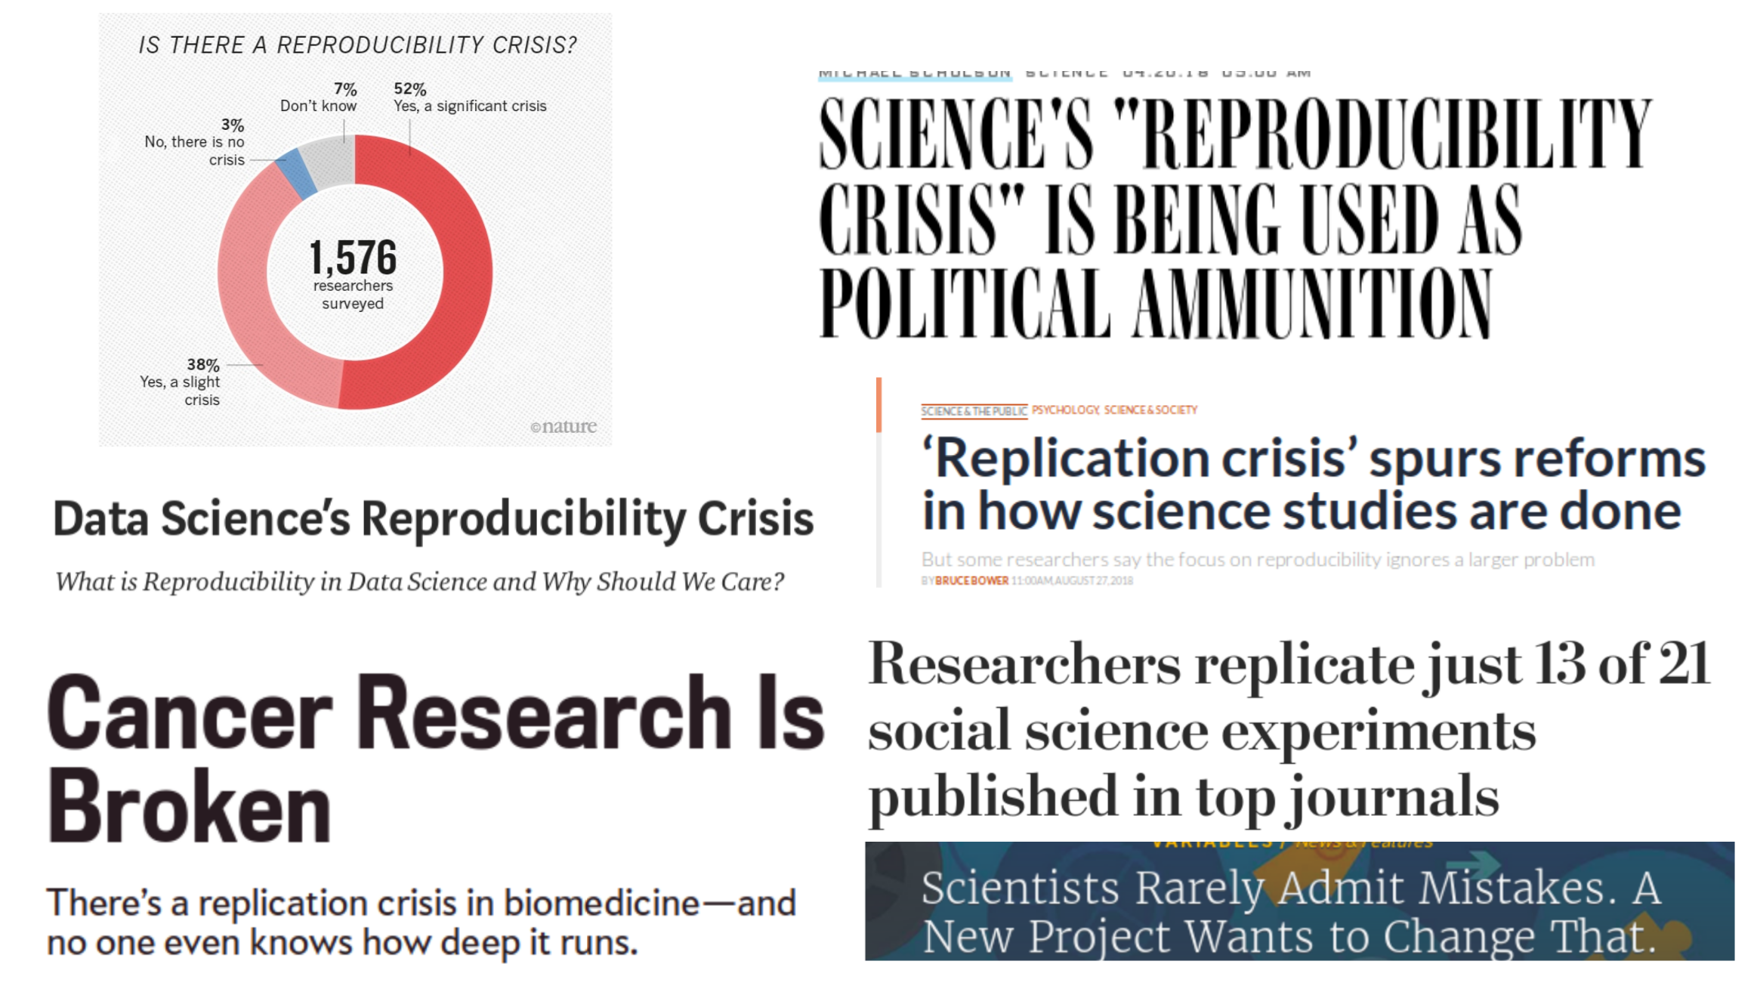
2. The Reproducibility Crisis
Slide courtesy of Rebecca Willen
Much research in many fields cannot be sufficiently reproduced

Slide 5
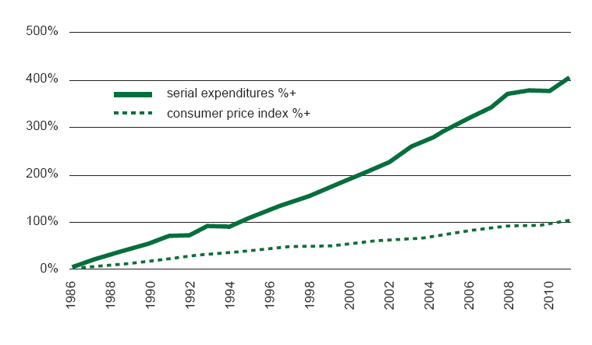
3. The Serials Crisis
Commercial publishers are draining our libraries dry
https://publications.parliament.uk/pa/cm201314/cmselect/cmbis/99/9905.htm
@protohedgehog

Slide 6
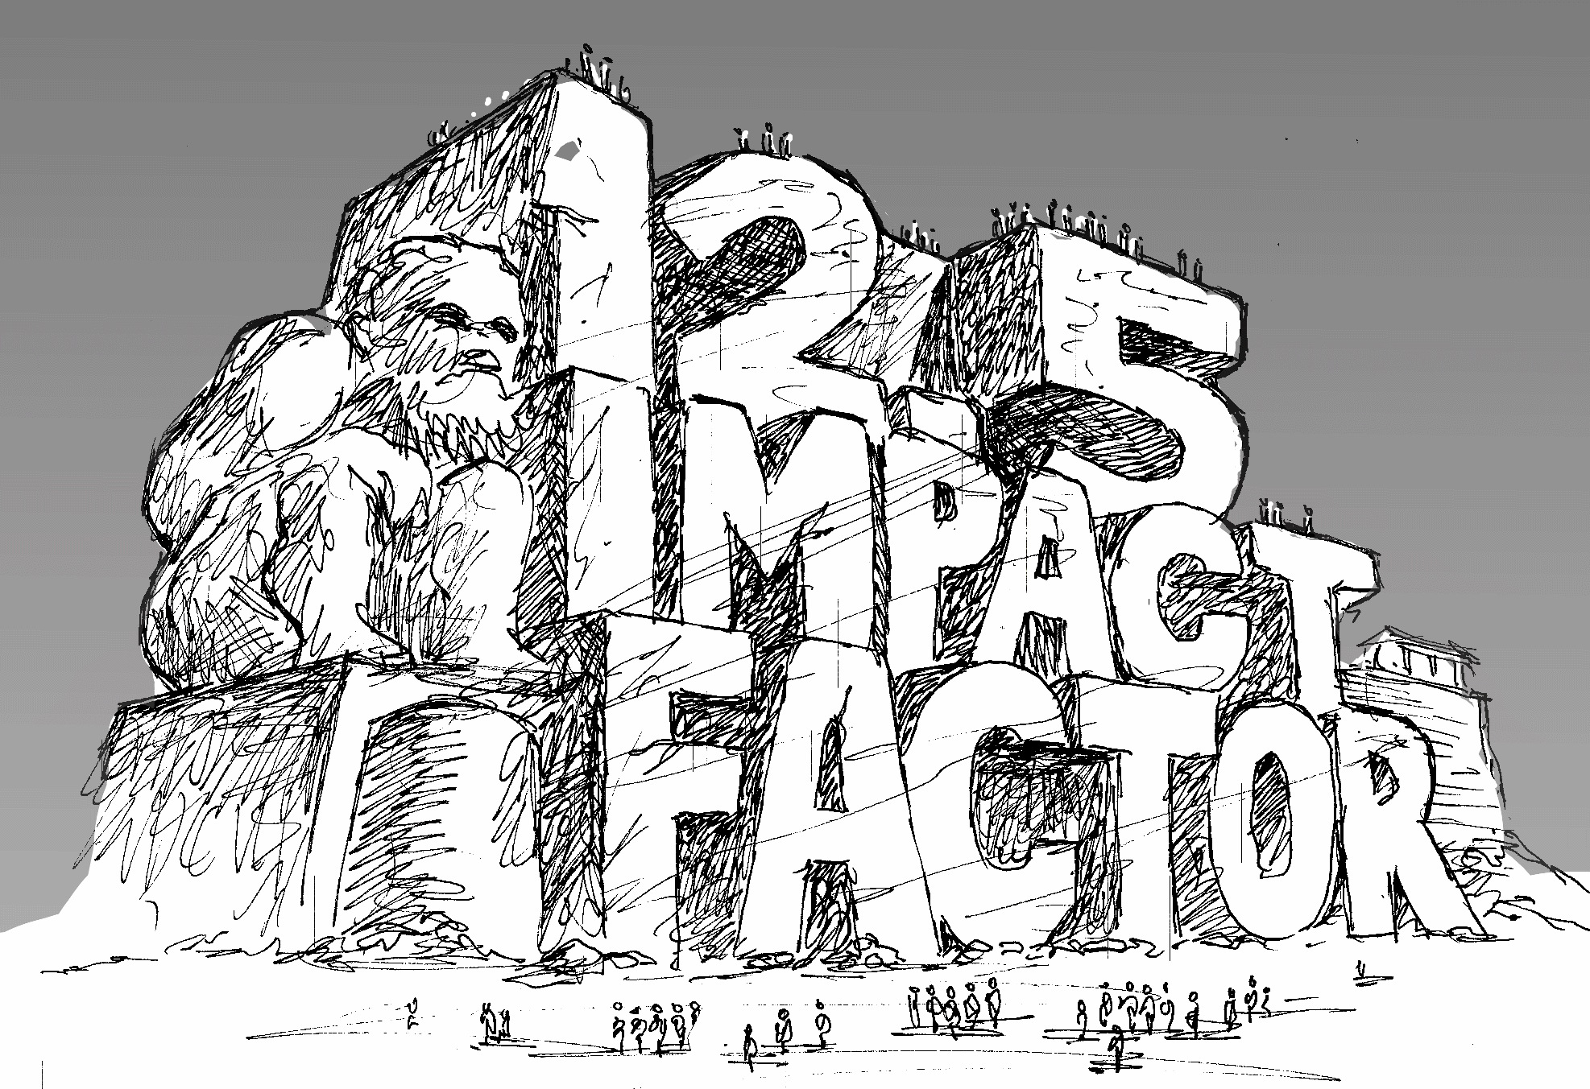
4. The Evaluation Crisis
All hail the sacred impact factor
http://whyopenresearch.org/impactfactor
@protohedgehog

Slide 7
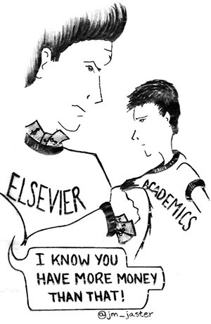

Why Open Science?
Science is not working as it should be
Slow, redundant, and wasteful
Ruled by commercial interests
Copyright is broken
The four major crises
Illusion of academic freedom
Questionable research practices
Closed science means people suffer
@protohedgehog

Slide 8
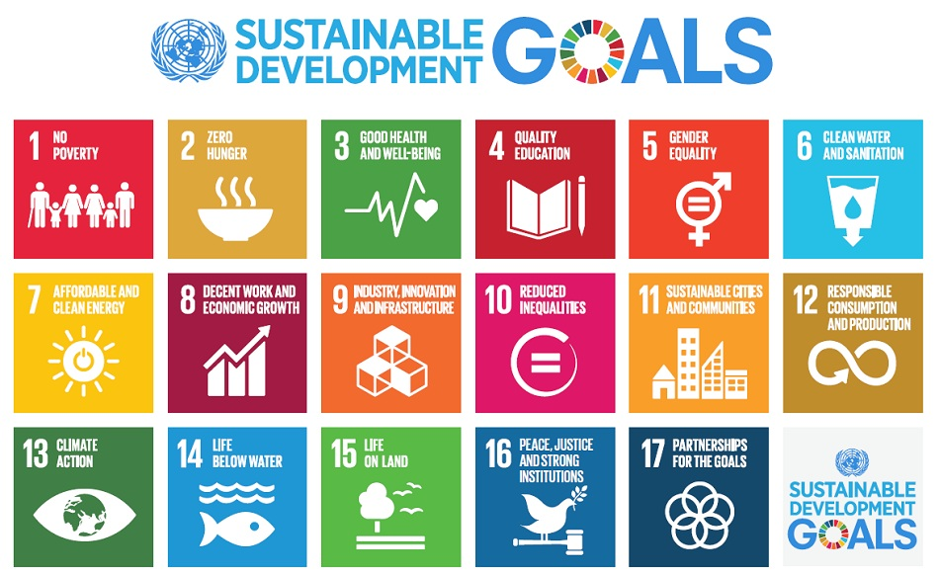
Do you believe that science can help us solve these problems?
http://www.who.int/mediacentre/events/meetings/2015/un-sustainable-development-summit/en
@protohedgehog

Slide 9
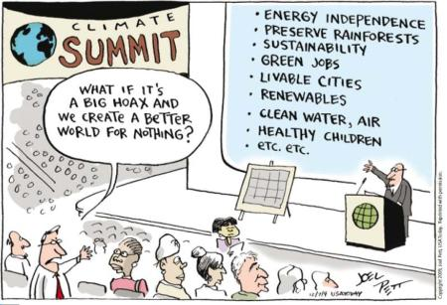
YES!
But then you also must acknowledge that by preventing access to research, we are acting against meeting these goals.
And this is what many in the present scholarly publishing industry are doing. In exchange for our money.
It’s not a bug. It‘s a feature.
All four ‘crises’ contribute to this together
@protohedgehog

Slide 10
For researchers, getting published is like going to a restaurant, bringing all of your own ingredients, cooking the meal yourself, and then being charged $40 for a waiter to bring it out on a plate for you.
  You are the provider, the product, and the consumer.
@protohedgehog

Slide 11
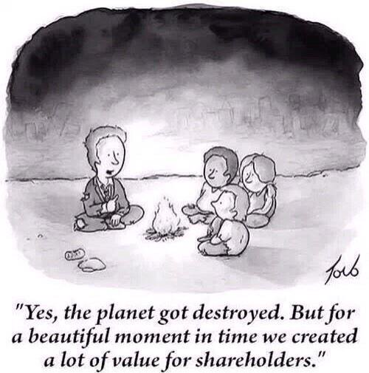
Why Open Science now?
Things are getting worse
  Lower public trust in science
  Co-option of Open Science
  Commercial interests strengthening
  Ownership of scholarly infrastructure
We have to act now, as a global community and take control of [Open] Science.
@protohedgehog

Slide 12
But...what is “Open Science”, exactly?
Open Science is a value-based approach to science in order to help address the major challenges to society, and undo the damage that commercial interests have done in the last half century. (Moi)
or...
Open Science is the movement to make scientific research, data and dissemination accessible to all levels of an inquiring society, amateur or professional. (Wikipedia)
or…
Open Science represents a new approach to the scientific process based on cooperative work and new ways of diffusing knowledge by using digital technologies and new collaborative tools. (European Commission)
@protohedgehog

Slide 13
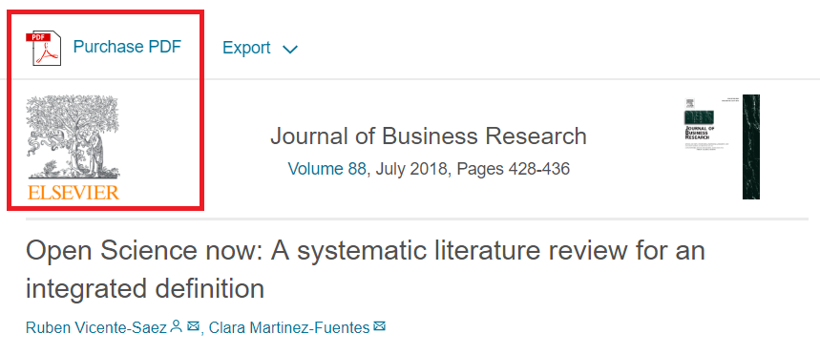
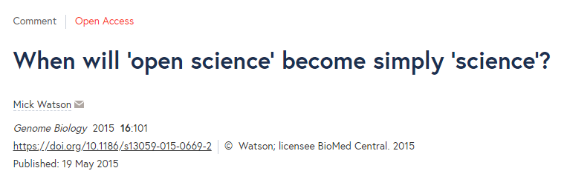
I feel like often we talk about “open science” as a different entity to “good science”.
“Open Science is transparent and accessible knowledge that is shared and developed through collaborative networks.”
“Open science describes the practice of carrying out scientific research in a completely transparent manner, and making the results of that research available to everyone. Isn’t that just ‘science’?”
THIS IS VERY BAD
THIS IS VERY GOOD
https://genomebiology.biomedcentral.com/articles/10.1186/s13059-015-0669-2
https://www.sciencedirect.com/science/article/abs/pii/S0148296317305441
@protohedgehog

Slide 14
What’s the fuss?
Because OS has become a poorly-defined process- based concept
Divorced from any human, value-based element
Treated as distinct from ‘good’ science
This makes it very easy AGAIN for commercial interests to co-opt
(which they are)
Or to be used as a political slogan to gain brownie points
(which it also is)
@protohedgehog

Slide 15
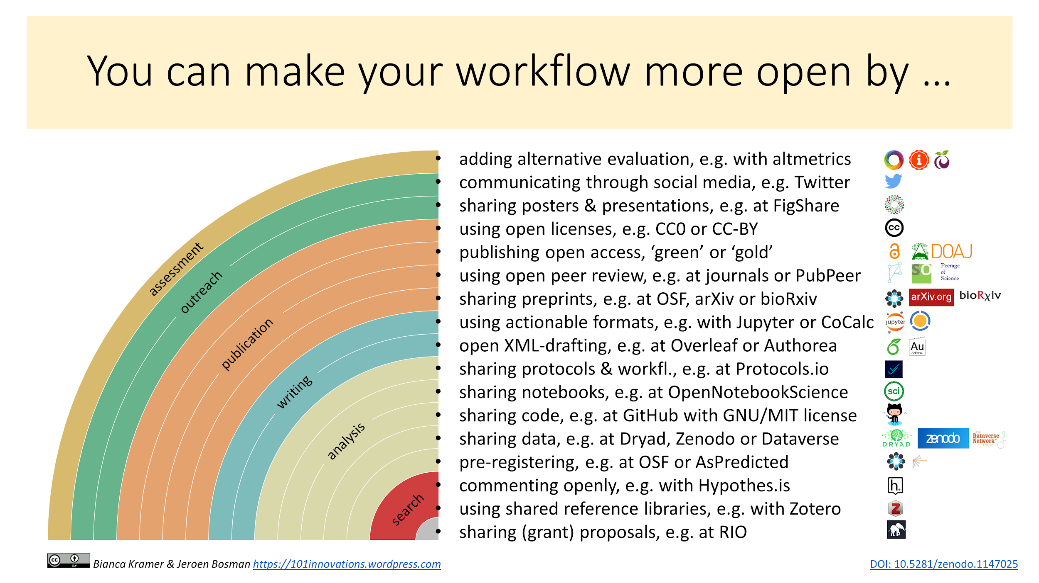

Slide 16
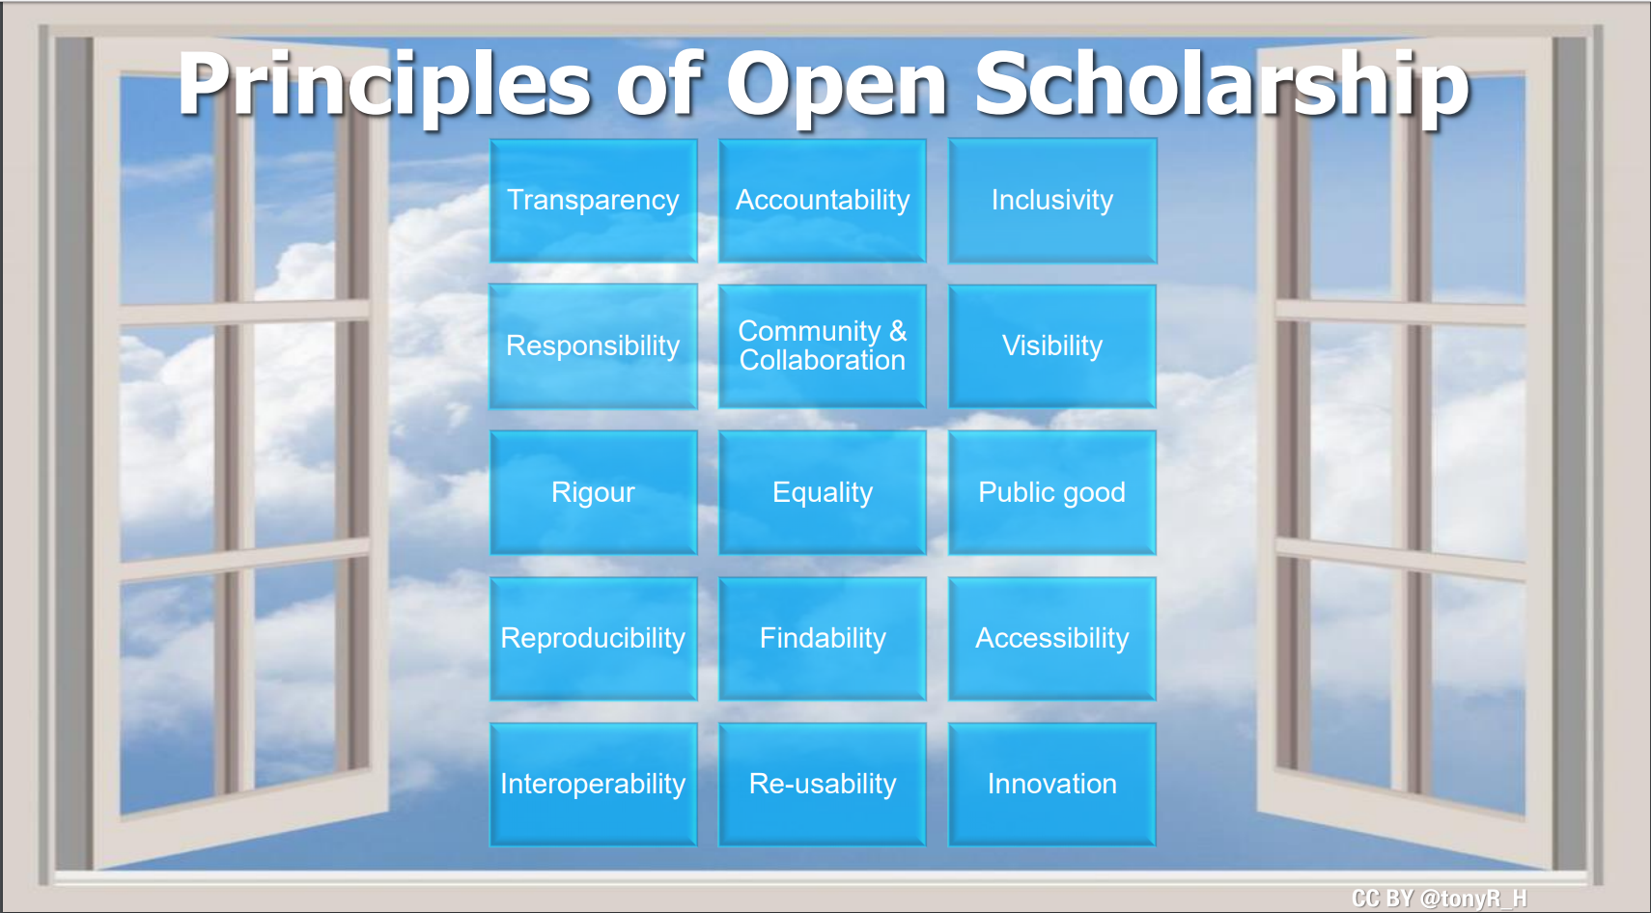
Freedom
Fairness
Justice
Truth
Liberty
FAIR principles
TOP guidelines
Principles of Open Scholarship, by Tony Ross-Hellauer (Source, CC BY).

Slide 17
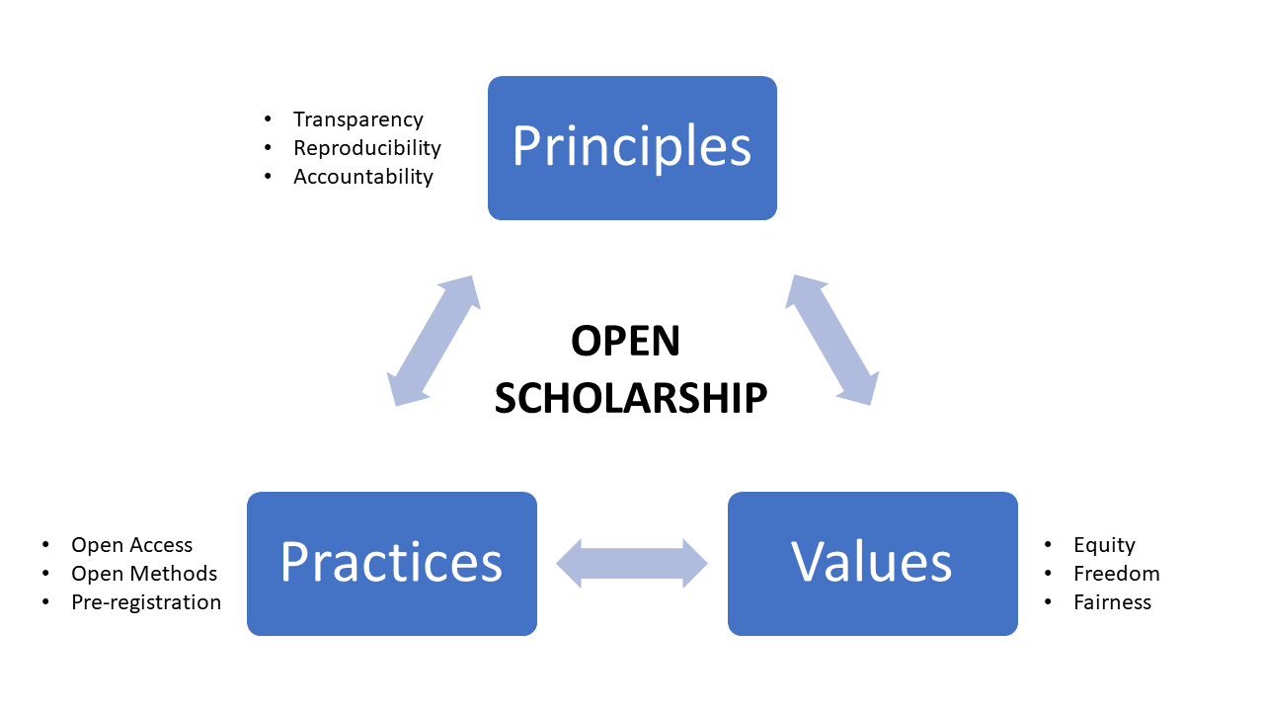
@protohedgehog

Slide 18
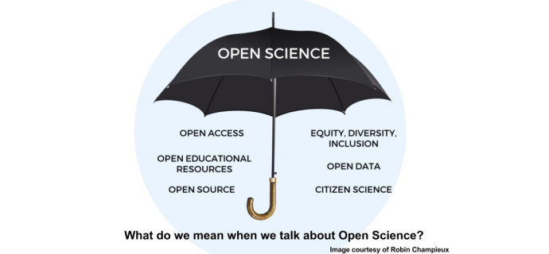
On Open Science and culture change
This is where it gets tough..
@protohedgehog

Slide 19
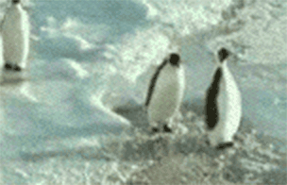
Have you ever met an average academic?
50% of academics are stupider than the average academic.
A system defined by cultural inertia.
Publish or perish mentality is still strong.
Generally resilient of new technologies or workflows.
What happened to doing good science? What are the incentives for that?
We are all penguins.
@protohedgehog

Slide 20
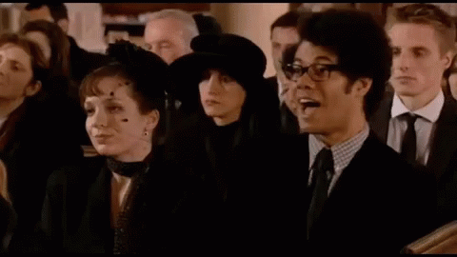
Academics are also generally terrible at making predictions...
“Open Access will never catch on.”
“Preprints will never be a thing.”
“Sharing our data won’t ever be mandatory.”
“Open peer review is fake news.”
“It doesn’t matter if research isn’t reproducible.”
“Open Science is just a fad.”
I wonder if they ever get tired being wrong all the time…
“IT DOES NOT MATTER IF MY RESEARCH IS REPRODUCIBLE OR NOT.”
@protohedgehog

Slide 21
Principles in open science
Drivers
Barriers
Reduce publication bias.
Increase replicability/reproducibility.
Increase reliability of scientific record.
Make publicly funded research publicly accessible.
Make research more efficient.
Increase public trust.
Foster collaboration.
Sustainable research.
Fear of scooping or ideas being stolen.
Fear of not being credited for ideas.
Fear of errors and public humiliation.
Fear of risk to reputation.
Fear of reduced scientific quality.
Fear of information overload.
Fear of career compromise.
Fear of backlash from senior figures.
Fear of being different.
@protohedgehog

Slide 22
Your career
Open Science
SOCIAL AND TECHNICAL BARRIERS
@protohedgehog

Slide 23
This is the absolute WRONG message to be sending to students and researchers
Because Open Science is not an independent thing from science
It’s an enhanced way of doing it based on practices, values and principles
@protohedgehog

Slide 24
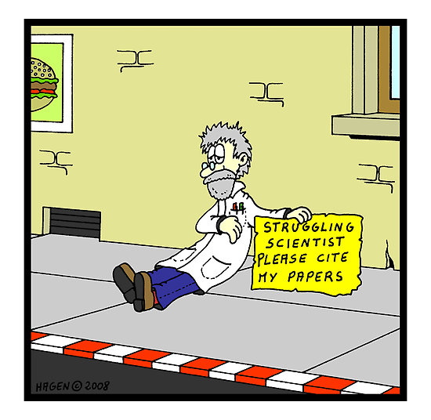
How does reproducibility fit in?
If research is not reproducible, is it really research? Hmmm…
It HAS to be researchers making the commitment to reproducibility
@protohedgehog

Slide 25
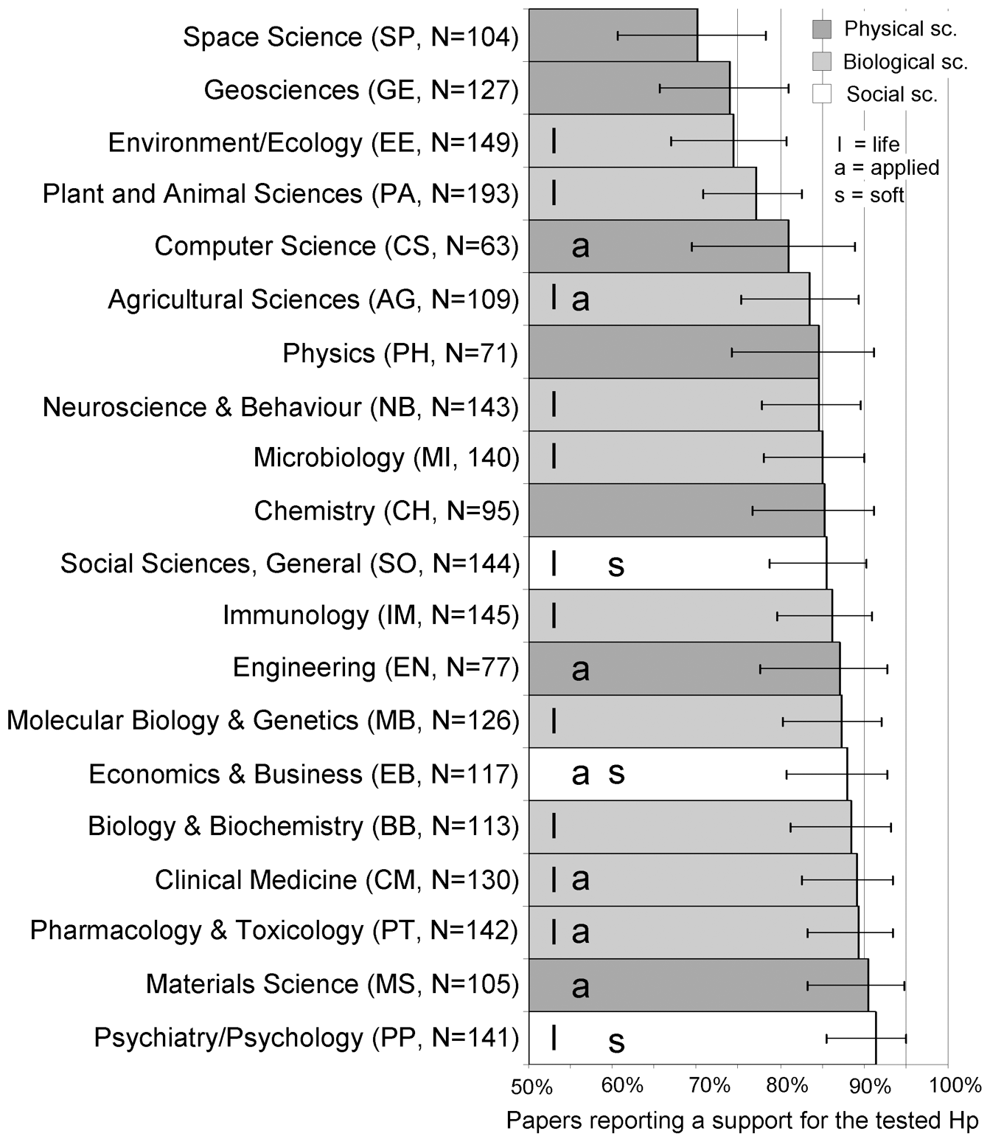
Something ain’t quite right..
Pretty much the exact opposite of what it is supposed to look like
Strong bias towards ‘positive’ results
Strong bias against ‘negative’ results
Bad incentives?
Bad research?
Fanelli, D. (2010)

Slide 26
What is reproducibility?
Computational reproducibility
  Results-based
Scientific method
Observation
Analysis
Question
Replication
Rerun the original experiment
Testing
Hypothesis
Prediction
https://osf.io/tervf/ - April Clyburne-Sherin, OSF
Notes:
Reproducibility = broad term
Computational Reproducibility
Data + code
Reran it
Can reproduce your numbers + figures
Surprisingly tricky:
Quarterly Journal of Political Science requires a ‘replication package’ (data and code)
58% of submissions not computationally reproducible

Slide 27
What is reproducibility?
Computational reproducibility
  Results-based
Empirical reproducibility
  Conclusions-based
Scientific method
Observation
Analysis
Question
Replication
Rerun the original experiment
Testing
Hypothesis
Prediction
https://osf.io/tervf/ - April Clyburne-Sherin, OSF
Notes:
Empirical Reproducibility
Can rerun the original experiment the way it was originally conducted
Draw the same conclusions

Slide 28
What is reproducibility?
Computational reproducibility
  Results-based
Empirical reproducibility
  Conclusions-based
Conceptual reproducibility
  Interpretation-based
Scientific method
Observation
Analysis
Question
New data
Replication
Testing
Hypothesis
Prediction
https://osf.io/tervf/ - April Clyburne-Sherin, OSF
Notes:
Conceptual reproducibility
An attempt to validate the interpretation of the original study
Collect new data on the same conceptual variables
Make the same interpretations
3 types important
need first 2 to achieve conceptual reproducibility
This workshop:
what you can do to improve all definitions of reproducibility
end goal of making scientific studies reproducible computationally, directly, and conceptually

Slide 29
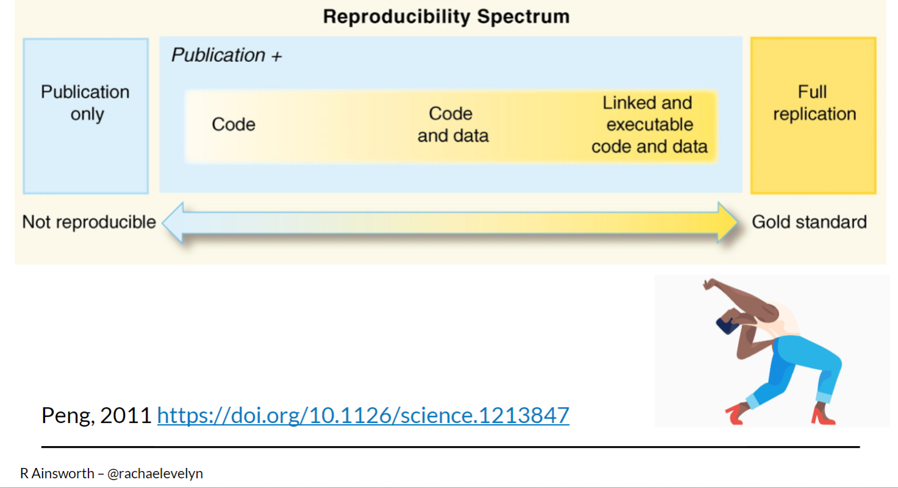
https://zenodo.org/record/1464853#.W8nO_mj7RPZ

Slide 30
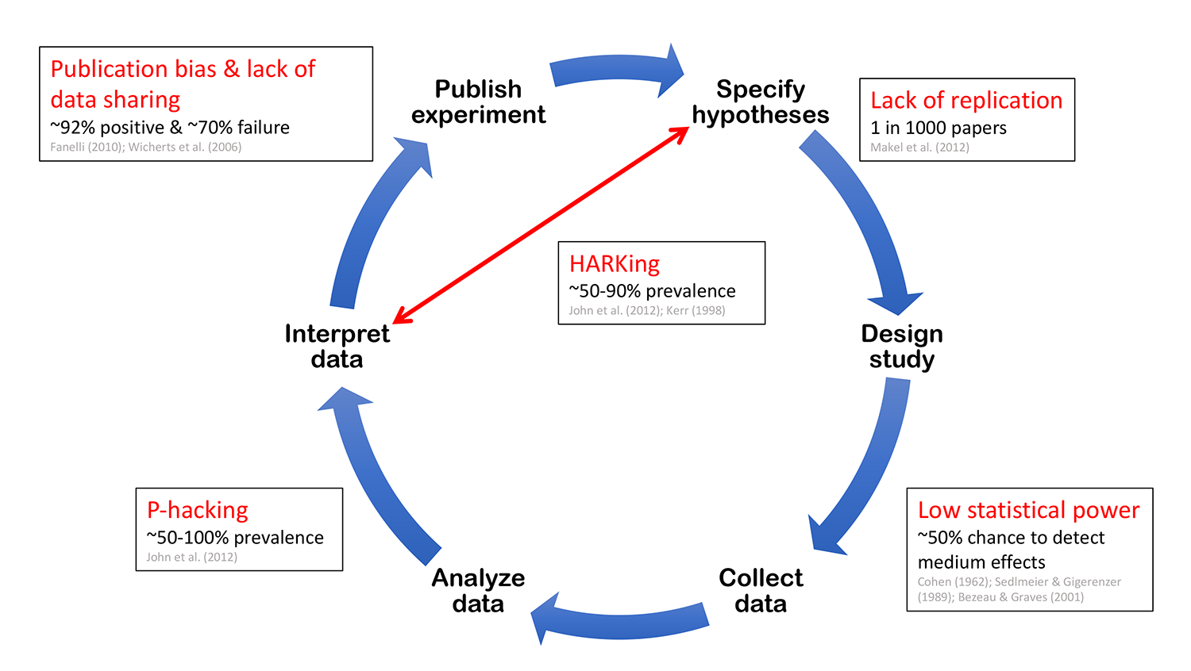
Why does this matter?
https://cos.io/rr/
@protohedgehog
Notes:
Figure 1. The hypothetico-deductive model of the scientific method is short-circuited by a range of questionable research practices (red). This example shows the prevalence of such practices in psychological science. Lack of replication impedes the elimination of false discoveries and weakens the evidence base underpinning theory. Low statistical power increases the chances of missing true discoveries and reduces the likelihood that obtained positive effects are real. Exploiting researcher degrees of freedom (p-hacking) manifests in two general forms: collecting data until analyses return statistically significant effects, and selectively reporting analyses that reveal desirable outcomes. HARKing, or hypothesizing after results are known, involves generating a hypothesis from the data and then presenting it as a priori. Publication bias occurs when journals reject manuscripts on the basis that they report negative or undesirable findings. Finally, lack of data sharing prevents detailed meta-analysis and hinders the detection of data fabrication.

Slide 31
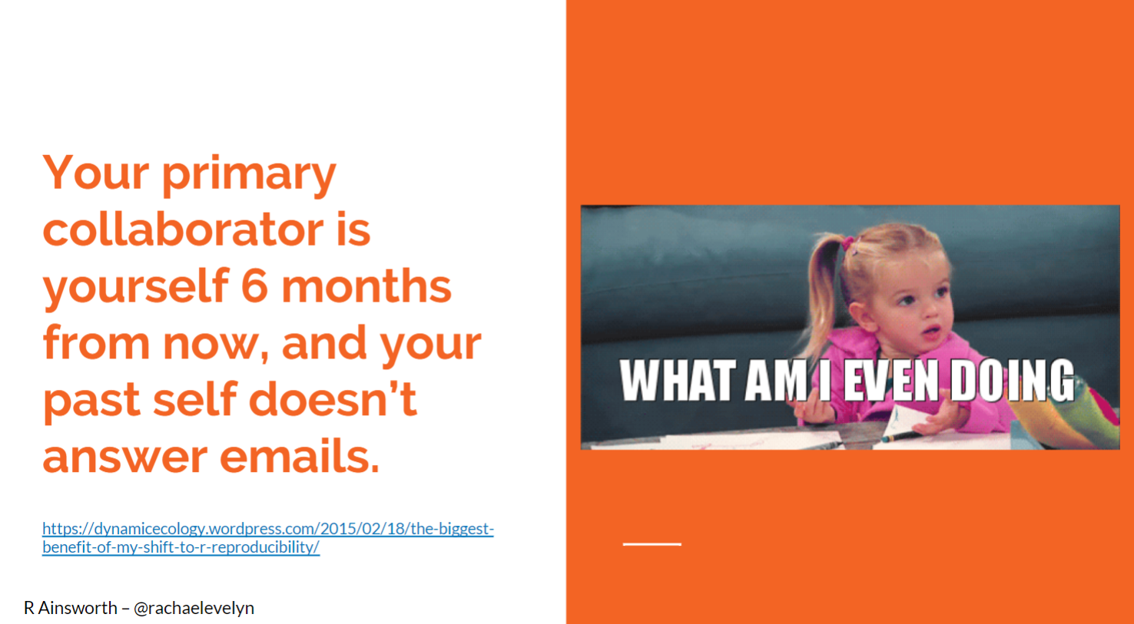
https://zenodo.org/record/1464853#.W8nO_mj7RPZ

Slide 32
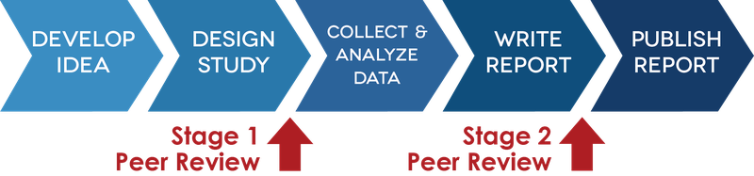
Solution 1? Registered reports
Emphasize the importance of the research question and the quality of methodology by conducting peer review prior to data collection.
https://cos.io/rr/
@protohedgehog

Slide 33
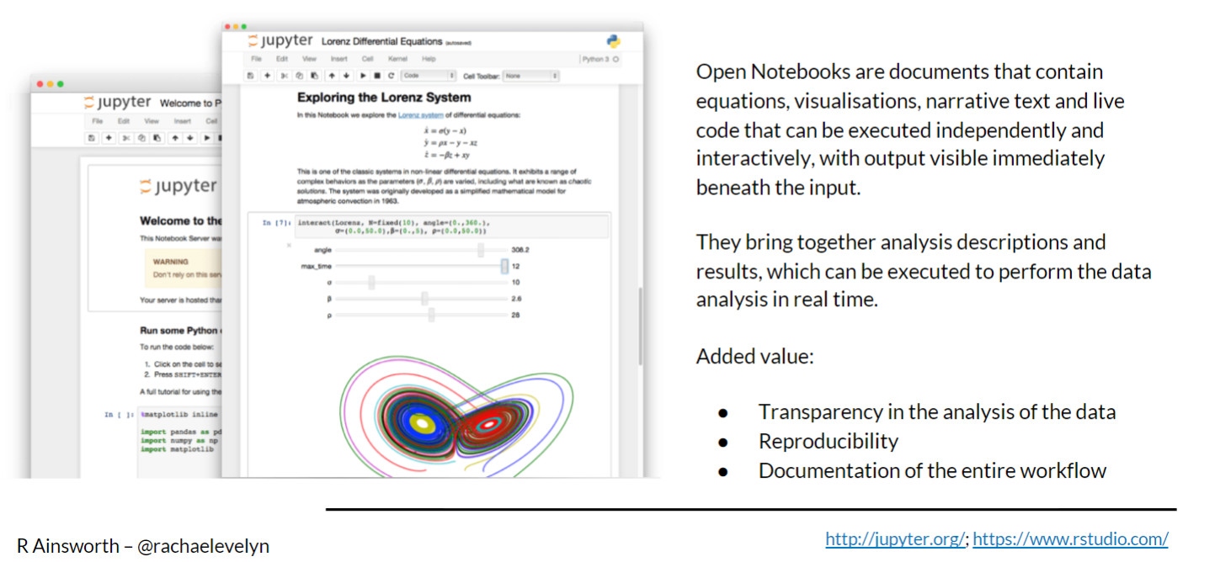
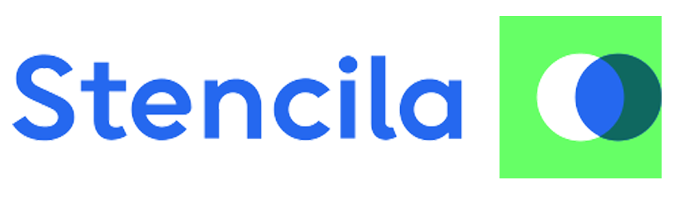
Solution 2? Open notebook science and ‘reproducible papers’
https://zenodo.org/record/1464853#.W8nO_mj7RPZ

Slide 34
Solution 3? Mandates and policies!
Mandatory open data policies can increase the frequency and quality of data sharing. However, suboptimal data curation, unclear analysis specification and reporting errors can impede analytic reproducibility, undermining the utility of data sharing and the credibility of scientific findings. – Hardwicke et al., for the journal Cognition
http://rsos.royalsocietypublishing.org/content/5/8/180448

Slide 35
Solution 4? Pledges!
I will teach my graduate students about reproducibility.
All our research code (and writing) is under version control.
We will always carry out verification and validation (V&V reports are posted to Figshare)
For main results in a paper, we will share data, plotting script & figure under CC-BY
We will upload the preprint to arXiv at the time of submission of a paper.
We will release code at the time of submission of a paper.
We will add a "Reproducibility" declaration at the end of each paper.
I will keep an up-to-date web presence.
http://lorenabarba.com/gallery/reproducibility-pi-manifesto/

Slide 36
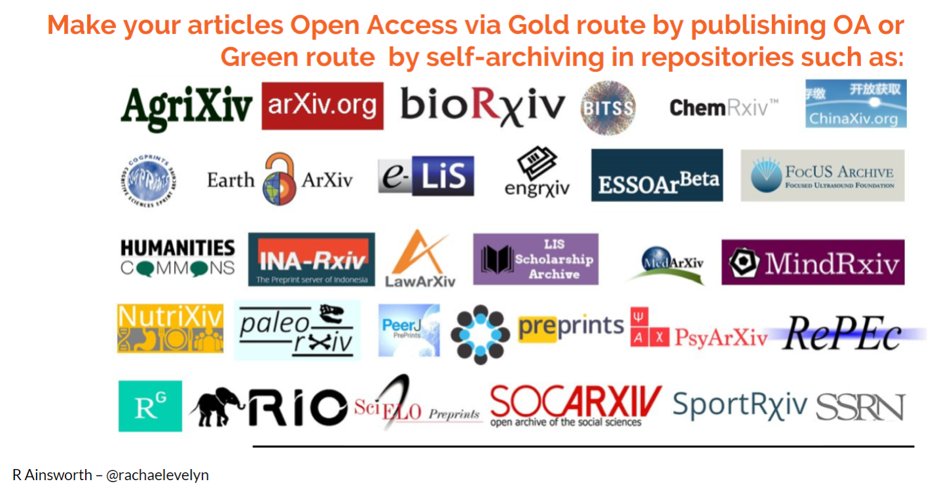
https://zenodo.org/record/1464853#.W8nO_mj7RPZ

Slide 37
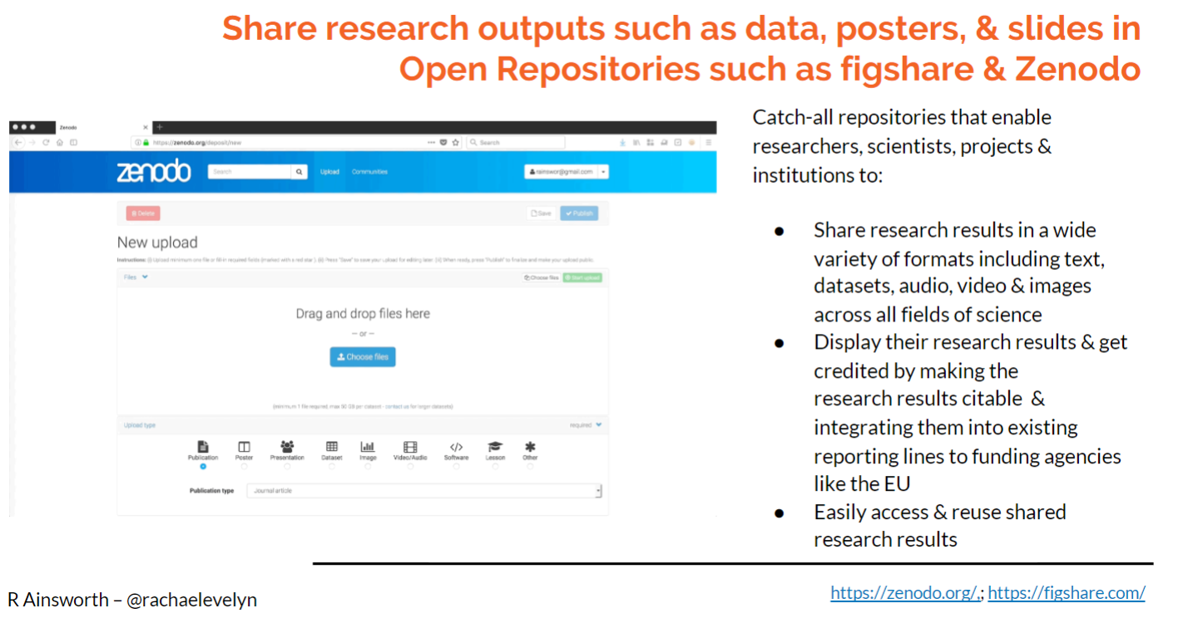
https://zenodo.org/record/1464853#.W8nO_mj7RPZ

Slide 38
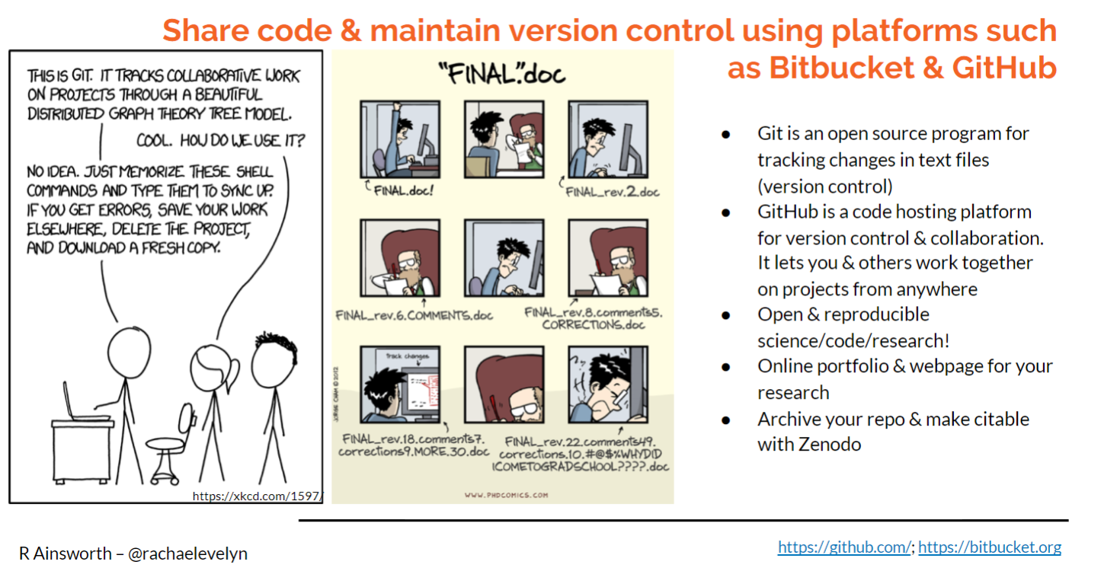
https://zenodo.org/record/1464853#.W8nO_mj7RPZ

Slide 39
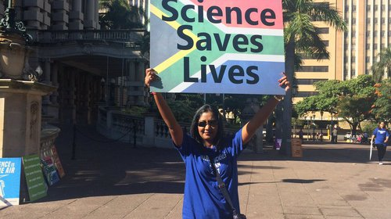
WHAT WE HAVE HERE IS A FAILURE TO COMMUNICATE
Can we break the inertia through training?
@protohedgehog

Slide 40
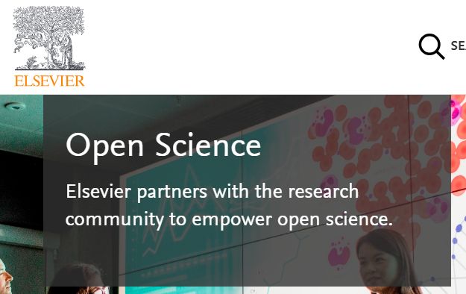
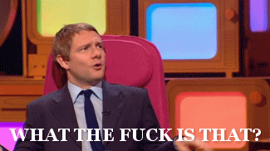
Mega-publishers are corrupting Open Science
Organisations stuck in a pre-digital mindset with a key product developed in the 17th Century.
Basically the reason why the Open Science ‘movement’ began.
Business models based on exclusion, exploitation of privilege, discrimination, extortion..
Who pay lip service to Open Science, while simultaneously subverting it to meet their own intentions.
We DO NOT share the same values and principles.
@protohedgehog

Slide 41
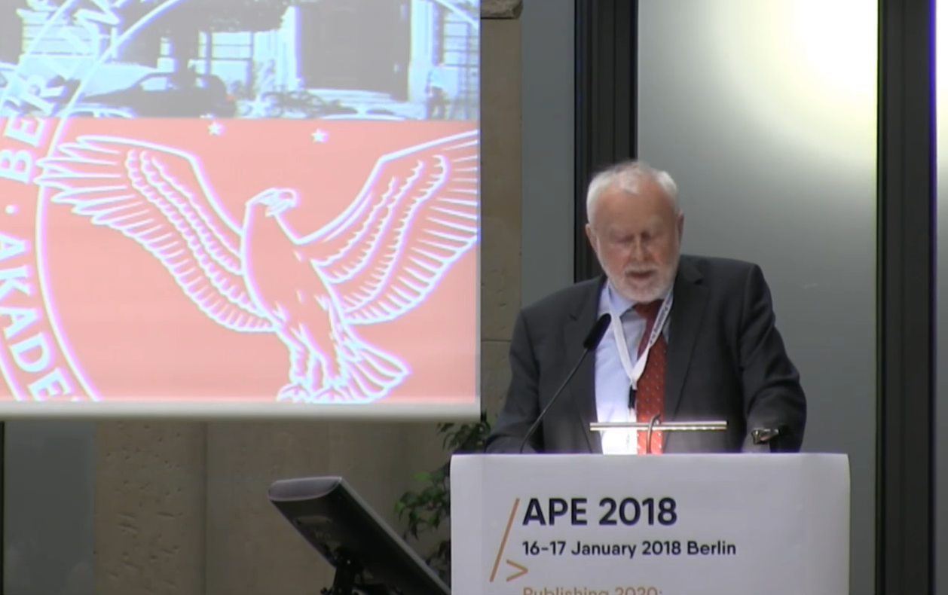
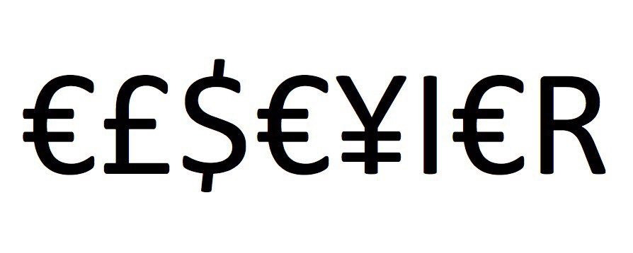
Germany versus Elsevier
“One big publisher stated: if your country stops subscribing to our journals, science in your country will be set back significantly. I responded […] it is interesting to hear such a threat from a producer of envelopes who does not have any idea of the contents.”
Martin Grötschel, President of the Berlin-Brandenburg Academy of Sciences and Humanities
#HERO
#villain
@protohedgehog

Slide 42

Page 99 of the Springer Nature IPO* prospectus:
“We also aim at increasing APCs by increasing the value we offer to authors through improving the impact factor and reputation of our existing journals.”
https://www.timeshighereducation.com/blog/linking-impact-factor-open-access-charges-creates-more-inequality-academic-publishing
*failed, lol
@protohedgehog

Slide 43

Attitudes versus practice
“60.8% of researchers do not self-archive their work even when it is free and in keeping with journal policy.”
“In a field where OA seems of practical and ethical importance for the sharing of knowledge promoting health equity, it is surprising that researchers do not make their papers available when they are legally able to do so without any cost.”
https://health-policy-systems.biomedcentral.com/articles/10.1186/s12961-017-0235-3
@protohedgehog

Slide 44
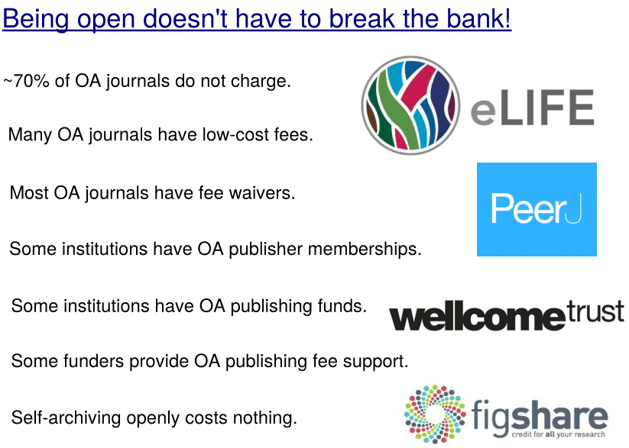
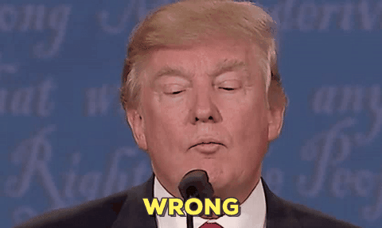
“Open Access
is too expensive.”
Common view about high costs is due to a combination of monopolisation and political broadsiding and sabotage by commercial publishers.
@protohedgehog

Slide 45
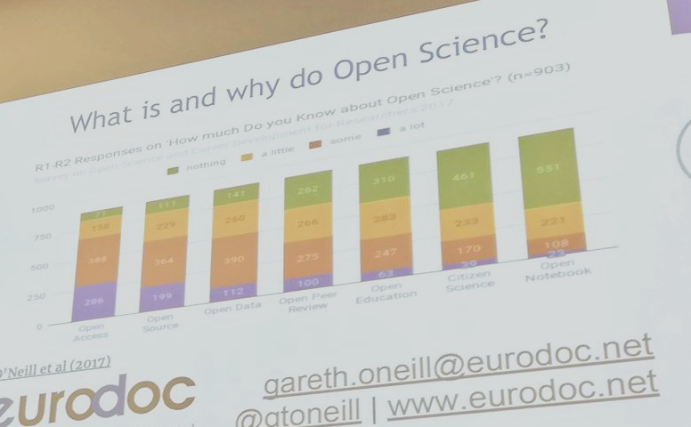
Sorry for the crap quality…
@protohedgehog

Slide 46
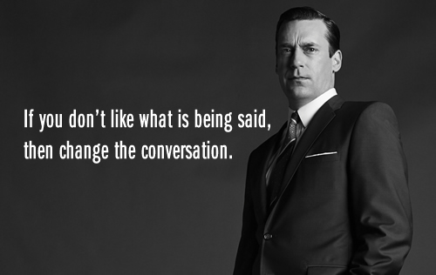
It is time to change the conversation
Open Science is AWESOME!
@protohedgehog

Slide 47
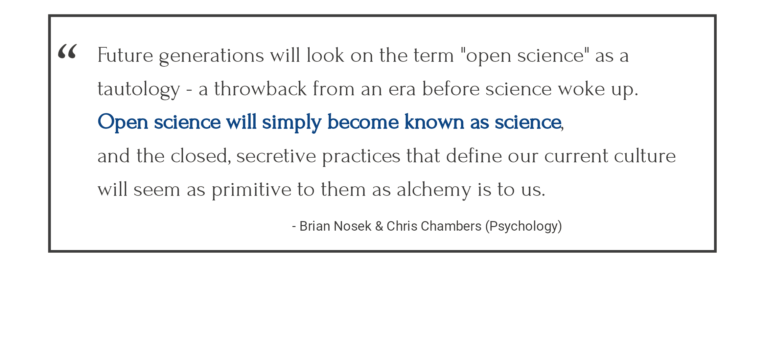
The future
Slide courtesy of Rebecca Willen
@protohedgehog

Slide 48
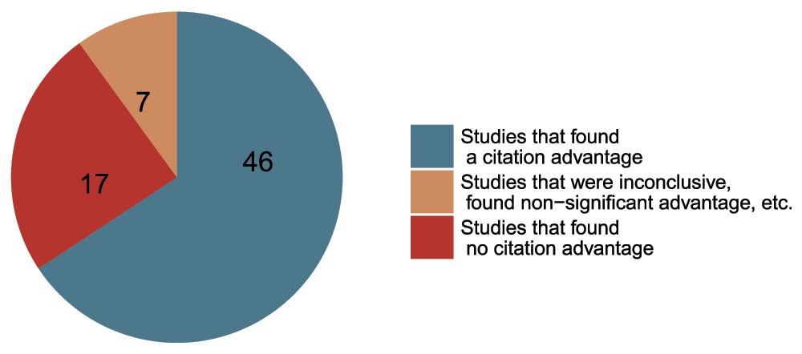
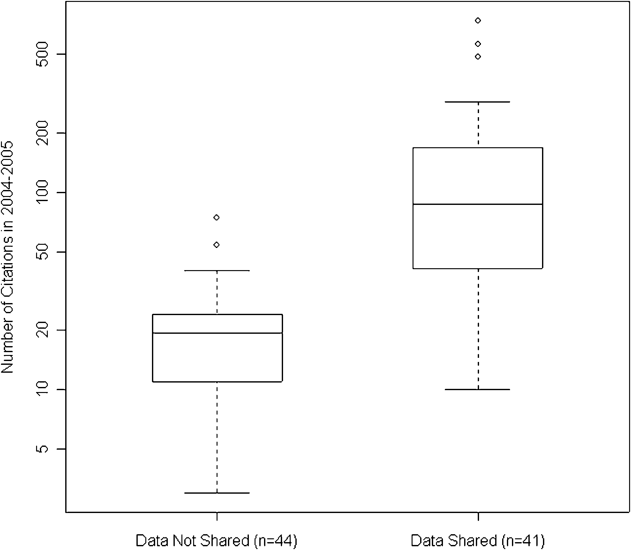
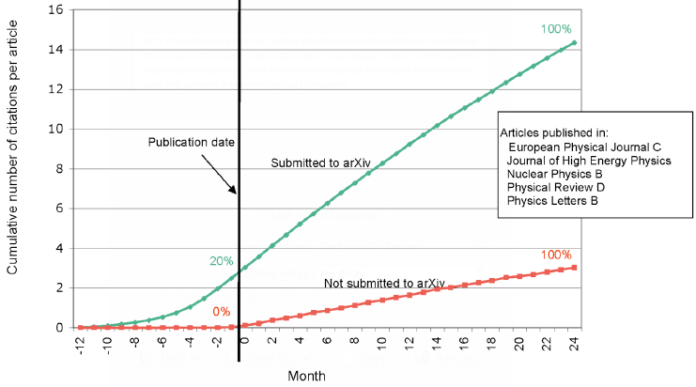
Openness is good for your work and career
Rapid communication
Greater exposure
More citations, faster
http://whyopenresearch.org
https://peerj.com/articles/175
Data from The Open Access Citation Advantage Service, SPARC Europe, accessed March 2016.
http://f1000research.com/articles/5-632/v3
@protohedgehog

Slide 49
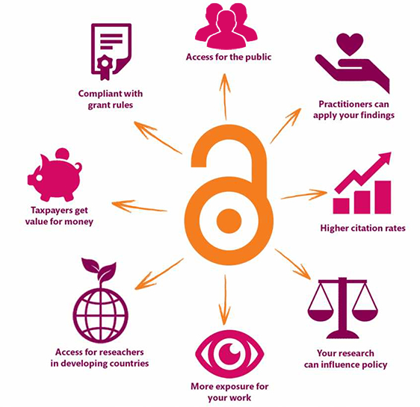
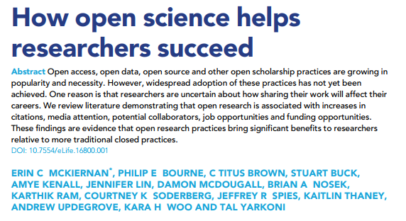
Open is better for EVERYONE
https://elifesciences.org/articles/16800
@protohedgehog
https://kib.ki.se/en/publish-analyse/open-access

Slide 50
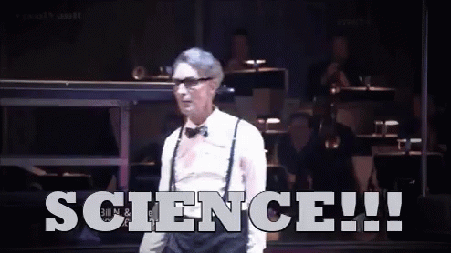
Being more open helps so much
Increases dissemination of your research.
Increases your academic profile.
Emphasises your core values.
Helps to combat the ‘reproducibility crisis’.
Increases your collaborations.
Makes you a more effective researcher.
@protohedgehog

Slide 51
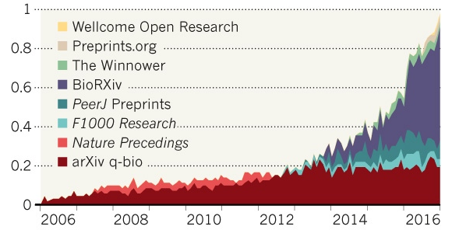
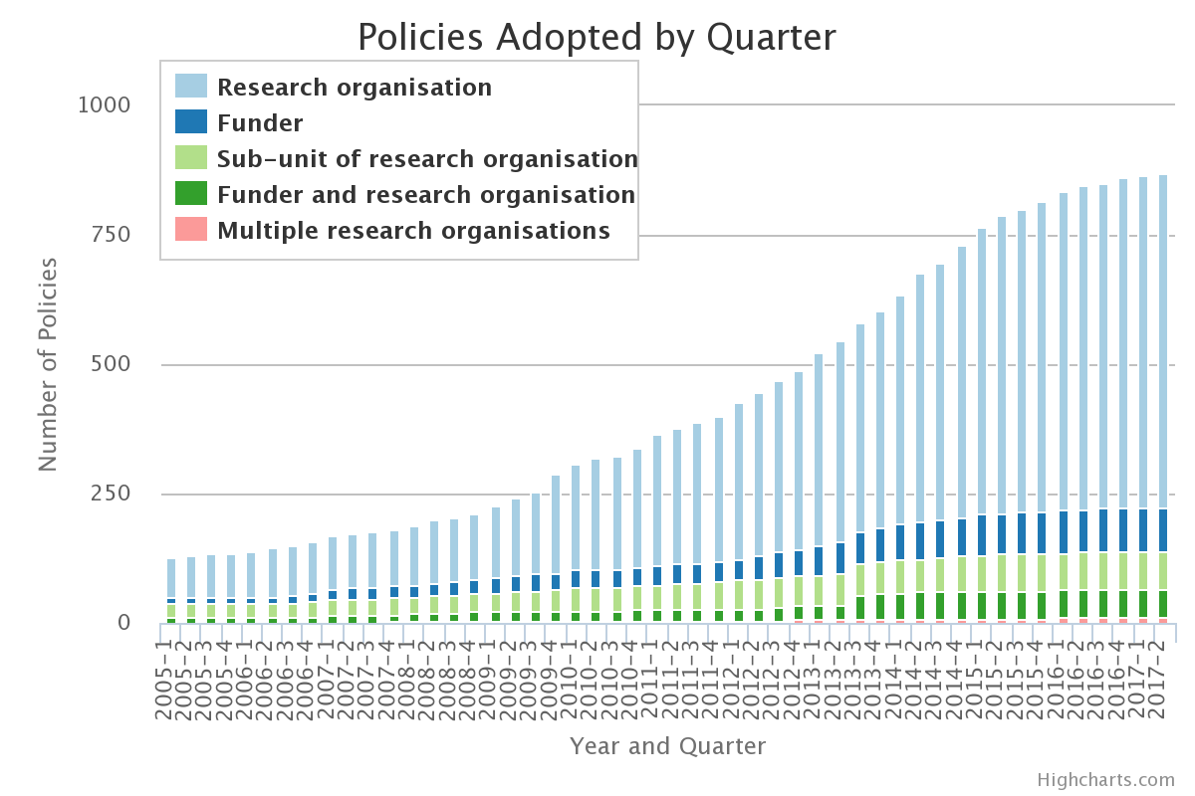
The future is OPEN
http://roarmap.eprints.org
We should be in a position where we are able to influence our academic system, not be stifled by the current actors in it.
@protohedgehog

Slide 52
Your career
Open Science
SOCIAL AND TECHNICAL BARRIERS
@protohedgehog

Slide 53
Your career
Open Science
TECHNICAL BARRIERS
SOCIAL BARRIERS
EDUCATION
@protohedgehog

Slide 54
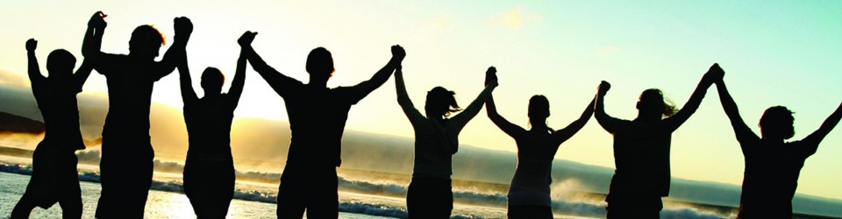
What can we all achieve if we stand together?
We need to stand together as a unified global community to make sure that we are acting in the best interests of the public, not corporate gains.
#PeopleNotProfits
https://letsallstandtogether.wordpress.com/
@protohedgehog

Slide 55
What do we need to change cultures?
Education, training, support.
Empowerment and leadership for the next generation.
Shifting power dynamics to reduce bias and abuse.
Building a global community based on sharing and collaboration.
Massive-scale engagement to re-align Open Science with current incentive structures.
@protohedgehog

Slide 56
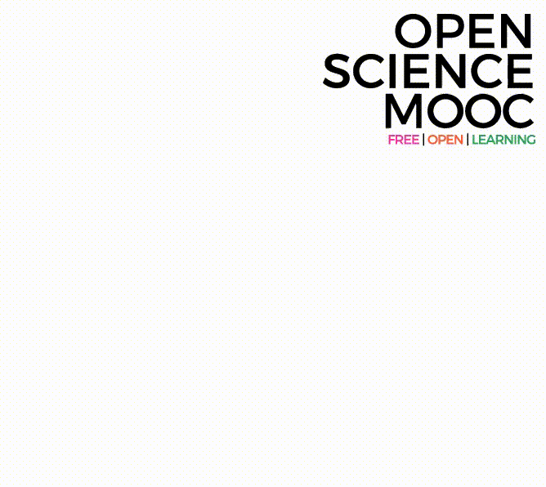
Introducing the Open Science MOOC*
A peer-to-peer value-based *Community that works towards better science for society
@OpenScienceMOOC

Slide 57
Our vision of the future
To help make ‘Open’ the default setting for all global research.
We want to help create a welcoming and supporting community, with good tools, teachers, and role-models, and built upon a solid values-based foundation of freedom and equitable access to research.
@protohedgehog

Slide 58
The way we do research has changed for good
We now have new expectations
Transparency
Not secrecy
Collaborative
Not solo
Continuous
Not discretised
@protohedgehog

Slide 59
We should be training ourselves
Sustained community engagement across disciplines
Being active both politically and at a community level
Rethinking our mindset (academic vs scientist)
Changing the defective incentive system
@protohedgehog

Slide 60
How do we get to where we want?
Imagine a future defined by the values of Open Science:
        Freely available public good
        Rigorous and reproducible
        Open to ALL
        Isn’t that just GOOD science?
@protohedgehog

Slide 61
The best researchers have already reinvented themselves into Openness
We need everyone to be collaborating together if we are going to help solve the challenges humanity faces.
#OpenScience
@protohedgehog

Slide 62
What do researchers care about?
Saving time and effort
Problem solving
Advancing research
We empower them with the knowledge and skills to do this
@protohedgehog

Slide 63
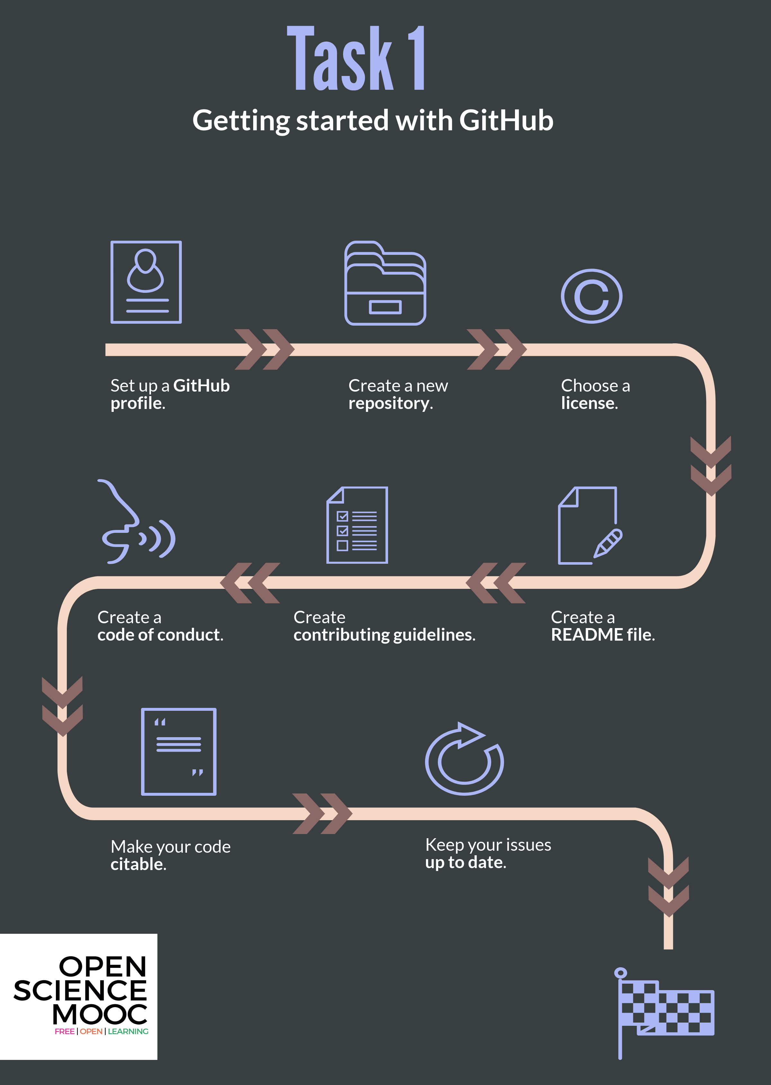
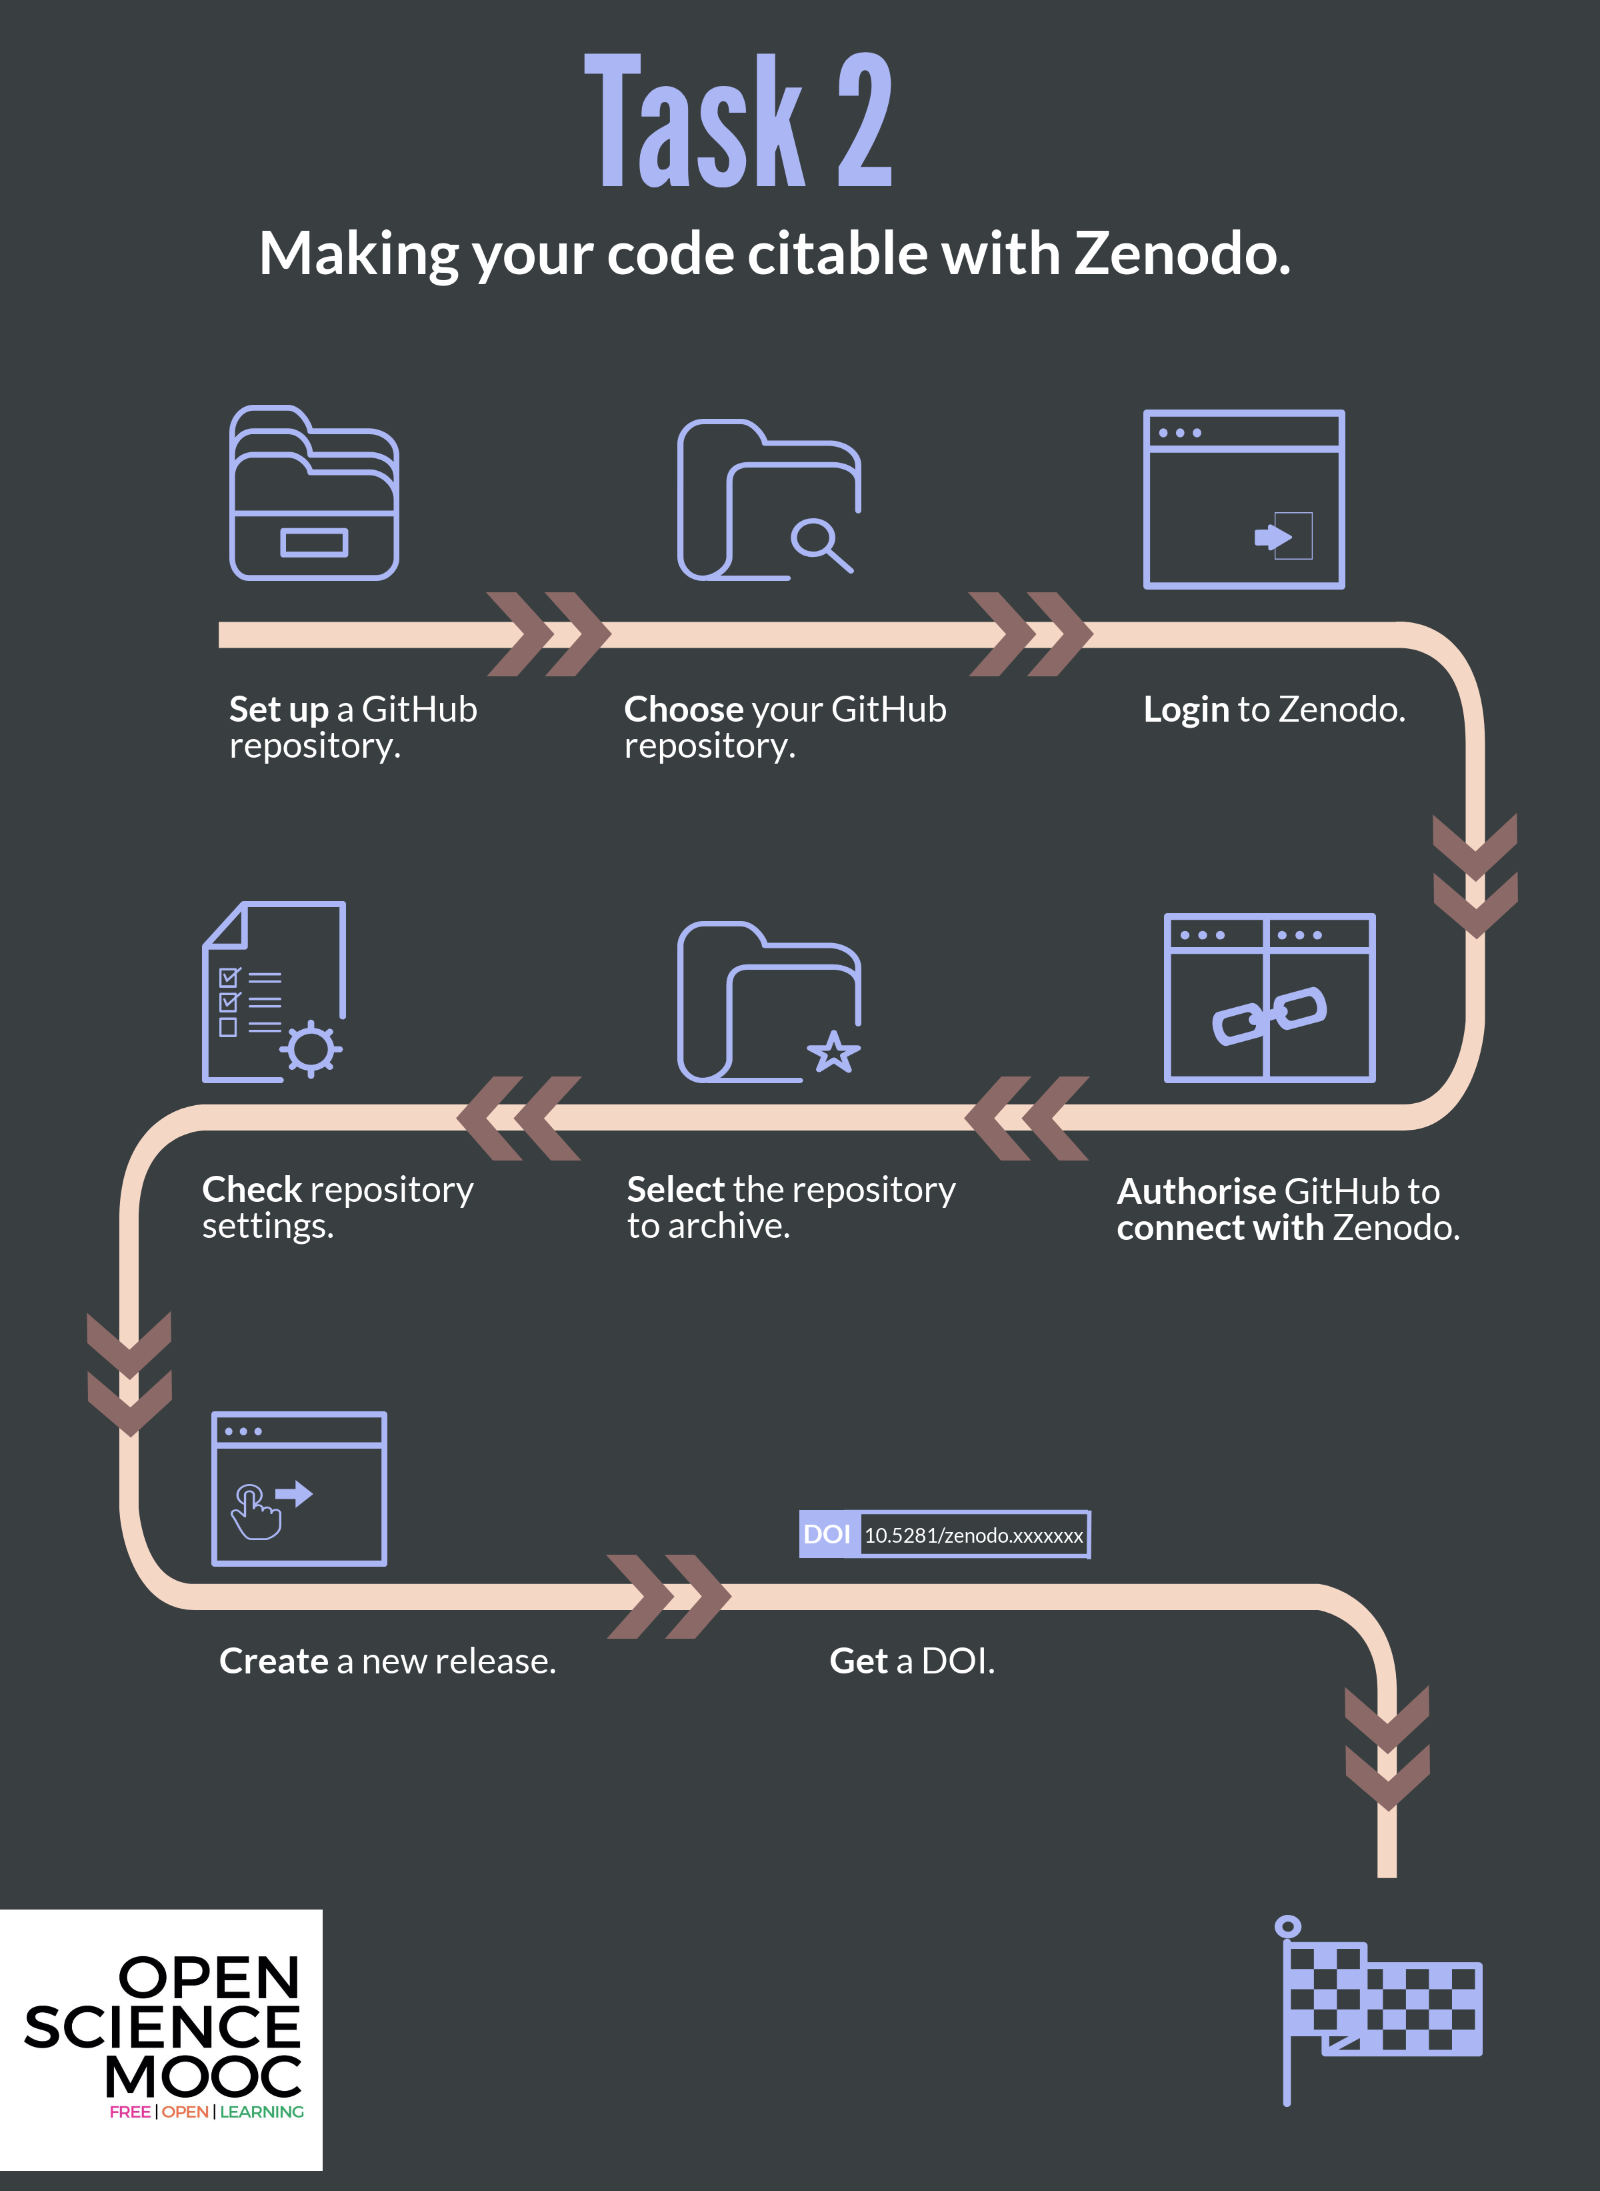

Slide 64
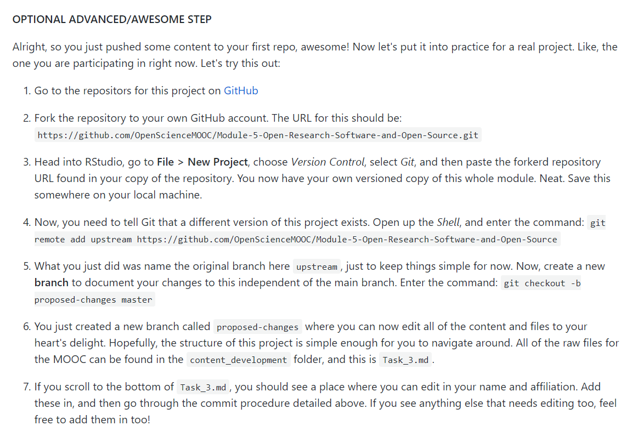
A fully interactive learning style
This allows learners to actually edit the MOOC content for this module. Nice.
Learning is based on participation and collaboration.
@protohedgehog

Slide 65

Modular learning
Designed by: Mike Morrison
@protohedgehog

Slide 66

https://github.com/OpenScienceMOOC/Module-3-Reproducible-Research-and-Data-Analysis
https://opensciencemooc.eu/modules/reproducible-research-and-data-analysis/
@protohedgehog

Slide 67


Open for re-use

Slide 68
Skeptical? You should be.
But it’s not as new as you think.
Science was founded on openness.
We closed it down.
It’s time to open it up again.
@protohedgehog

Slide 69
Some small future challenges
Working models exist and show ‘Open Science’ is a more effective process.
Simultaneous uptake of new behaviours across the whole scholarly ecosystem.
Standardised communication between a range of key participants.
Interoperability between specific and diverse communities.
Increasing the role and recognition of ‘Open Science’ across the board.
Getting research funders (and researchers..) interested.
@protohedgehog

Slide 70
Promising initiatives in this space
Open Science Coalition
Political and public activism
Tools, services, and infrastructure
Community engagement, training, and education
Open Scholarship Initiative
Cross-national initiatives in this space (e.g., Plan S, SciELO, OCSDnet, DOAJ, OpenAIRE)
Joint Roadmap for Open Science Tools
Open Science MOOC and Open Scholarship Strategy
Scholarly Commons (Force11)
http://elephantinthelab.org/do-we-need-an-open-science-coalition/
@protohedgehog

Slide 71
What could the future of scholarly communication look like?
Imagine if we were to rebuild it from scratch in 2018…
@protohedgehog

Slide 72



Welcome to the networked 21st century
Everywhere we are using networks to evaluate information on the Web. Why not in science? Use the power of professional networks to evaluate scientific results.
http://journals.plos.org/plosone/article?id=10.1371/journal.pone.0193148
@protohedgehog

Slide 73




We have the tools to blow things wide open
Low cost
Creditable
Collaborative
Instant
Community-owned
Inherently reproducible
https://doi.org/10.1093/femsle/fny204
@protohedgehog

Slide 74
The ultimate goal
Pooling knowledge and resources to create a decentralised scholarly infrastructure, with communities as the focus.
Inclusivity
Equality
Accountability
Freedom
Fairness
Justice
Truth
Rigour
Transparency
Reproducibility
SCIENCE AS A PUBLIC GOOD FOR THE BETTERMENT OF SOCIETY
http://elephantinthelab.org/do-we-need-an-open-science-coalition/
@protohedgehog

Slide 75

Or…
Melanie Imming, & Jon Tennant. (2018, June 8). Sticker open science: just science done right. Zenodo. http://doi.org/10.5281/zenodo.128557
@protohedgehog

Slide 76
LEARN MORE!
Existing reproducible research workshops/practical resources:
Reproducible Research Workshop (April Clyburne-Sherin & Courtney Soderberg).
Initial steps towards reproducible research (Karl Broman).
The Open Science and Reproducible Research course (Christie Bahlai).
Reproducibility Workshop: Best practices and easy steps to save time for yourself and other researchers (Code Ocean).
Reproducibility in Science: A guide to enhancing reproducibility in scientific results and writing, ROpenSci.
Reproducible Research using Jupyter Notebooks workshop (Data Carpentry).
R markdown workshop (Liberate Science).
rrtools: Tools for Writing Reproducible Research in R (Ben Marwick).
https://github.com/OpenScienceMOOC/Module-3-Reproducible-Research-and-Data-Analysis/blob/master/key_elements.md#key-resources
@protohedgehog

Slide 77

Thanks!
GitHub: https://github.com/OpenScienceMOOC
Website: https://opensciencemooc.eu
Twitter: @OpenScienceMOOC
Email: info@opensciencemooc.eu
@protohedgehog

Slide 78

Questions?

