Slide 1
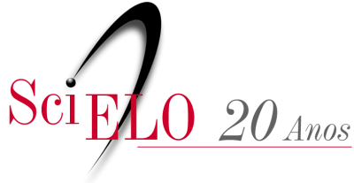
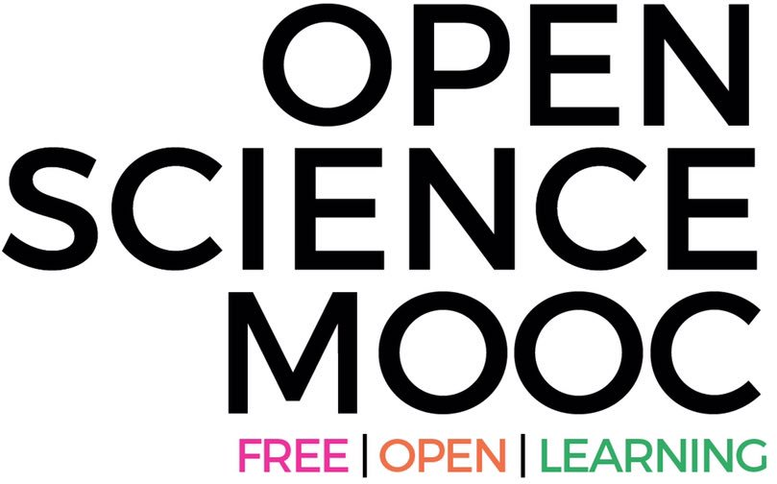
The global road to Open Science
Dr. Jon Tennant, Open Science MOOC
@protohedgehog
https://orcid.org/0000-0001-7794-0218
September 26-28, 2018, São Paulo, Brazil

Slide 2
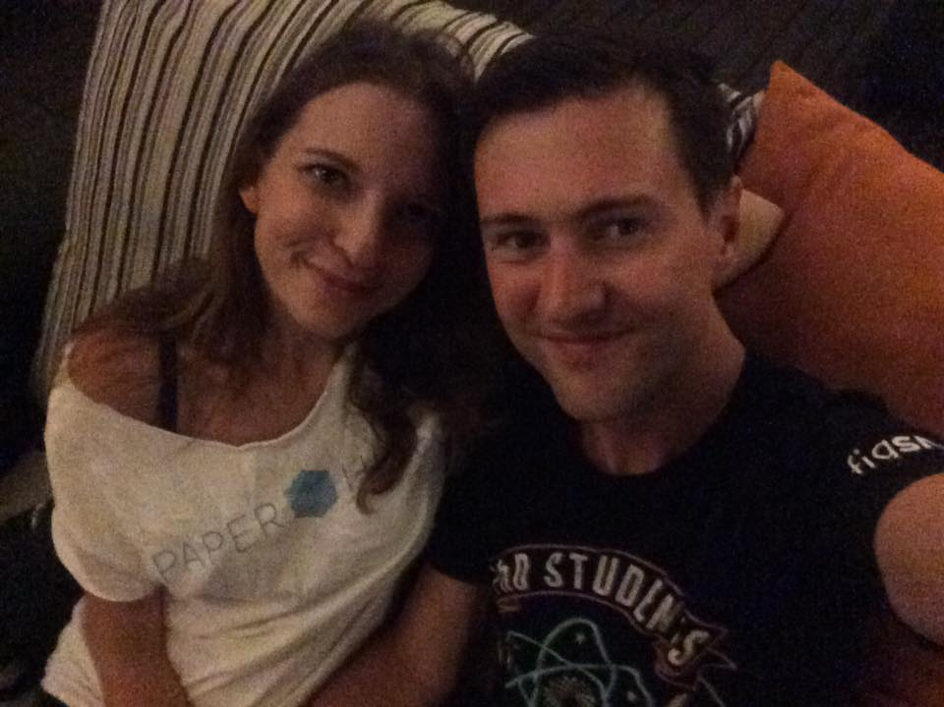
But first, an apology…
And yes, I am in a lot of trouble..

Slide 3

We are in the midst of a global access crisis
Most scholarly research remains inaccessible to most people on this planet
https://paywallthemovie.com/
@protohedgehog

Slide 4
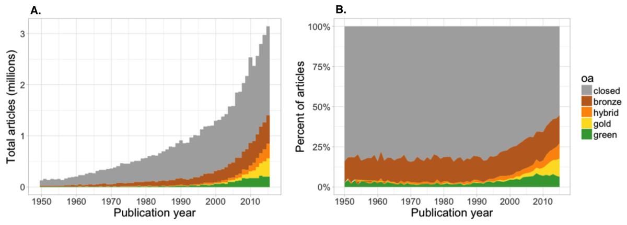
Painfully slow growth of Open Access
“We estimate that at least 28% of the scholarly literature is OA (19M in total) and that this proportion is growing, driven particularly by growth in Gold and Hybrid.” – Piwowar et al., 2018.
https://peerj.com/articles/4375/
@protohedgehog

Slide 5
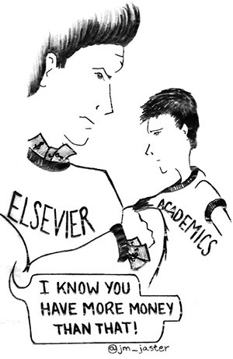

Why Open Science NOW?
We have waited long enough, and things are getting worse
Science is not working as it should be
Slow and redundant/wasteful
Ruled by commercial interests
Copyright is broken
Serials/access crisis
Reproducibility crisis
Illusion of academic freedom
Questionable research practices
Closed science means people suffer
@protohedgehog

Slide 6
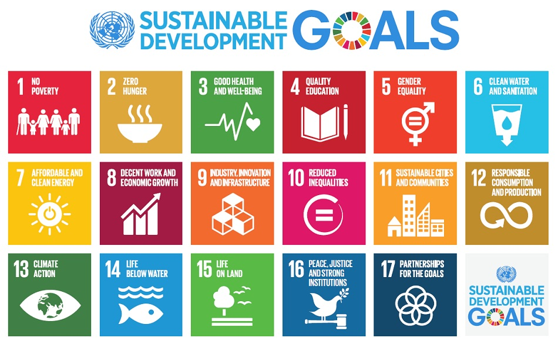
Do you believe that science can help us solve these problems?
http://www.who.int/mediacentre/events/meetings/2015/un-sustainable-development-summit/en
@protohedgehog

Slide 7
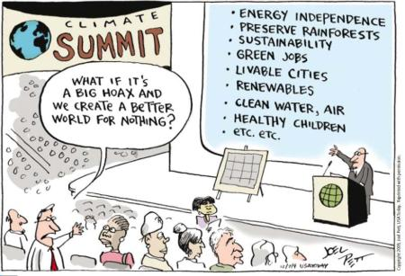
YES!
But then you also must acknowledge that by preventing access to research, we are acting against meeting these goals.
And this is what many in the scholarly publishing industry are doing. In exchange for our money.
It’s not a bug. It‘s a feature.
#NotAllPublishers
@protohedgehog

Slide 8

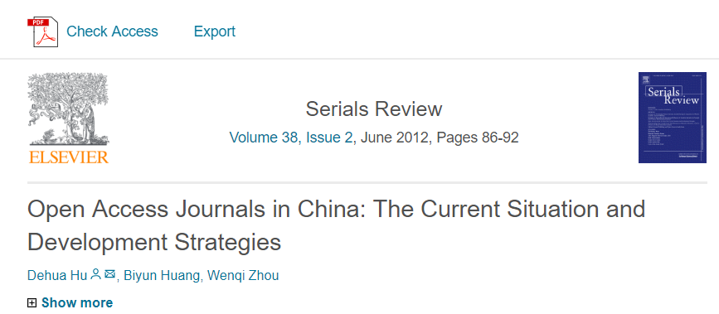
The regional landscape of OA
China: What is the most populous country in the world doing?
@protohedgehog

Slide 9
Turns out, not that much..
8114 scholarly journals indexed by the Chinese National Knowledge Information (CNKI) database
  Only 8.44% of these are fully or delayed OA
7174 indexed in the Chinese Science and Technology Paper Citation Database (CSTPCD) (as of 2016)
  Also only around 8% here are OA journals in Chinese
“The central conclusions of the study are that Chinese-language OA journals need to increase their visibility in journal indexes such as the Directory of Open Access Journals (DOAJ), and that an OA publishing platform (similar to the Latin American SciELO) should be established for Chinese-language OA journals.”
http://www.mdpi.com/2304-6775/5/4/22/htm
@protohedgehog

Slide 10
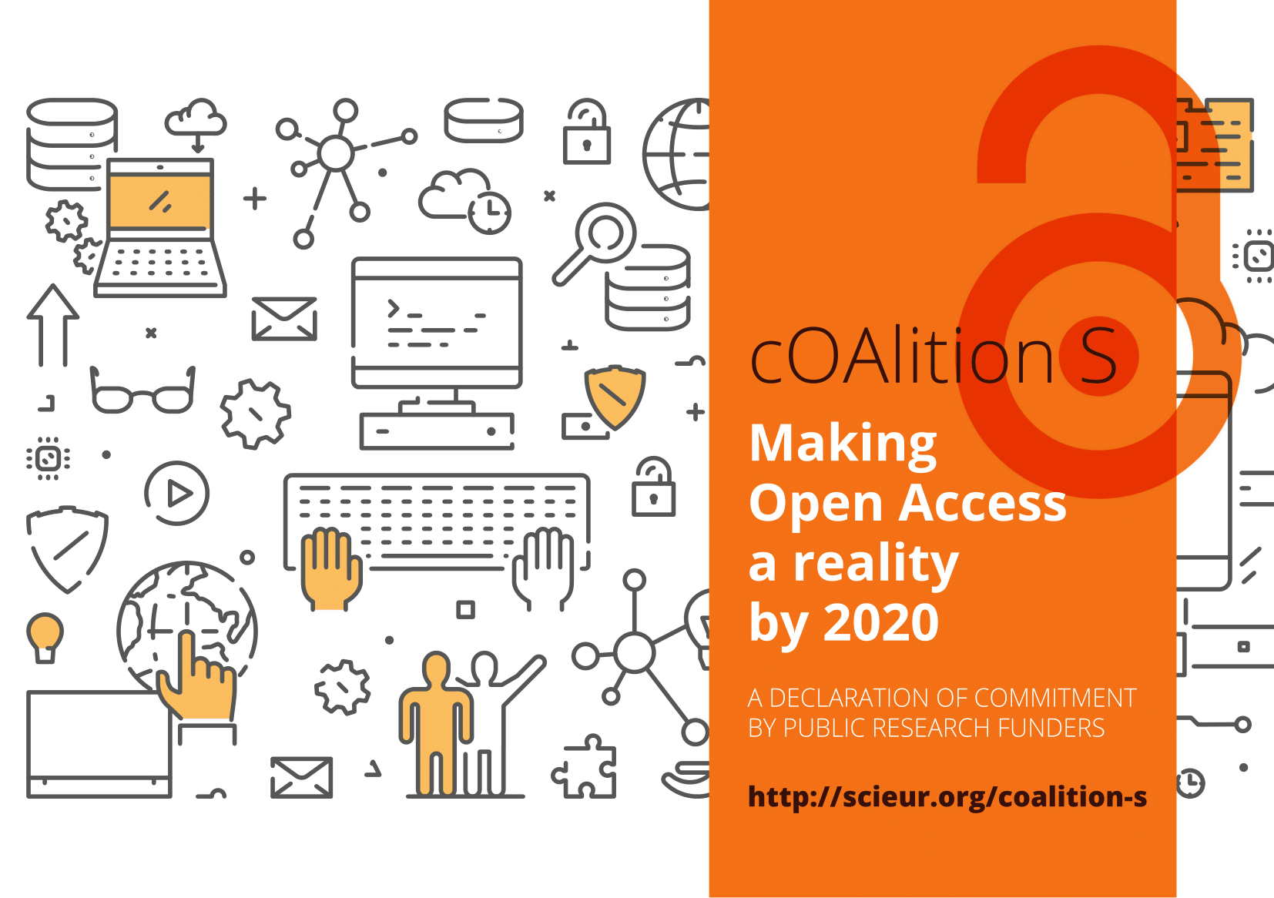
Europe: To boldly go where Latin America has been before?
https://www.scienceeurope.org/coalition-s/
@protohedgehog

Slide 11
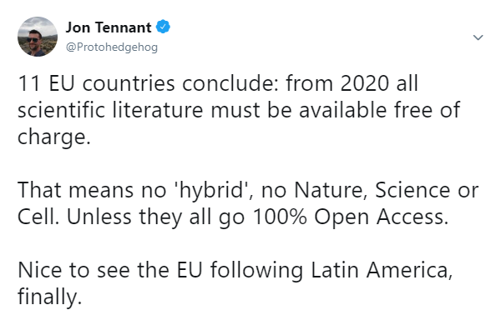
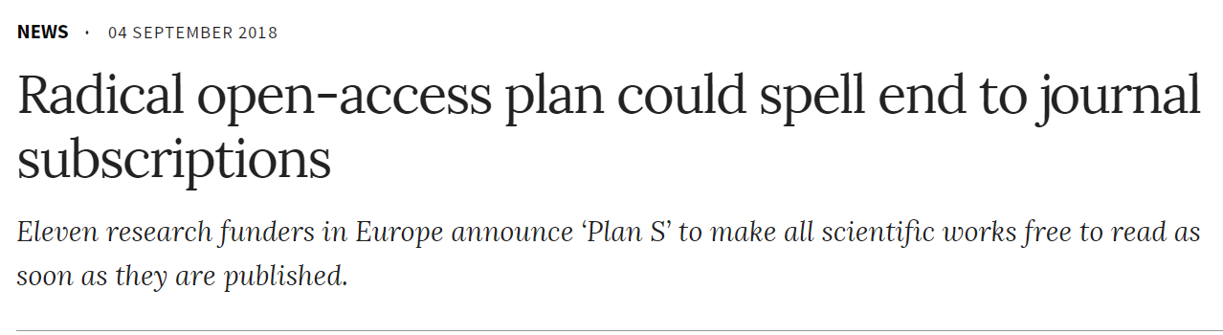
“Marie Curie Alumni Association chair Matthew DiFranco said that Plan S was a step in the right direction for “reigning in the exploitation of publicly funded research for private profits” by publishers.”
“By 2020 scientific publications that result from research funded by public grants provided by participating national and European research councils and funding bodies, must be published in compliant Open Access Journals or on compliant Open Access Platforms.”
https://www.researchresearch.com/news/article/?articleId=1377349
https://www.nature.com/articles/d41586-018-06178-7
https://twitter.com/protohedgehog/status/1036864873886412800
@protohedgehog

Slide 12
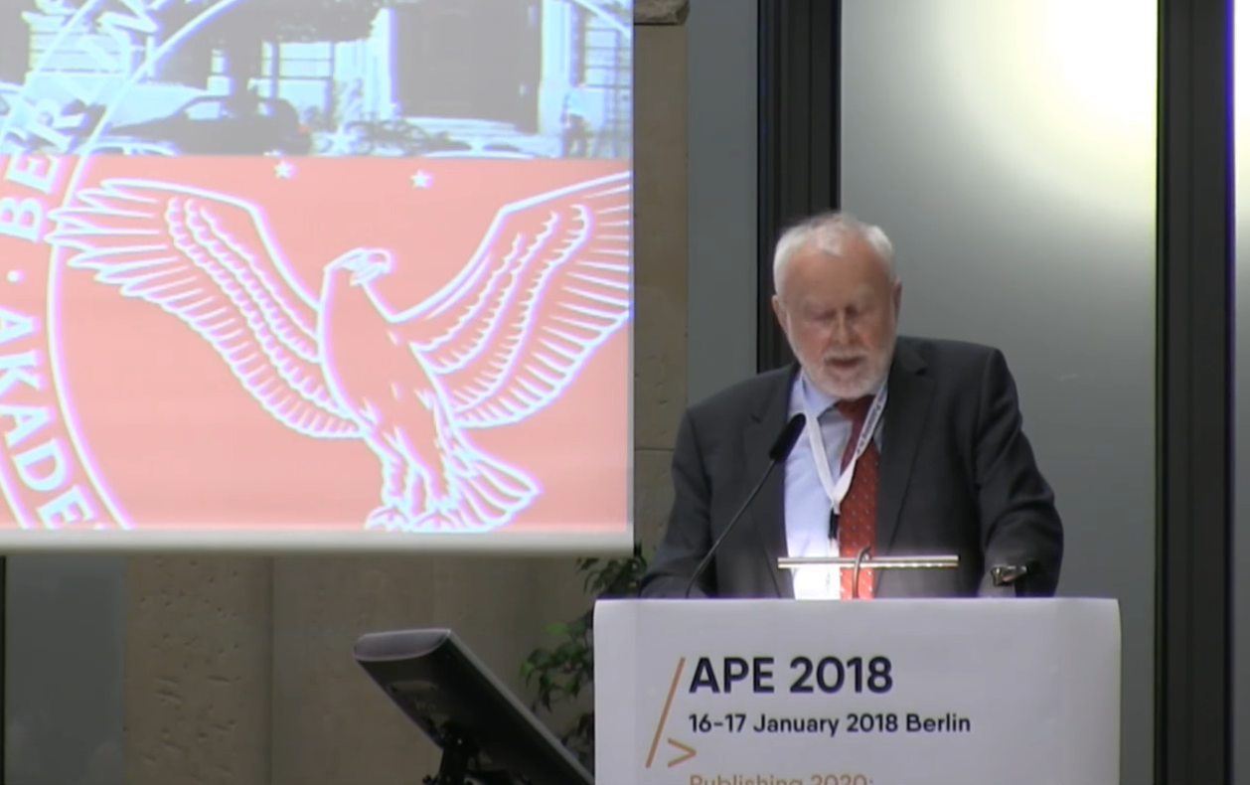
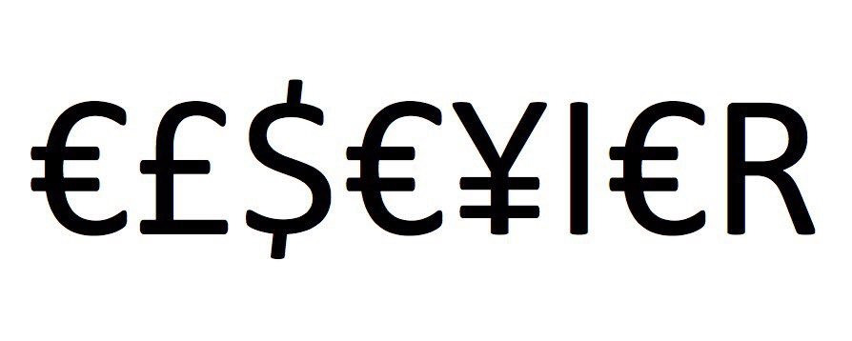
Germany versus Elsevier
“One big publisher stated: if your country stops subscribing to our journals, science in your country will be set back significantly. I responded […] it is interesting to hear such a threat from a producer of envelopes who does not have any idea of the contents.”
Martin Grötschel, President of the Berlin-Brandenburg Academy of Sciences and Humanities
#HERO
#villain
@protohedgehog

Slide 13

SciELO: the hero the world needs?
Covers Latin America, Iberian Peninsula, and South Africa (13 countries)
Around 750,000 published papers, 1,200 active journals – all OA!
20 years of free/low cost publishing for researchers
Production costs much lower than ‘western’ publishing houses
@protohedgehog

Slide 14
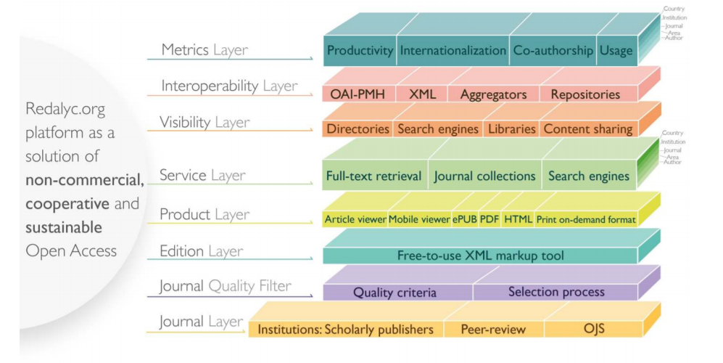
REDALYC
1,000 journals from 15 countries
425,000 full text articles
Generates bibliometric indicators too
We are so far away from anything like either of these in Europe/North America
What can the ‘western’ world learn from Latin America about doing this stuff better?
https://www.opencon2018.org/opencon_2018_latam
https://hal.archives-ouvertes.fr/hal-01816693/
@protohedgehog

Slide 15
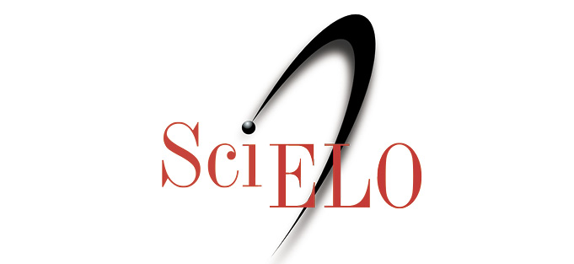

Why are SciELO/REDALYC so effective?
Strong cultural commitment and sense of public mission among Latin American universities and researchers:
  “Iberoamérican scientists especially are committed to the movement as a way to ensure that society benefits from their research.” - Victoriano Colodrón.
Have we lost this idea around much of the rest of the world?
Or have the ‘western’ publishing houses corrupted the process?
https://www.timeshighereducation.com/blog/why-open-access-publishing-growing-latin-america
@protohedgehog

Slide 16
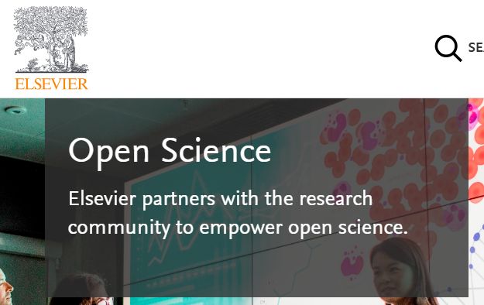
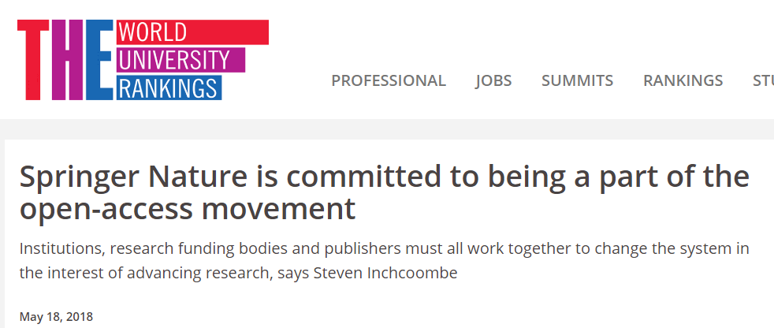
Who is leading the global change?
Elsevier?
Organisations stuck in a pre-digital mindset with a key product developed in the 17th Century.
Basically the reason why the Open Science ‘movement’ began.
Business models based on exclusion, exploitation of privilege, homogeneity, discrimination, extortion etc...
Who pay lip service to Open Science, while simultaneously subverting it to meet their own intentions.
Springer Nature?
https://www.elsevier.com/about/open-science
https://www.timeshighereducation.com/blog/springer-nature-committed-being-part-open-access-movement
@protohedgehog

Slide 17
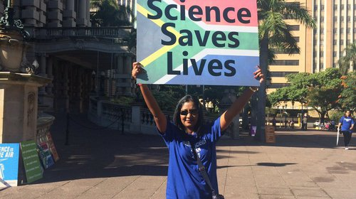
Academics? Attitudes versus practice
“60.8% of researchers do not self-archive their work even when it is free and in keeping with journal policy.”
“In a field where OA seems of practical and ethical importance for the sharing of knowledge promoting health equity, it is surprising that researchers do not make their papers available when they are legally able to do so without any cost.”
https://health-policy-systems.biomedcentral.com/articles/10.1186/s12961-017-0235-3
@protohedgehog

Slide 18
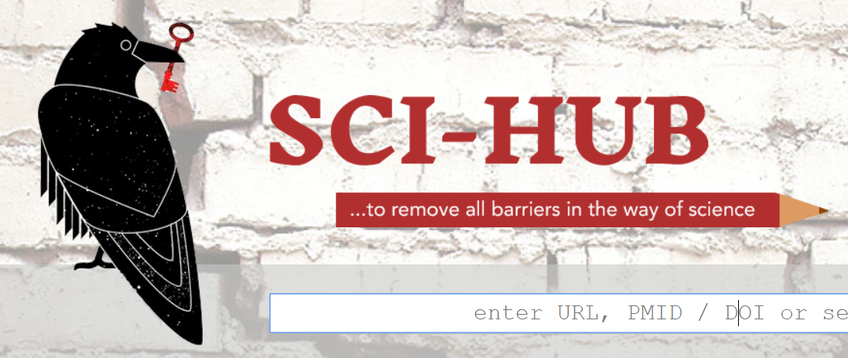
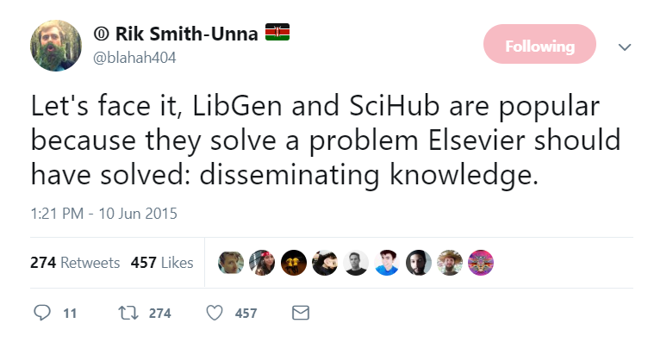
Sci-Hub: Hero or Hindrance?
70 million records+ now ‘liberated’
Sued for $15 million USD by Elsevier
And again by the ACS
Clearly provides short-term value through providing access
But has it made us lose our Open Access mojo?
http://sci-hub.tw/
https://twitter.com/blahah404/status/608609909903634432
@protohedgehog

Slide 19

What can we all achieve if we stand together?
We need to stand together as a unified global community to make sure that we are acting in the best interests of the public, not corporate gains.
#PeopleNotProfits
https://letsallstandtogether.wordpress.com/
@protohedgehog

Slide 20
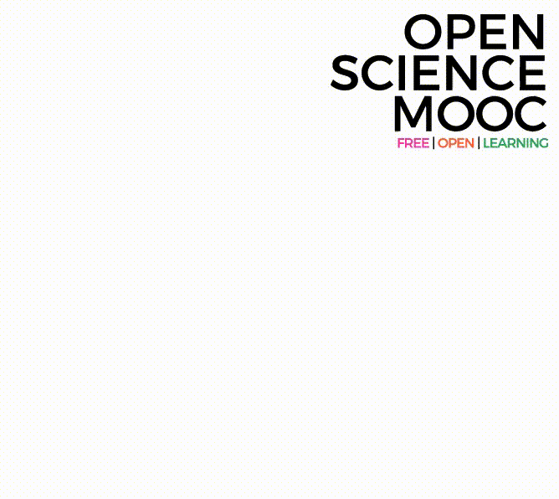
What do we need to change cultures?
Education, training, support.
Empowerment and leadership for the next generation.
Shifting power dynamics to reduce bias and abuse.
Building a global community based on sharing and collaboration.
Massive-scale engagement to re-align Open Science with current incentive structures.
@protohedgehog

Slide 21
Promising initiatives in this space
Open Science Coalition
Political and public activism
Tools, services, and infrastructure
Community engagement, training, and education
Open Scholarship Initiative
Cross-national initiatives in this space (e.g., Plan S, SciELO, OCSDnet, DOAJ, OpenAIRE)
Joint Roadmap for Open Science Tools
Open Science MOOC and Open Scholarship Strategy
Scholarly Commons (Force11)
http://elephantinthelab.org/do-we-need-an-open-science-coalition/
@protohedgehog

Slide 22
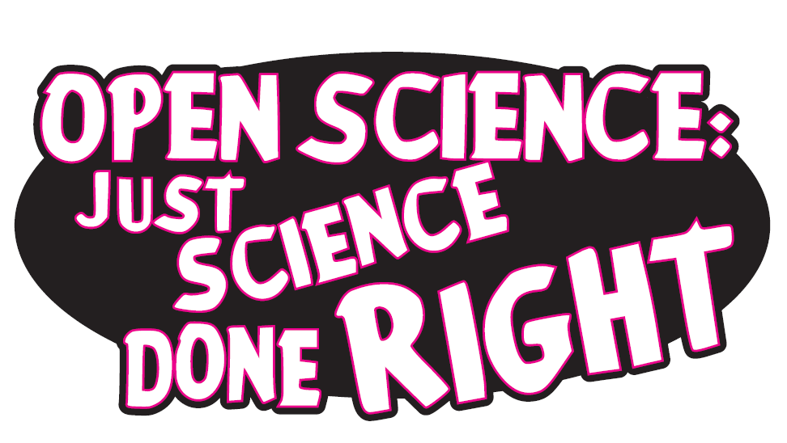
Our ultimate goal
Pooling knowledge and resources to create an open and decentralised scholarly infrastructure, with communities as the focus.
Inclusivity
Equality
Accountability
Freedom
Fairness
Justice
Truth
Rigour
Transparency
Reproducibility
SCIENCE AS A PUBLIC GOOD FOR THE BETTERMENT OF SOCIETY
Melanie Imming, & Jon Tennant. (2018, June 8). Sticker open science: just science done right.
Zenodo. http://doi.org/10.5281/zenodo.128557
@protohedgehog

