Slide 1

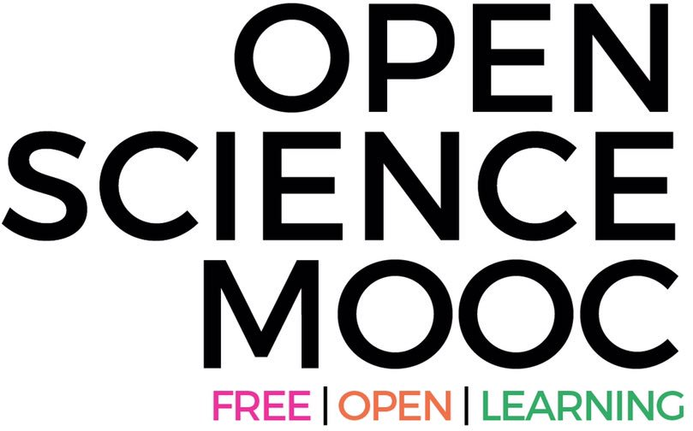

Social media, science communication, and your career
Dr. Jon Tennant
Founder, Open Science MOOC
Institute for Globally Distributed Open Research and Education
Scientists with and for society
Strasbourg, 19th October

Slide 2
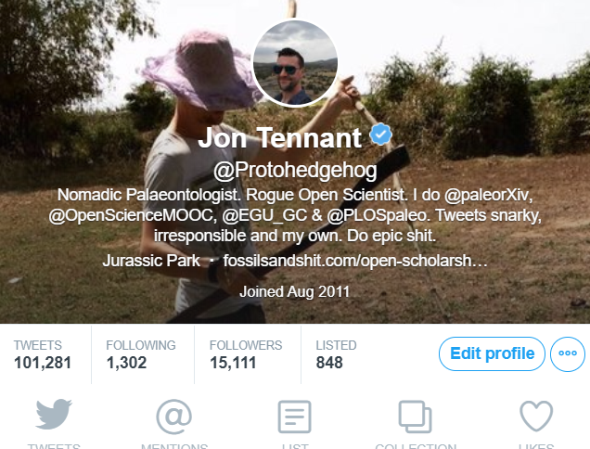
Who am I?
Procrastinate way too much on Twitter
Extensive blogging and media experience
Worked for a stint in science policy
Freelance science journalist/consultant/thing
PhD in dead things
@protohedgehog

Slide 3
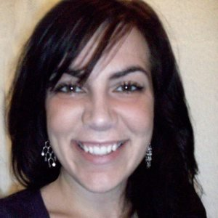
So what is all the fuss about?
Liz Neeley (2013):
Science communication is at a tipping point. For decades, we’ve making the case for broader engagement. Whether it’s framed as a moral imperative, a financial obligation, or a pragmatic undertaking, the question is settled.
“Should we?” Yes. The hard question remains “How?”
https://twitter.com/lizneeley
http://blogs.nature.com/soapboxscience/2013/05/15/science-communication-at-a-tipping-point
@protohedgehog

Slide 4
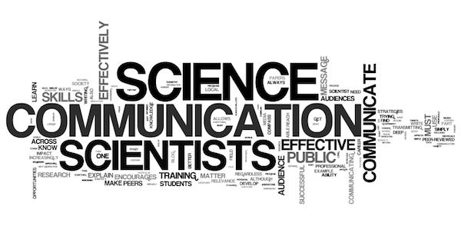
But what is ‘science communication’?
“..any activity that involves one person transmitting science-related information to another, from peer-reviewed articles to tweets.”
AKA, Public Engagement with Science
https://blogs.scientificamerican.com/guest-blog/effective-communication-better-science/
@protohedgehog

Slide 5
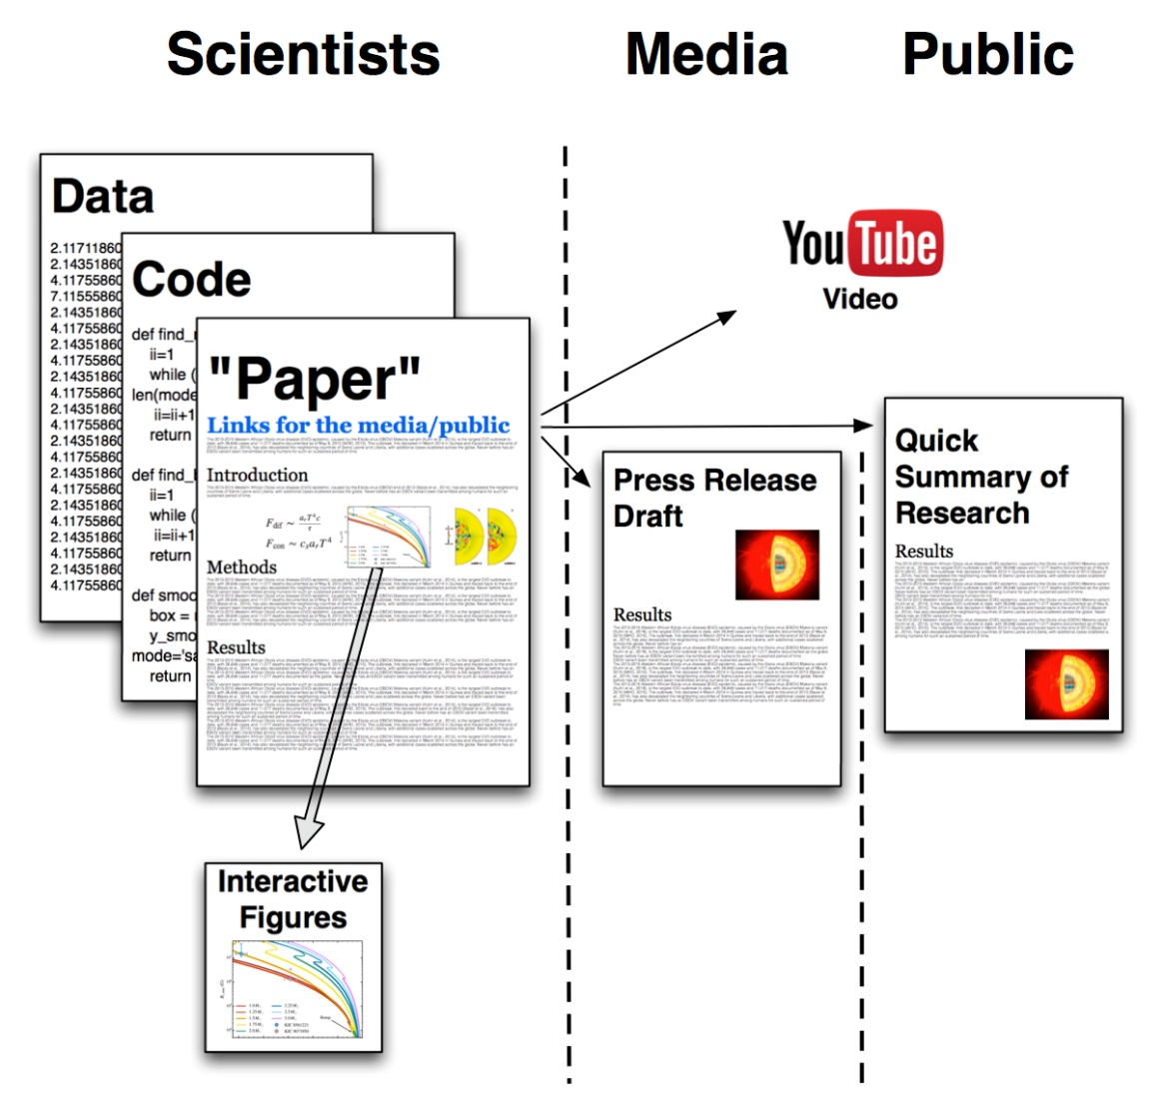
‘Traditional’ science communication
Information flow
https://www.authorea.com/users/2/articles/50890-public-friendly-open-science/_show_article
@protohedgehog

Slide 6
3 rules for effective science communication?
Rule 1: Tell people what you are going to tell them
Rule 2: Tell them the information
Rule 3 Tell the people what you just told them
NOT..
Abstract
Introduction
Methods
Results
Discussion
Conclusions
Works really well for public talks
But less so for online social engagement
@protohedgehog

Slide 7
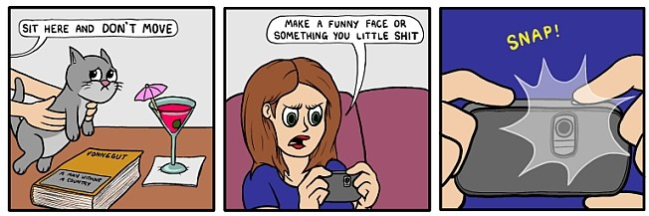
What is social media?
Whatever you want it to be
A way to mobilise the power of networks
  i.e., NOT uni-directional
Where everything happens
  If a tree falls in a forest and no-one is around to tweet it, did it really happen?
Not this..
@protohedgehog

Slide 8
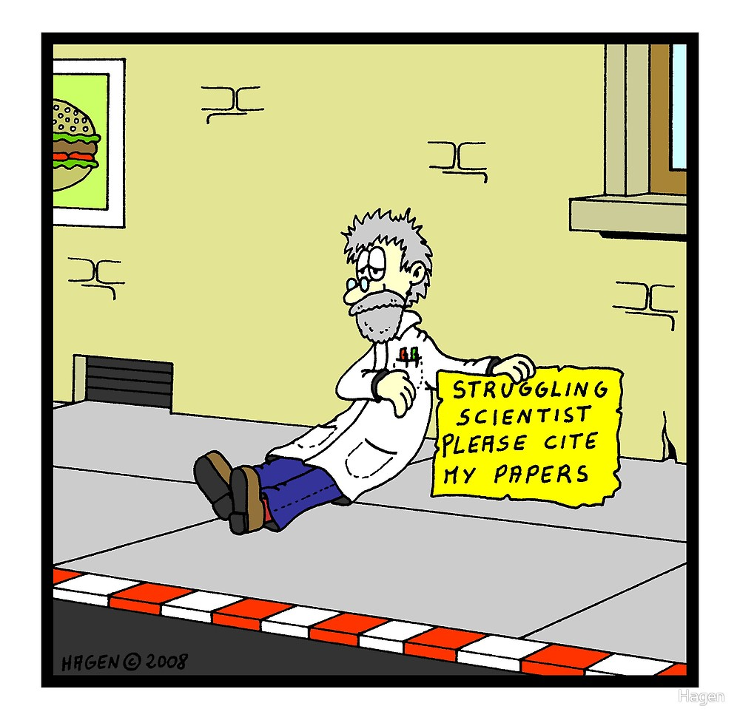
The key question
We are all looking to get a competitive edge in modern academia.
So…
What roles can social media play in the digital age of science communication? While..
  Enhancing your academic experience
  Diversifying your skill-set
  Furthering your career
@protohedgehog

Slide 9
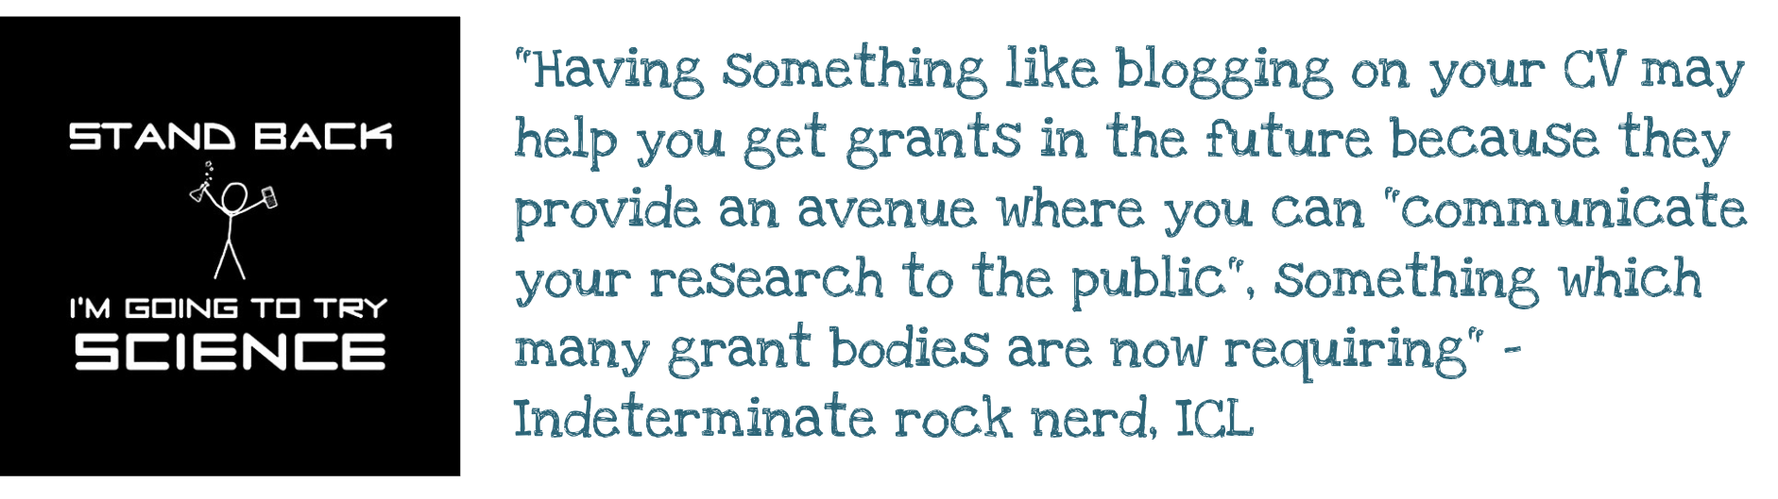
Pros
Opens up research – access and accessibility
Communication with different audiences
Impact case studies
Feedback and discussion about your work
Natural development of online profile
@protohedgehog

Slide 10
Cons
Time. Never enough time.
Privacy issues and over-sharing
Viewed as ‘self-promotion’ by some
Not peer-reviewed so seen as low quality
Can be viewed as a waste of time
  Aidan Horner:
  Views on blogging are polarised, a lot like marmite..
  Chris Chambers:
  Being anti-blogging is “narrow ivory-tower hypocritical b*ll*cks.”
@protohedgehog

Slide 11
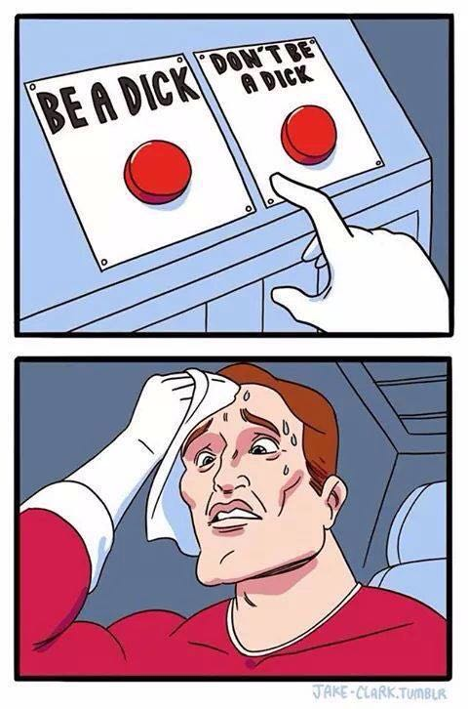
How to reconcile these?
Two key points:
Think strategically
Don’t be stupid
Communication and outreach should not be an afterthought
@protohedgehog

Slide 12
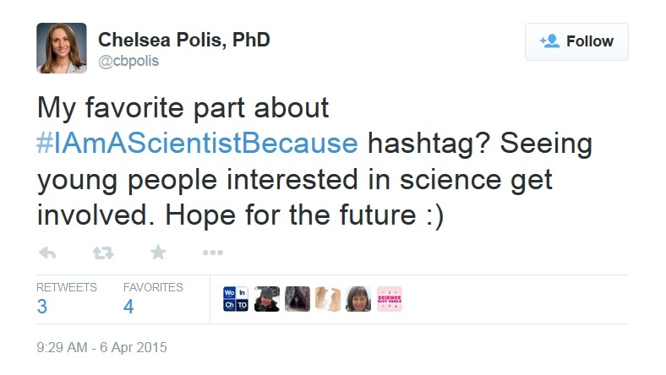
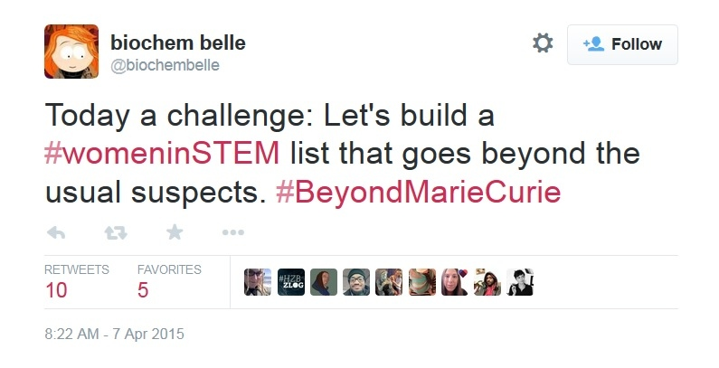
More positive points
Open science and collaboration
Networking, 21st Century style
Virtual conferences, chats, webinars
Jobs, grants, events, opportunities
Fast and dynamic – stay ahead of the game
Build your digital profile, advance your career
Open up yourself to experiences beyond your physical bubble
@protohedgehog

Slide 13
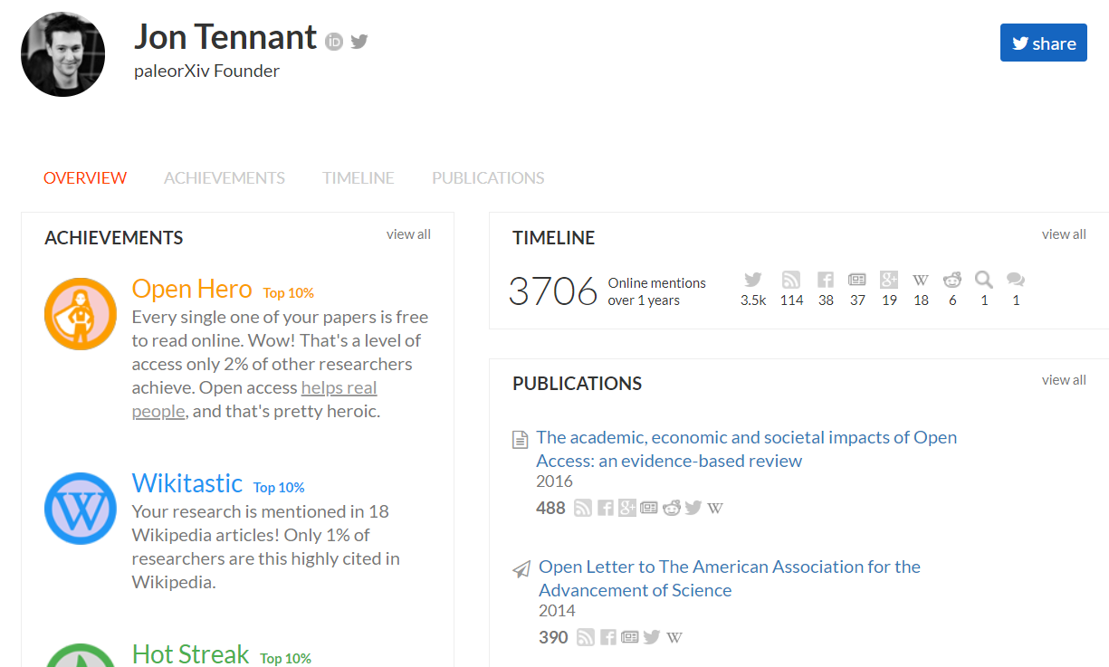
Social media: Just for scientists
Academia.edu and ResearchGate (not recommended)
Figshare, Zenodo, Open Science Framework, ScienceOpen
LinkedIn, ORCID, Altmetric, ImpactStory, Publons
All social networks designed for you to showcase your work
@protohedgehog

Slide 14
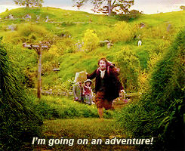
How to know if it’s worth it
Impact assessment (woooo..)
  Blog statistics (hits, comments, shares)
  Altmetrics (social media shares)
The stories and anecdotes
Being part of a community
Define your own path in life
  Find out what works for you, and own it!
  Take inspiration from others.
It’s a dangerous business, going out your door. You step onto the road, and if you don’t keep your feet, there’s no telling where you might get swept off to (Baggins, 1954).
@protohedgehog

Slide 15
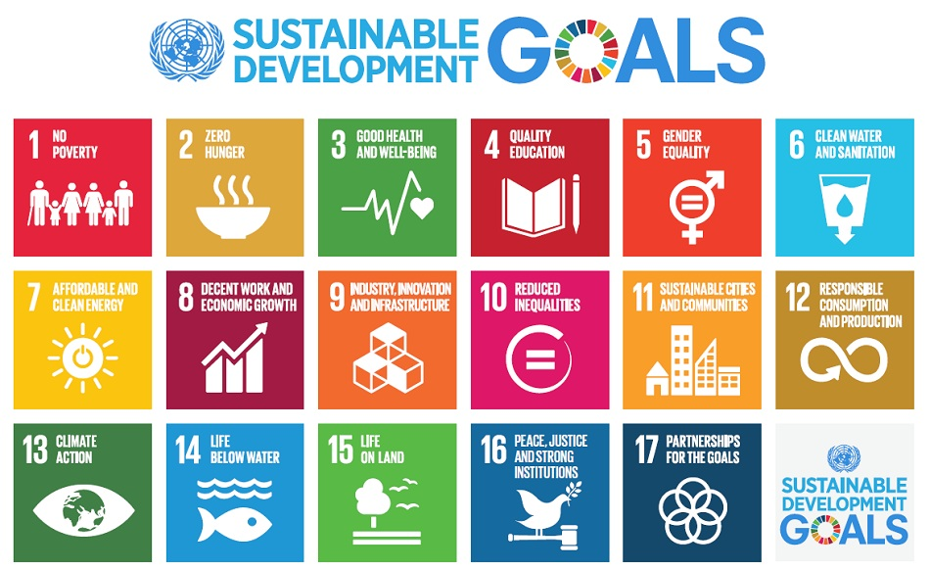
Why Open Science communication now?
Do you believe that science can help us solve these problems?
http://www.who.int/mediacentre/events/meetings/2015/un-sustainable-development-summit/en
@protohedgehog

Slide 16
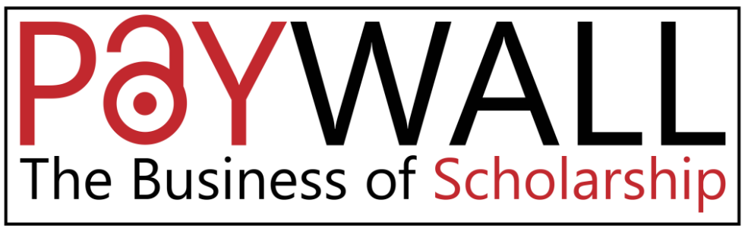
YES!
But then you also must acknowledge that by preventing access to research, we are acting against meeting these goals.
And this is what the present scholarly publishing industry is doing. In exchange for our money.
It’s not a bug. It‘s a feature.
We have to be more effective at communicating our research.
https://paywallthemovie.com/
@protohedgehog

Slide 17
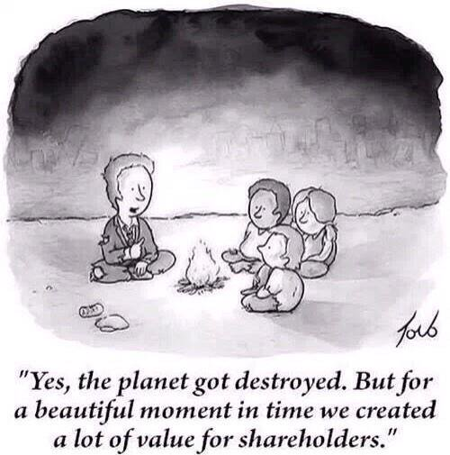
Why is sci comm so important now?
Things are getting worse
  Low/variable public trust in science
  Reproducibility/accessibility crises
  Co-option of Open Science
  Commercial interests strengthening
We have to act now, as a global community, and take control of the communication of Science.
@protohedgehog

Slide 18
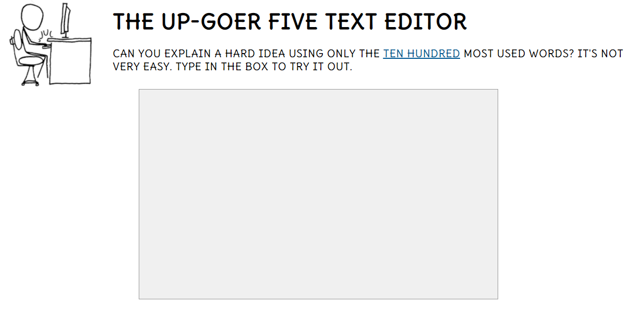
Pro-tips 1:
Be patient. Don’t expect to become an expert or viral overnight.
This is a skill and takes training – TEST BELOW!!
Don’t self-promote, let your work do the talking.
Be strategic (i.e., think about what you are doing)
http://splasho.com/upgoer5/
@protohedgehog

Slide 19
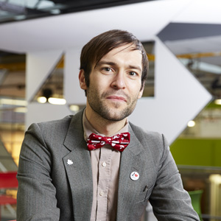
Pro-tips 2:
Establishing trust is critical. Why should people listen to you?
Maintain independence and neutrality.
Don’t fall for the ‘deficit model’.
You are an informer, not an advocate. Science speaks.
Be engaging, not uni-directional.
Don’t be intimidated.
Find out what your unique angle is.
Never lose sight of the message in favour of the story.
https://twitter.com/samillingworth
@protohedgehog

Slide 20

What does it all mean?
As the open science movement is demonstrating, the solitary genius of individuals is rarely superior to the speed and power of expert networks. We are stronger, wiser, and more creative as a community. And we are going to need all of that.
Liz Neeley (2013).
The ultimate goal:
SCIENCE AS A PUBLIC GOOD FOR THE BETTERMENT OF SOCIETY
https://letsallstandtogether.wordpress.com/
@protohedgehog

Slide 21
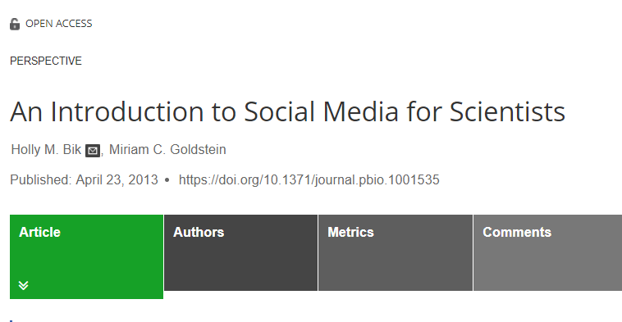
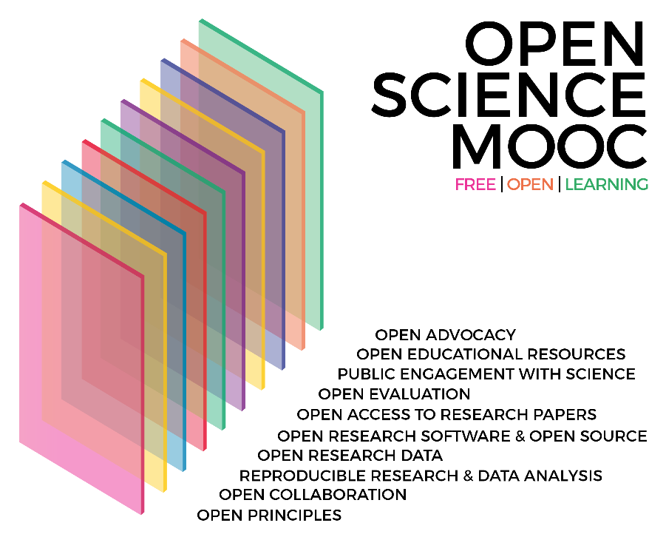
Learn more!
http://journals.plos.org/plosbiology/article?id=10.1371/journal.pbio.1001535
https://github.com/OpenScienceMOOC/Module-8-Public-Engagement-with-Science
@protohedgehog

