Slide 1

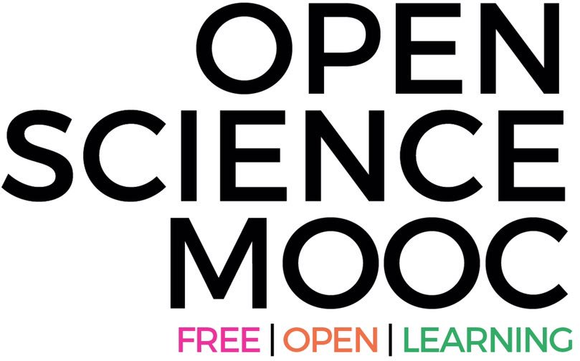
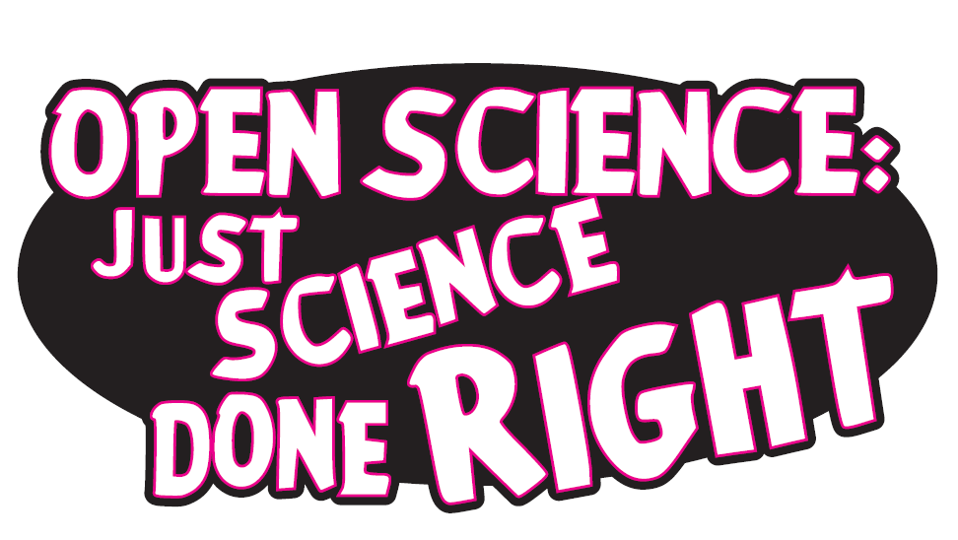
Dr. Jon Tennant
Institute for Globally Distributed Open Research and Education (IGDORE)
Founder Open Science MOOC; paleorXiv
Seminar on Reproducibility and Open Research 10 October, Oxford, UK
https://orcid.org/0000-0001-7794-0218

Slide 2

We are in the midst of a global scientific crisis
https://paywallthemovie.com/
There are four major crises: Access, Reproducibility, Serials, Evaluation
#ARSEcrisis
Previous slide: Melanie Imming, & Jon Tennant. (2018, June 8). Sticker open science: just science done right.
Zenodo. http://doi.org/10.5281/zenodo.128557
@protohedgehog

Slide 3
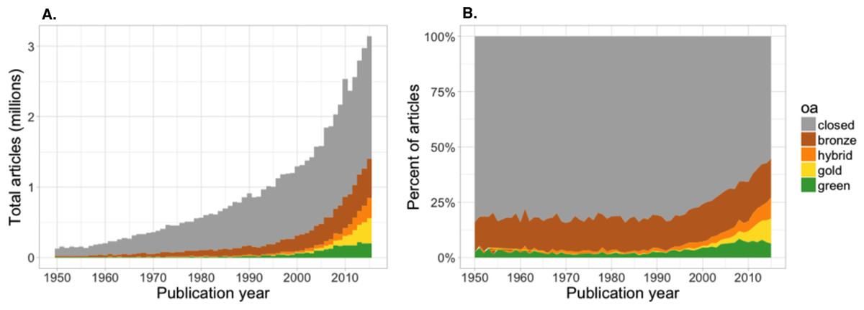
1. The Access Crisis
A graphical visualisation
of how bad this is
Most scholarly research remains inaccessible to most people on this planet
“We estimate that at least 28% of the scholarly literature is OA (19M in total) and that this proportion is growing, driven particularly by growth in Gold and Hybrid.” – Piwowar et al., 2018.
https://peerj.com/articles/4375/
@protohedgehog

Slide 4
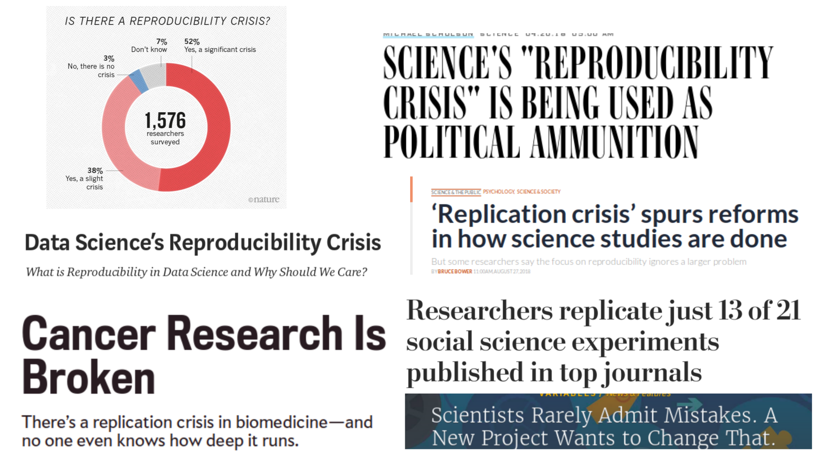
2. The Reproducibility Crisis
Slide courtesy of Rebecca Willen
Much research in many fields cannot be sufficiently reproduced

Slide 5
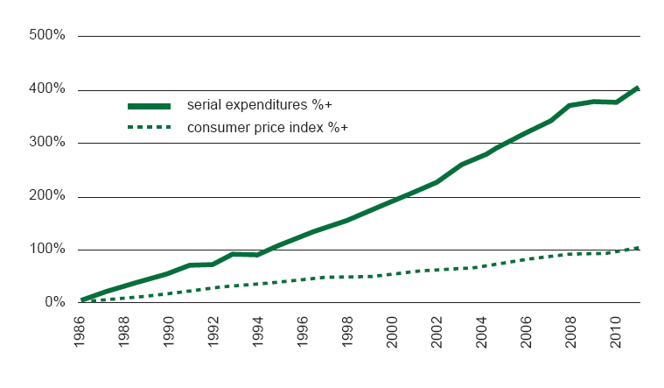
3. The Serials Crisis
Commercial publishers are draining our libraries dry
https://publications.parliament.uk/pa/cm201314/cmselect/cmbis/99/9905.htm
@protohedgehog

Slide 6
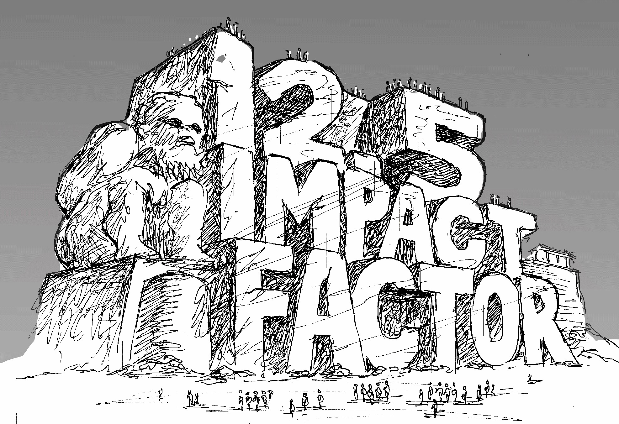
4. The Evaluation Crisis
All hail the sacred impact factor (aka Glam-humping)
http://whyopenresearch.org/impactfactor
@protohedgehog

Slide 7
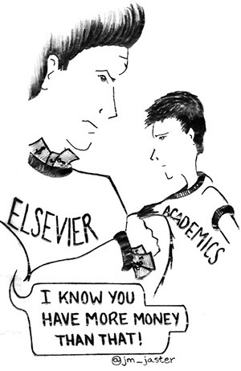

Why “Open Science”?
These things have been going on for long enough, and things are getting worse
Science is not working as it should be
Slow, redundant, and wasteful
Ruled by commercial interests
Copyright is broken
The four major crises
Illusion of academic freedom
Questionable research practices
Closed science means people suffer
@protohedgehog

Slide 8
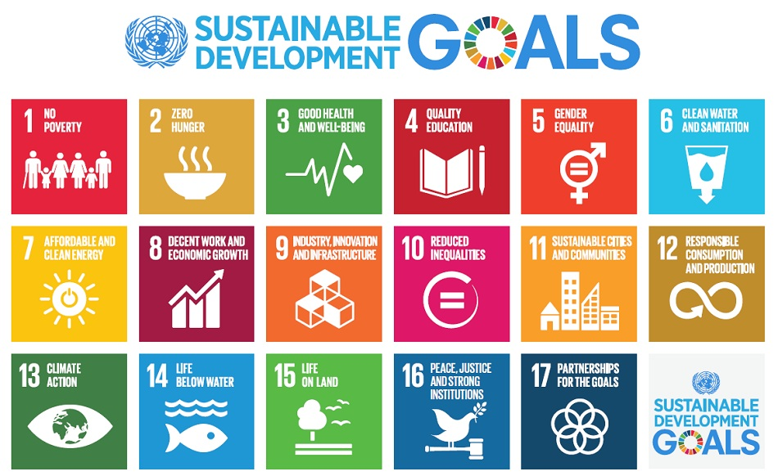
Do you believe that science can help us solve these problems?
http://www.who.int/mediacentre/events/meetings/2015/un-sustainable-development-summit/en
@protohedgehog

Slide 9
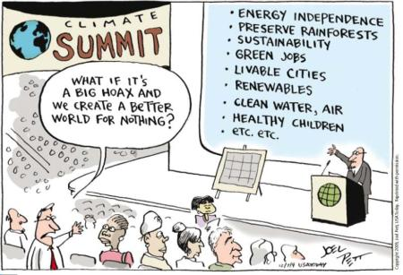
YES!
But then you also must acknowledge that by preventing access to research, we are acting against meeting these goals.
And this is what many in the present scholarly publishing industry are doing. In exchange for our money.
It’s not a bug. It‘s a feature.
@protohedgehog

Slide 10
For researchers, it‘s like going to a restaurant, bringing all of your own ingredients, cooking the meal yourself, and then being charged $40 for a waiter to bring it out on a plate for you.
  You are the provider, the product, and the consumer.
@protohedgehog

Slide 11
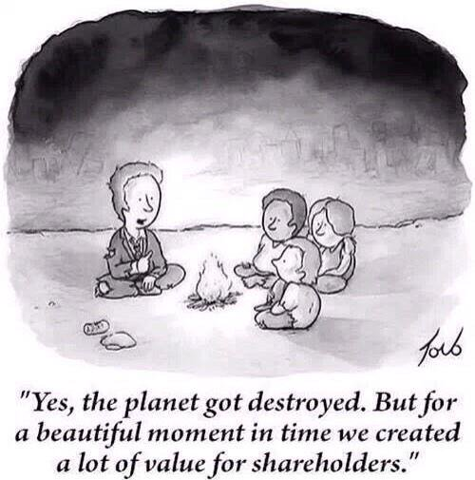
Why Open Science now?
Things are getting worse
  Lower public trust in science
  Co-option of Open Science
  Commercial interests strengthening
  Ownership of scholarly infrastructure
We have to act now, as a global community and take control of [Open] Science.
@protohedgehog

Slide 12
But...what is “Open Science”, exactly?
Open Science is the movement to make scientific research, data and dissemination accessible to all levels of an inquiring society, amateur or professional. (Wikipedia)
or…
Open Science represents a new approach to the scientific process based on cooperative work and new ways of diffusing knowledge by using digital technologies and new collaborative tools. (European Commission)
or…
Open Science is a value-based approach to science in order to help address the major challenges to society, and undo the damage that commercial interests have done in the last half century. (Moi)
@protohedgehog

Slide 13
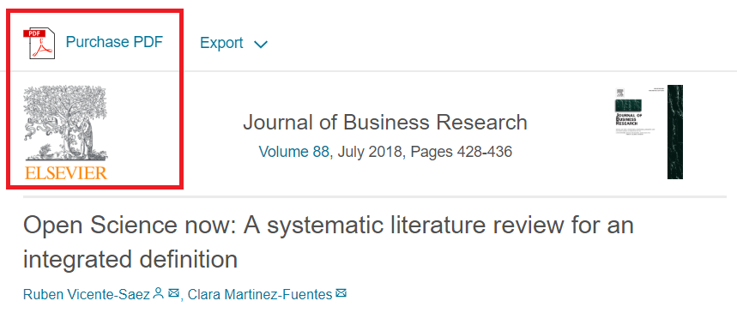
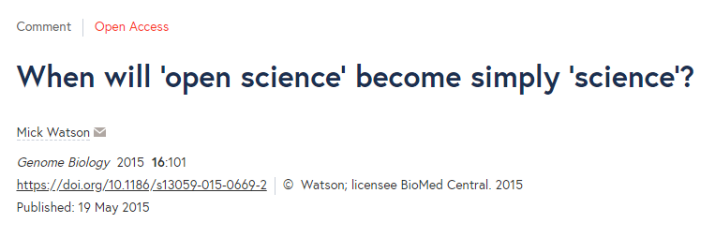
I feel like often we talk about “open science” as a different entity to “science”.
@biomickwatson
“Open Science is transparent and accessible knowledge that is shared and developed through collaborative networks.”
“Open science describes the practice of carrying out scientific research in a completely transparent manner, and making the results of that research available to everyone. Isn’t that just ‘science’?”
THIS IS VERY BAD
THIS IS VERY GOOD
But could still be improved
https://genomebiology.biomedcentral.com/articles/10.1186/s13059-015-0669-2
https://www.sciencedirect.com/science/article/abs/pii/S0148296317305441
@protohedgehog

Slide 14
What’s the fuss?
Because OS has become a poorly-defined process- based concept
Divorced from any human, value-based element
Treated as distinct from ‘good’ science
This makes it very easy AGAIN for commercial interests to co-opt
(which they are)
Or to be used as a political slogan to gain brownie points
(which it also is)
Or is this just a case of scholarly pedantry…
@protohedgehog

Slide 15
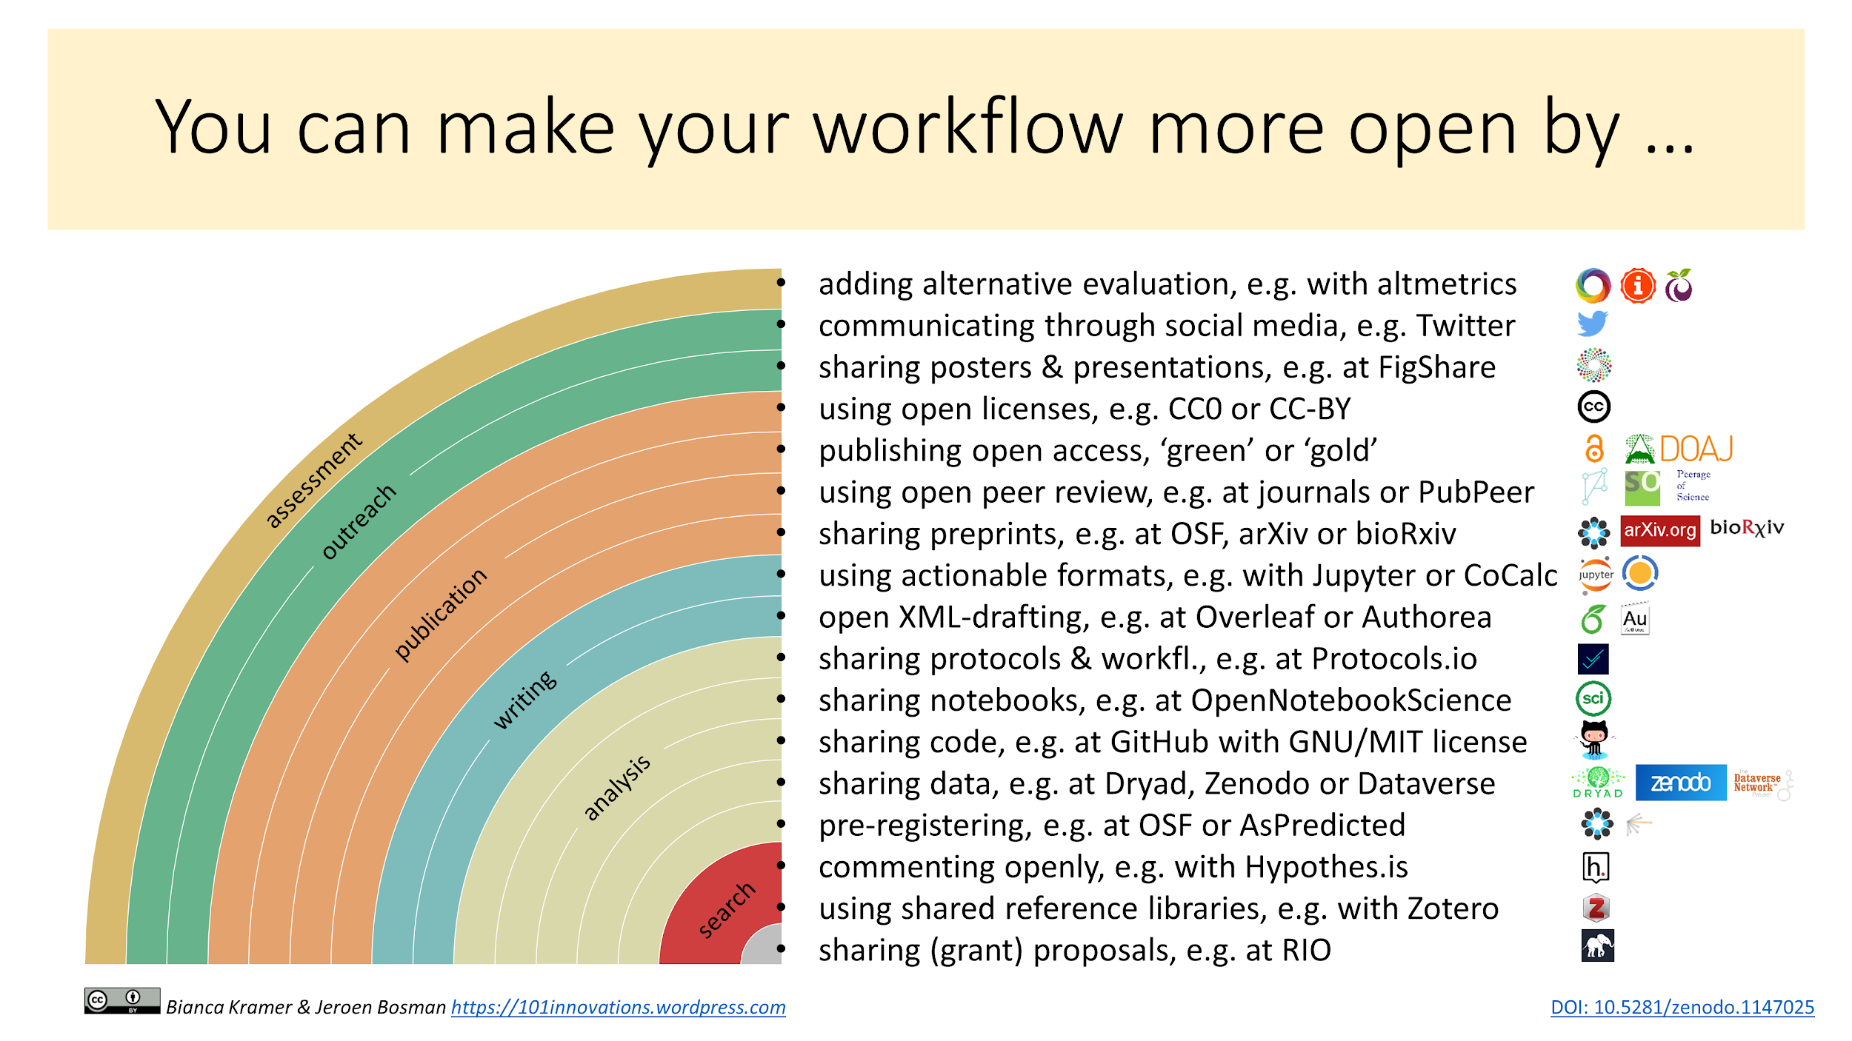

Slide 16
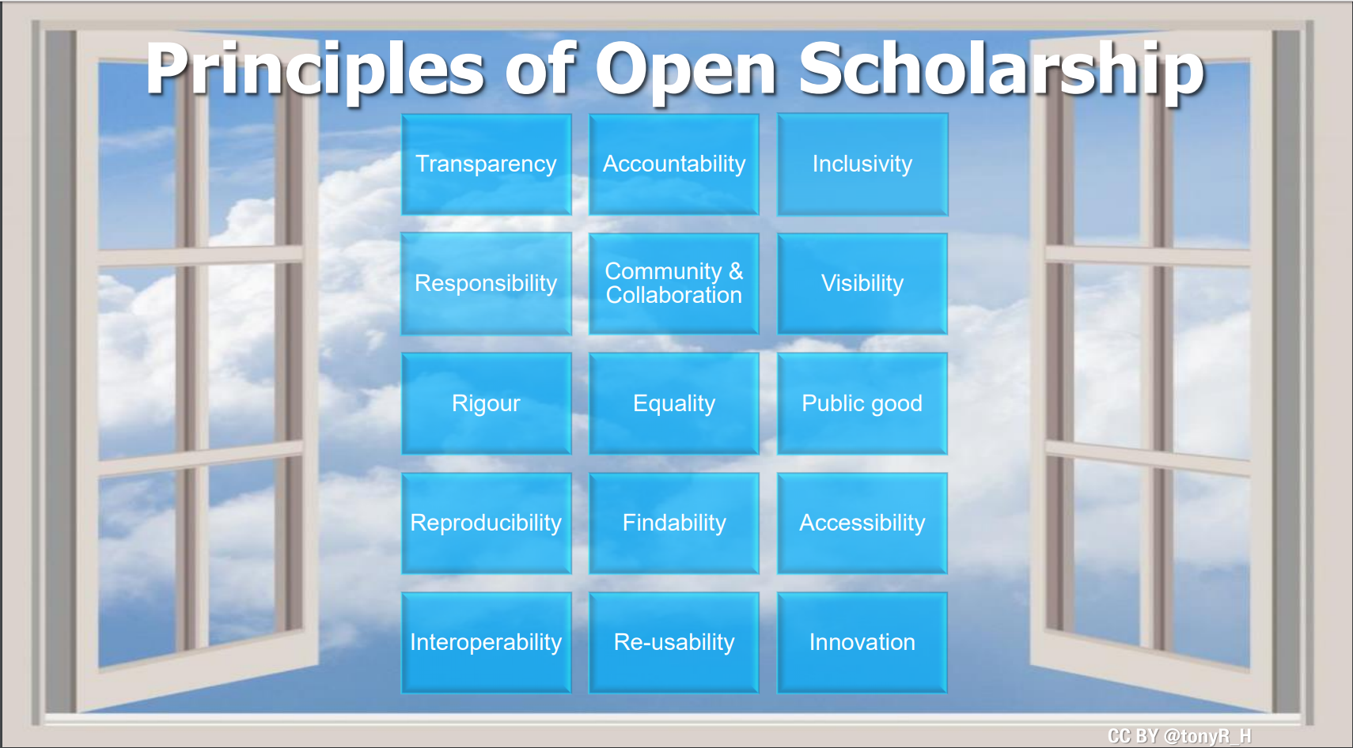
Freedom
Fairness
Justice
Truth
Liberty
FAIR principles
TOP guidelines
Principles of Open Scholarship, by Tony Ross-Hellauer (Source, CC BY).

Slide 17
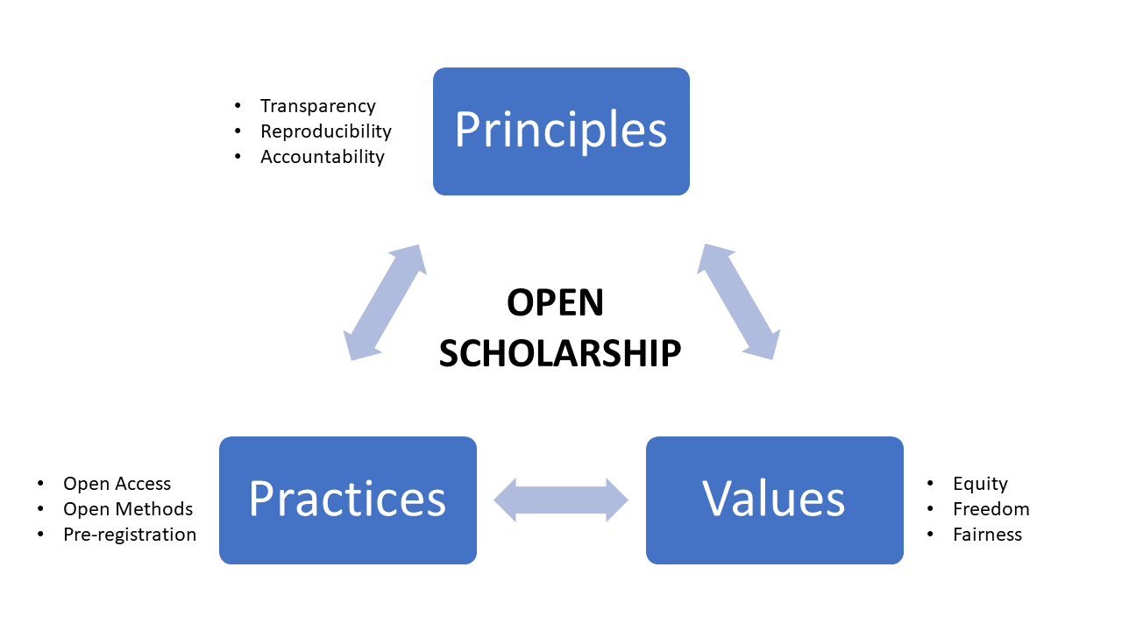
@protohedgehog

Slide 18
Ask the audience
For you, is Open Science:
A process? An ideal? A vision? A principle? A club? A political agenda? A fad? A distraction? Exclusive?
People have called it all of these at one point or another…
@protohedgehog

Slide 19
Is Open Science a ‘movement’?
“..a group of people working together to advance their shared political, social, or artistic ideas.”
  Movements have a direction.
  Movements have shared goals.
  Movements are defined by commonality.
Who is defining these for Open Science?
Who is leading this movement?
What happens if you’re ‘outside’ this movement?
What happens when a ‘movement’ can’t answer these questions..?
@protohedgehog

Slide 20
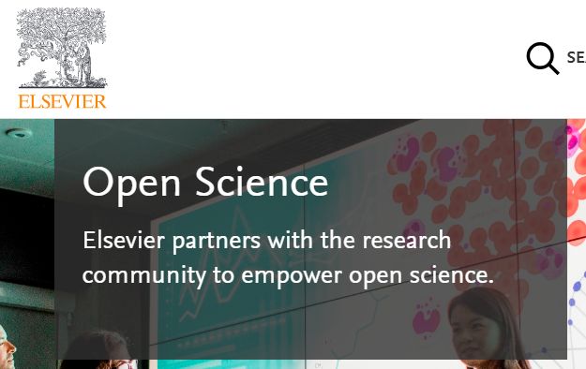
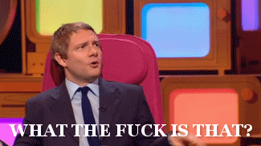
Who is leading the change?
Elsevier?
Springer Nature?
Organisations stuck in a pre-digital mindset with a key product developed in the 17th Century.
Basically the reason why the Open Science ‘movement’ began.
Business models based on exclusion, exploitation of privilege, discrimination, extortion..
Who pay lip service to Open Science, while simultaneously subverting it to meet their own intentions.
@protohedgehog

Slide 21

Western publishers: Evolve or Die
Page 99 of the Springer Nature IPO* prospectus:
“We also aim at increasing APCs by increasing the value we offer to authors through improving the impact factor and reputation of our existing journals.”
https://www.timeshighereducation.com/blog/linking-impact-factor-open-access-charges-creates-more-inequality-academic-publishing
*failed, lol
@protohedgehog

Slide 22
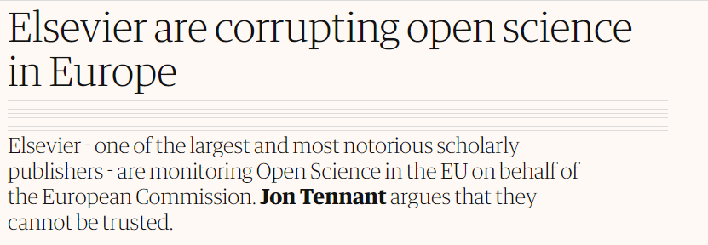
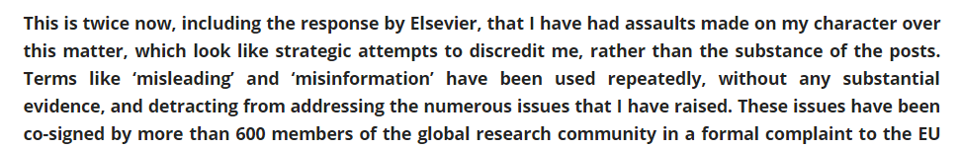
Recent events have been a bit odd…
Now with 1100+ supporting signatures!!
Elsevier and the Lisbon Council get miffed and respond..
http://fossilsandshit.com/response-to-president-paul-hofheinz-of-the-lisbon-council-regarding-elsevier-and-the-open-science-monitor/
@protohedgehog

Slide 23
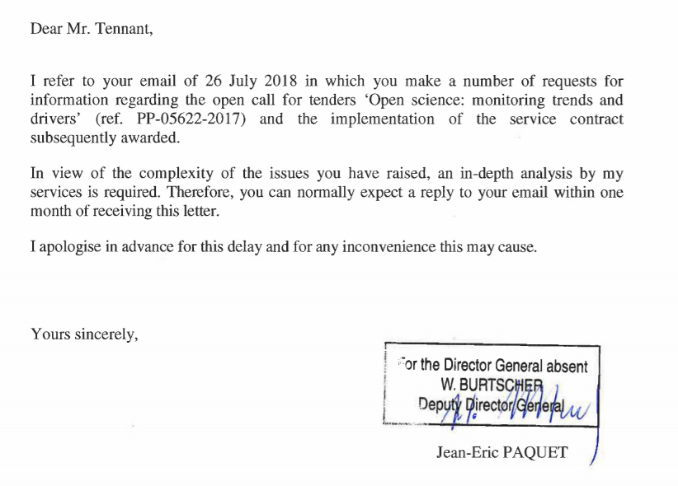
Cough
Dated 28th August
https://zenodo.org/record/1405079#.W5dYdej7RPY
@protohedgehog

Slide 24
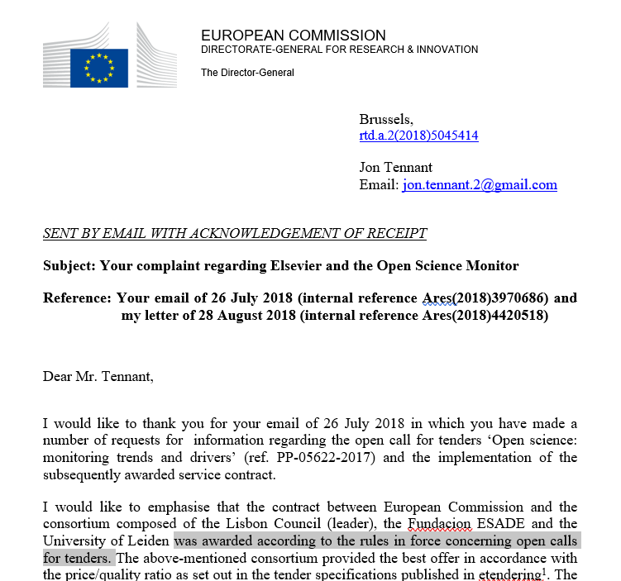
They responded!
But they failed to adequately address the role of Elsevier, the COIs, some of the suspicious circumstances surrounding the award…
Their response is being annotated here for a counter-reply:
https://docdrop.org/pdf/Annex-to-letter-to-Jon-Tennant-1--BbPfR.pdf/?
https://zenodo.org/record/1443395?#.W724P2j7RPY
@protohedgehog

Slide 25
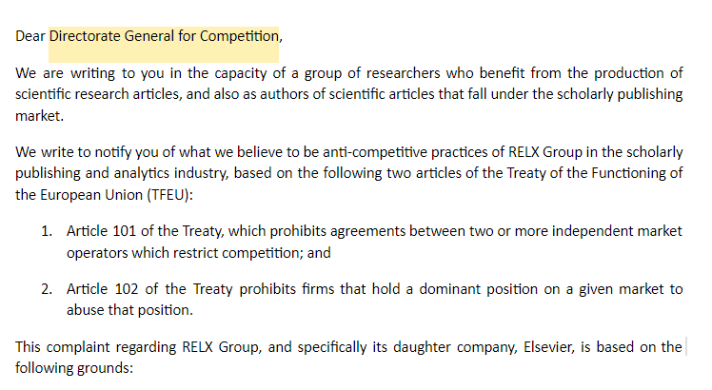
Always be two steps ahead
@protohedgehog

Slide 26
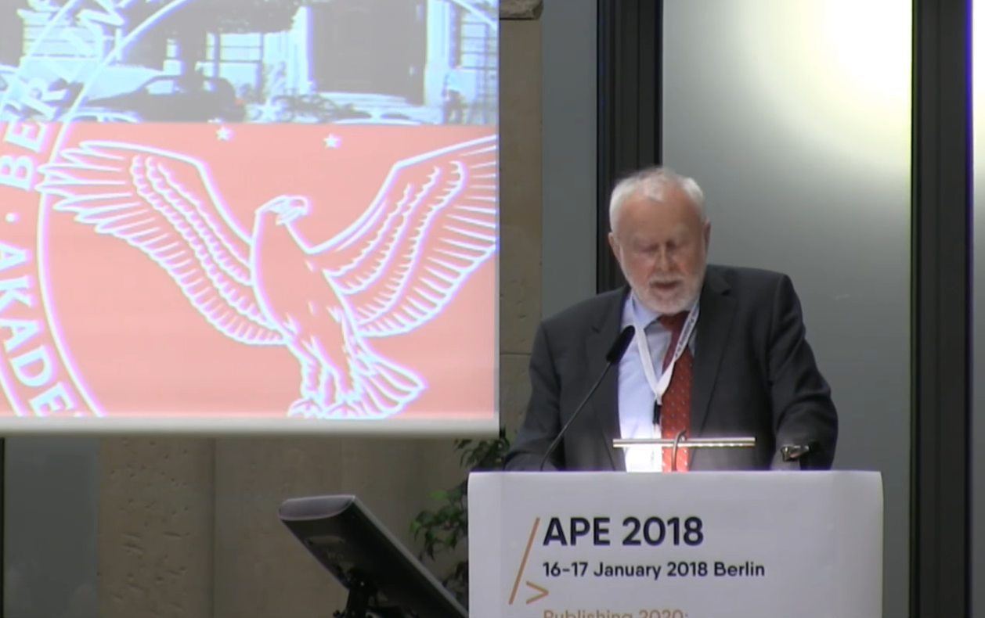
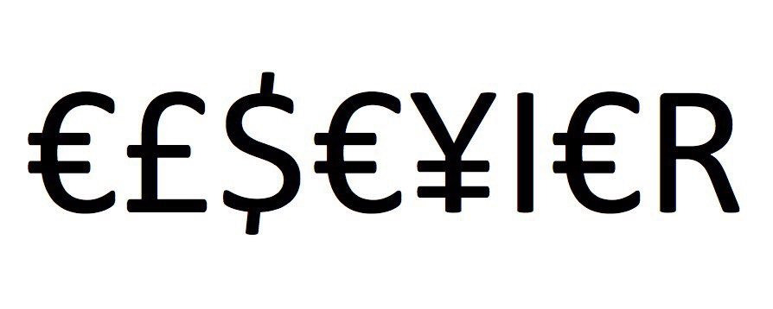
Germany versus Elsevier
“One big publisher stated: if your country stops subscribing to our journals, science in your country will be set back significantly. I responded […] it is interesting to hear such a threat from a producer of envelopes who does not have any idea of the contents.”
Martin Grötschel, President of the Berlin-Brandenburg Academy of Sciences and Humanities
#HERO
#villain
@protohedgehog

Slide 27
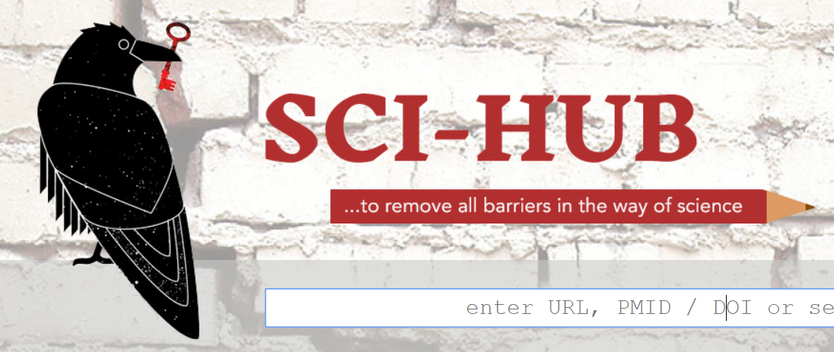
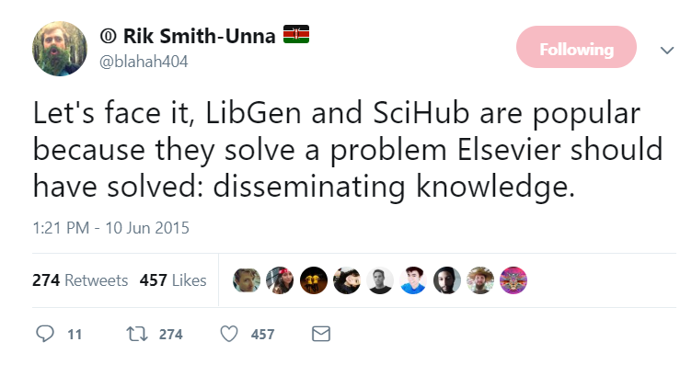
Sci-Hub: Hero or Hindrance?
70 million records+ now ‘liberated’
Sued for $15 million USD by Elsevier
And again by the ACS ($6.5 million)
Clearly of short-term value through providing access
But has it made us lose our Open Access mojo?
http://sci-hub.tw/
https://twitter.com/blahah404/status/608609909903634432
@protohedgehog

Slide 28

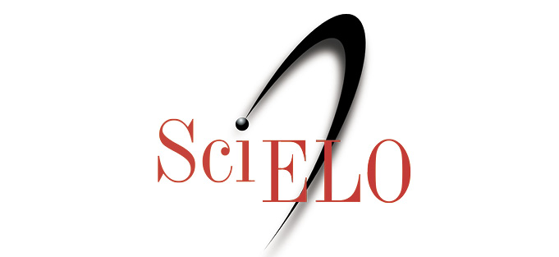
Latin America: Doing this sh*t properly.
SciELO: Covers Latin America, Iberian Peninsula, and South Africa (13 countries)
Around 750,000 published papers, 1,200 active journals – all OA!
20 years of free/low cost publishing
  i.e., they were doing Open Access before it was even called Open Access…
Production cheaper than ‘western’ publishers
@protohedgehog

Slide 29

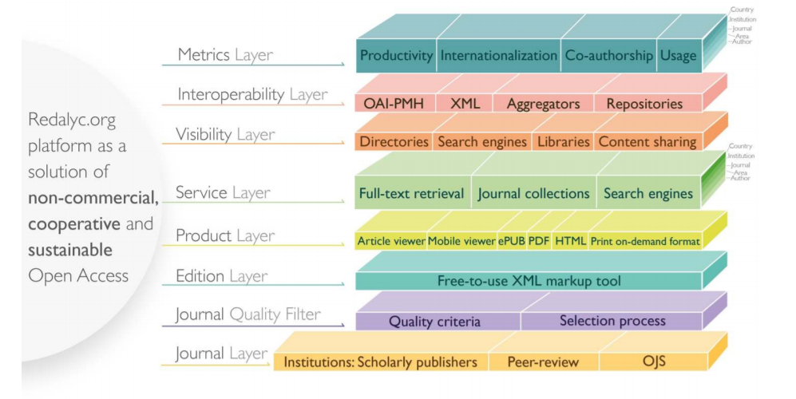
REDALYC
1,000 journals from 15 countries
425,000 full text articles
Generates bibliometric indicators too
We are so far away from anything like either of these in Europe/North America
What can the ‘western’ world learn from Latin America?
https://www.opencon2018.org/opencon_2018_latam
https://hal.archives-ouvertes.fr/hal-01816693/
@protohedgehog

Slide 30
Why are SciELO/REDALYC so effective?
Strong cultural commitment and sense of public mission among Latin American universities and researchers:
  “Iberoamérican scientists especially are committed to the movement as a way to ensure that society benefits from their research.” - Victoriano Colodrón.
Have we lost this idea around much of the rest of the world?
Or have the ‘western’ publishing houses corrupted the process?
https://www.timeshighereducation.com/blog/why-open-access-publishing-growing-latin-america
@protohedgehog

Slide 31
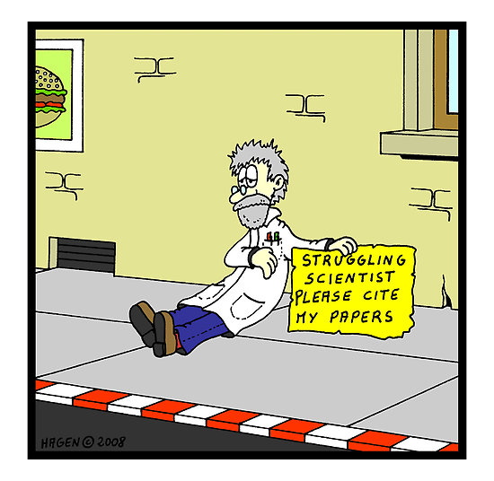
What does it all come down to?
Incentives, careers, scientists being suspiciously human creatures

Slide 32
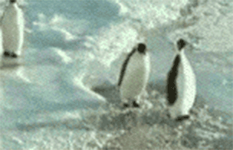
Have you ever met an average academic?
50% of academics are stupider than the average academic.
A system defined by cultural inertia.
Publish or perish mentality is still strong.
Generally terrified of new technologies.
What happened to doing good science? What are the incentives for that?
We are all penguins.
@protohedgehog

Slide 33
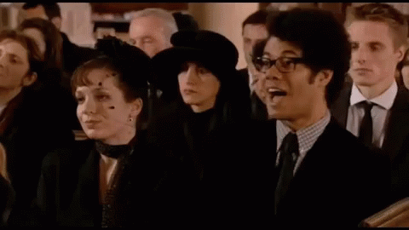
Academics are also generally terrible at making predictions...
“Open Access will never catch on.”
“Preprints will never be a thing.”
“Sharing our data won’t ever be mandatory.”
“Open peer review is fake news.”
“It doesn’t matter if research isn’t reproducible.”
“Open Science is just a fad.”
I wonder if they ever get tired being wrong all the time…
Be part of the conversation in advance, or you don‘t get to complain when it becomes the future.
@protohedgehog

Slide 34
Barriers to the principles of open science
Drivers
Barriers
Reduce publication bias.
Increase replicability/reproducibility.
Increase reliability of scientific record.
Make publicly funded research publicly accessible.
Make research more efficient.
Increase public trust.
Foster collaboration.
Sustainable research.
Fear of scooping or ideas being stolen.
Fear of not being credited for ideas.
Fear of errors and public humiliation.
Fear of risk to reputation.
Fear of reduced scientific quality.
Fear of information overload.
Fear of career compromise.
Fear of backlash from senior figures.
Fear of being different.
@protohedgehog

Slide 35
Your career
Open Science
SOCIAL AND TECHNICAL BARRIERS
@protohedgehog

Slide 36
This is the absolute WRONG message to be sending to students and researchers
Because Open Science is not an independent thing from science
It’s an enhanced way of doing it based on practices, values and principles

Slide 37
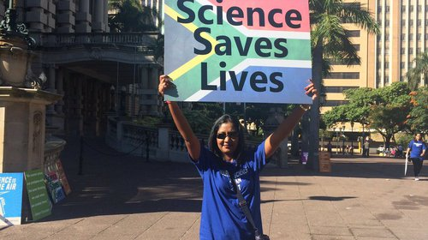
AN OPEN SCIENCE EDUCATION CRISIS
Can we break the inertia through training?
@protohedgehog

Slide 38

Attitudes versus practice
“60.8% of researchers do not self-archive their work even when it is free and in keeping with journal policy.”
“In a field where OA seems of practical and ethical importance for the sharing of knowledge promoting health equity, it is surprising that researchers do not make their papers available when they are legally able to do so without any cost.”
https://health-policy-systems.biomedcentral.com/articles/10.1186/s12961-017-0235-3
@protohedgehog

Slide 39
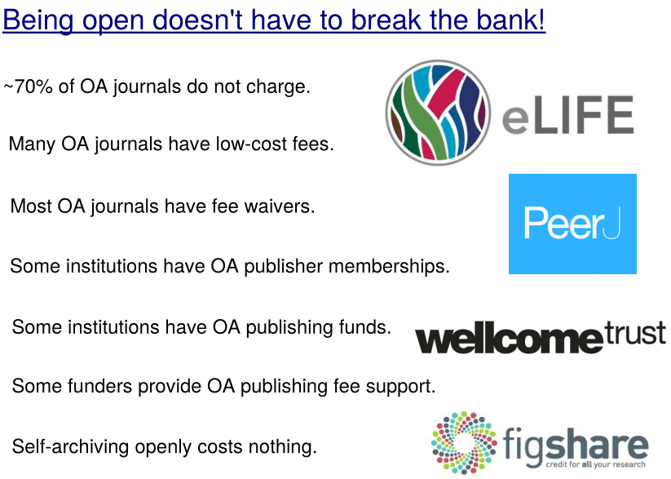
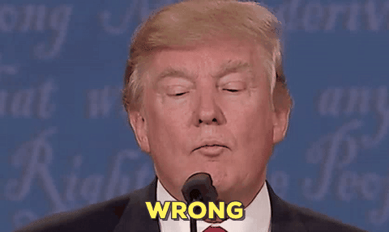
“Open Access
is too expensive.”
Common view about high costs is due to a combination of monopolisation and political broadsiding and sabotage by commercial publishers.
@protohedgehog

Slide 40
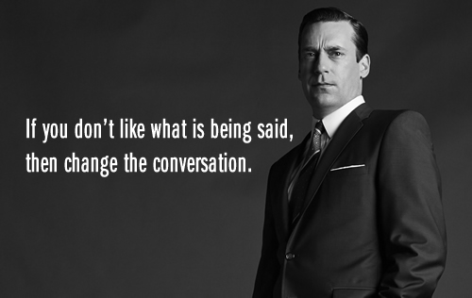
It is time to change the conversation
Open Science is AWESOME! And just doing science better/right.
@protohedgehog

Slide 41
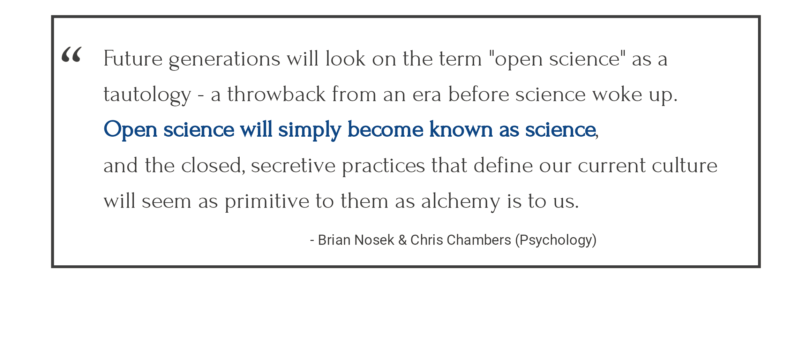
The future
Slide courtesy of Rebecca Willen
@protohedgehog

Slide 42
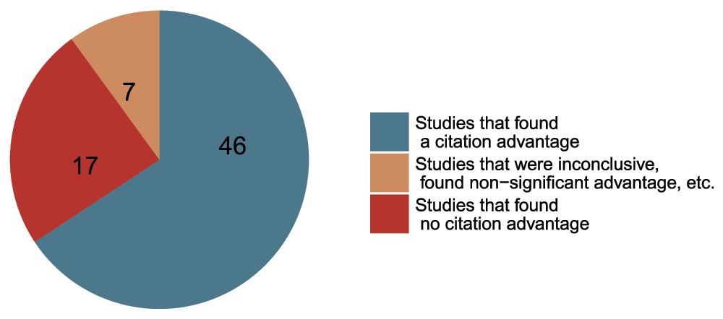
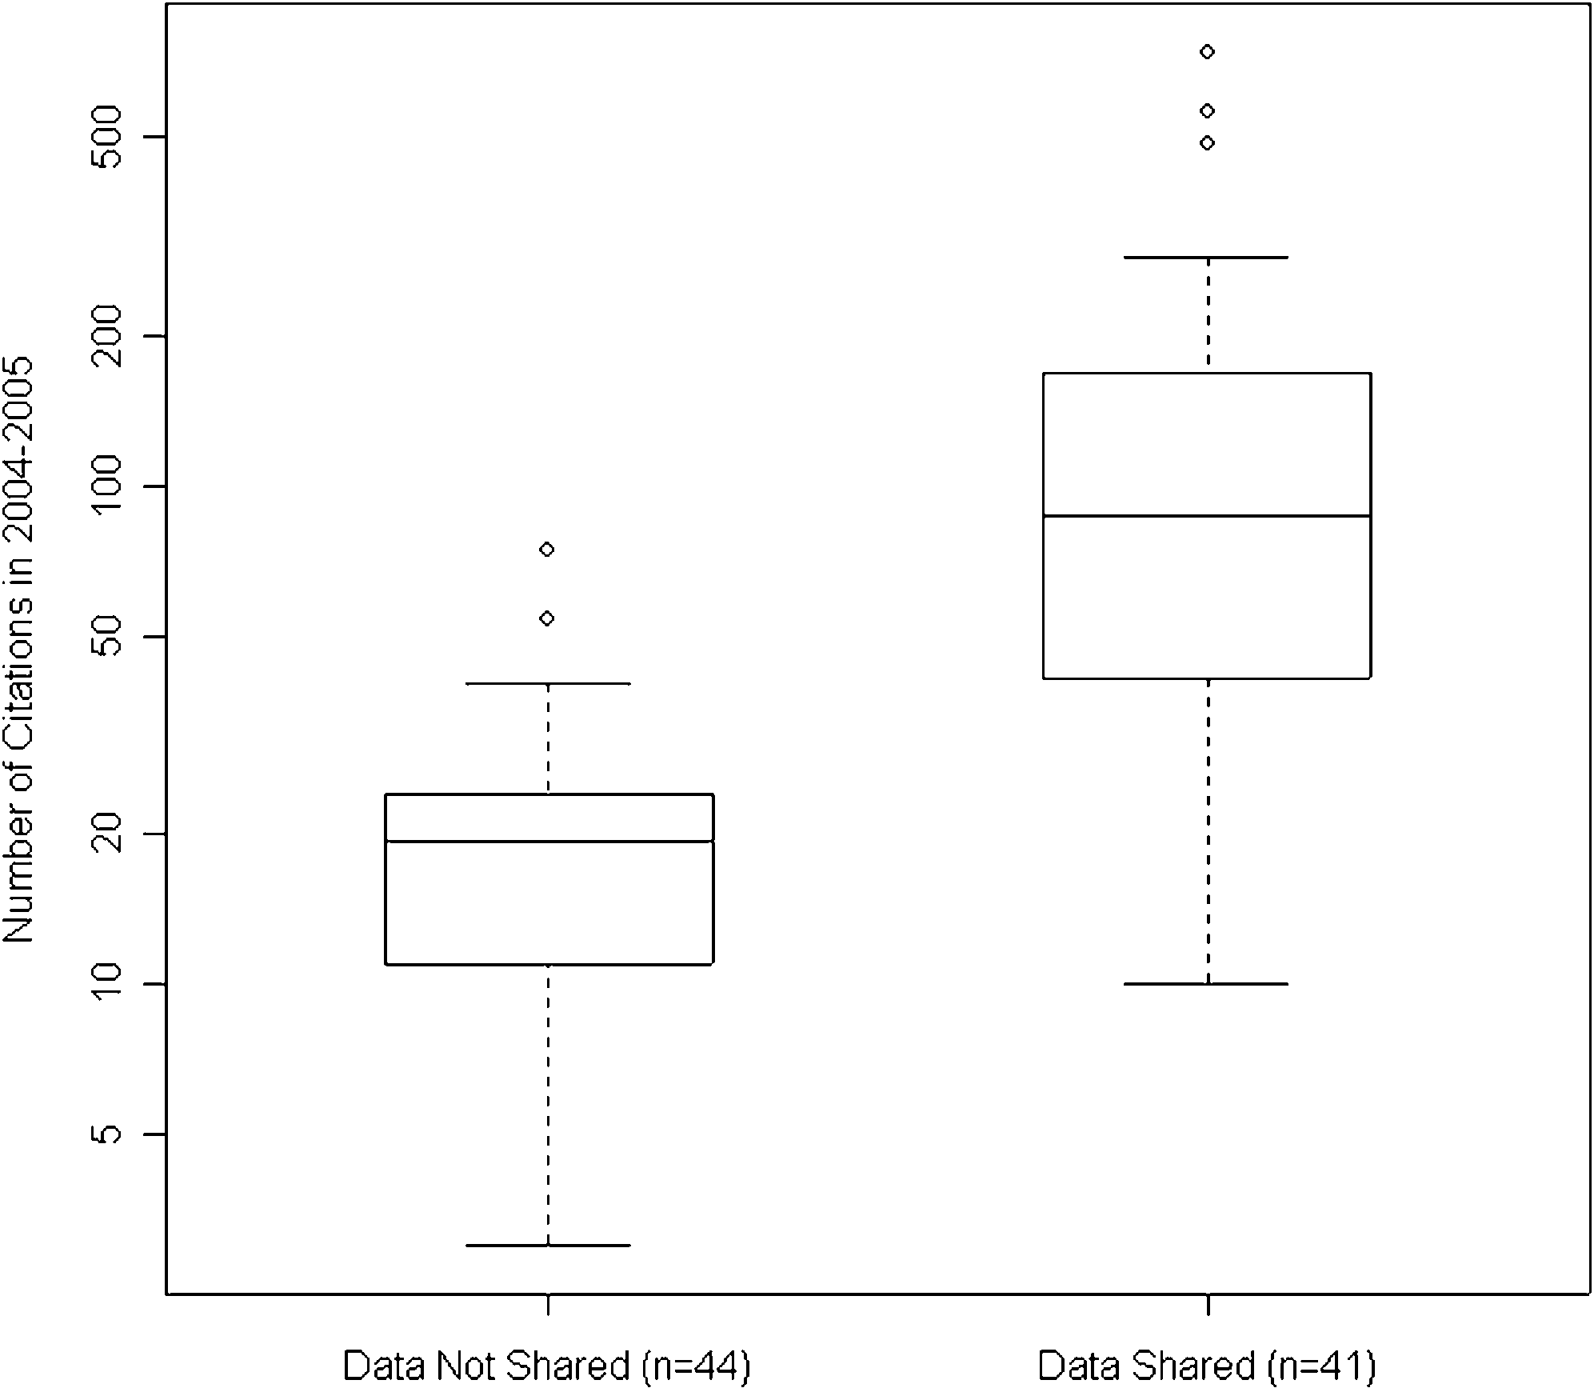
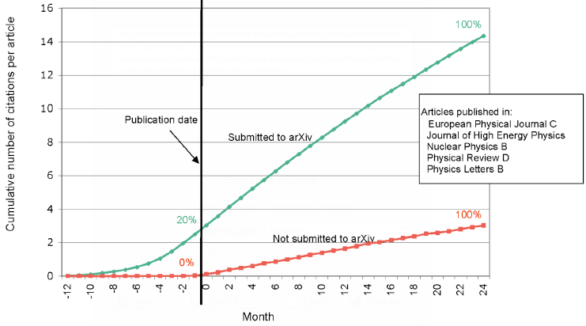
Openness is good for your work and career
Rapid communication
Greater exposure
More citations, faster
http://whyopenresearch.org
https://peerj.com/articles/175
Data from The Open Access Citation Advantage Service, SPARC Europe, accessed March 2016.
http://f1000research.com/articles/5-632/v3
@protohedgehog

Slide 43
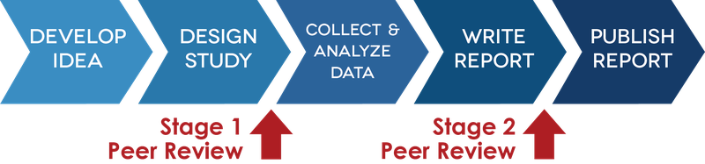
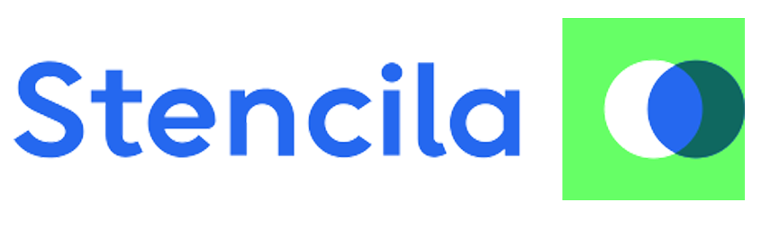
Openness and reproducibility
REGISTERED REPORTS
CODE OCEAN and STENCILA

Slide 44
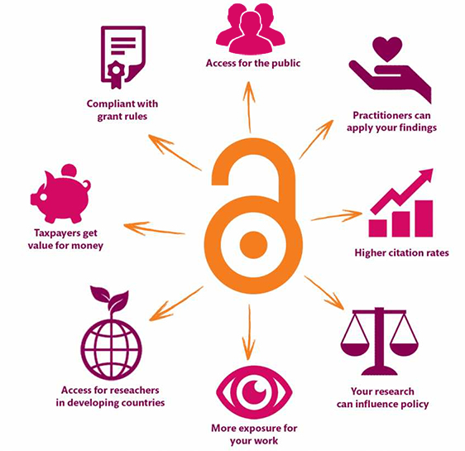
Open is better for EVERYONE
@protohedgehog
https://kib.ki.se/en/publish-analyse/open-access

Slide 45
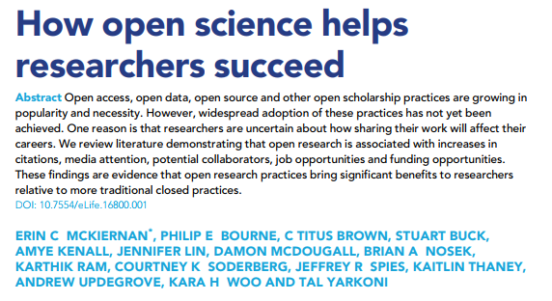
What is science without ‘openness’?
Without data? That can‘t be accessed? That can‘t be reproduced? That contains only cherry-picked results?
@protohedgehog
https://elifesciences.org/articles/16800

Slide 46
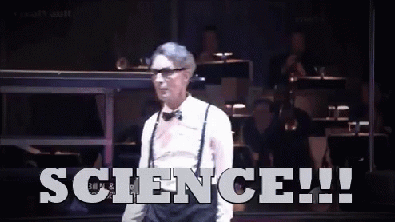
Being more open helps so much
Emphasises your core values.
Increases dissemination of your research.
Increases your academic profile.
Helps to combat the four crises.
Increases your collaborations.
Makes you a more effective researcher.
@protohedgehog

Slide 47
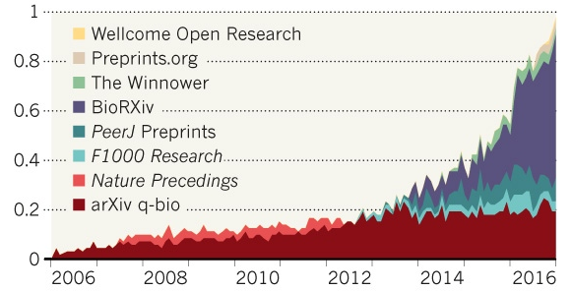
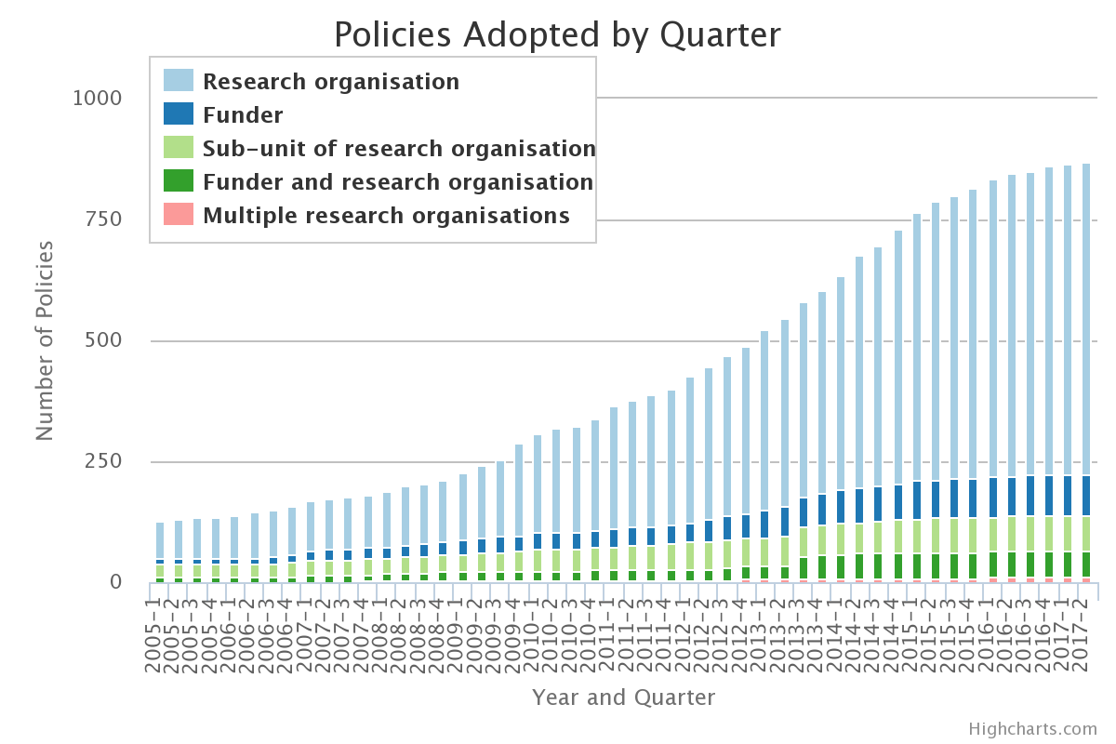
The future is OPEN
http://roarmap.eprints.org
We should be in a position where we are able to influence our academic system, not be stifled by the current actors in it.
@protohedgehog

Slide 48
Your career
Open Science
SOCIAL AND TECHNICAL BARRIERS
@protohedgehog

Slide 49
Your career
Open Science
TECHNICAL BARRIERS
SOCIAL BARRIERS
EDUCATION
@protohedgehog

Slide 50
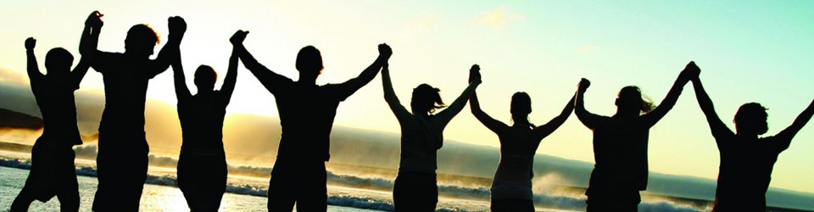
What can we all achieve if we stand together?
We need to stand together as a unified global community to make sure that we are acting in the best interests of the public, not corporate gains.
#PeopleNotProfits
https://letsallstandtogether.wordpress.com/
@protohedgehog

Slide 51
What do we need to achieve this and to change cultures?
Education, training, support.
Empowerment and leadership for the next generation.
Shifting power dynamics to reduce bias and abuse.
Building a global community based on sharing and collaboration.
Massive-scale engagement to re-align Open Science with current incentive structures.
@protohedgehog

Slide 52
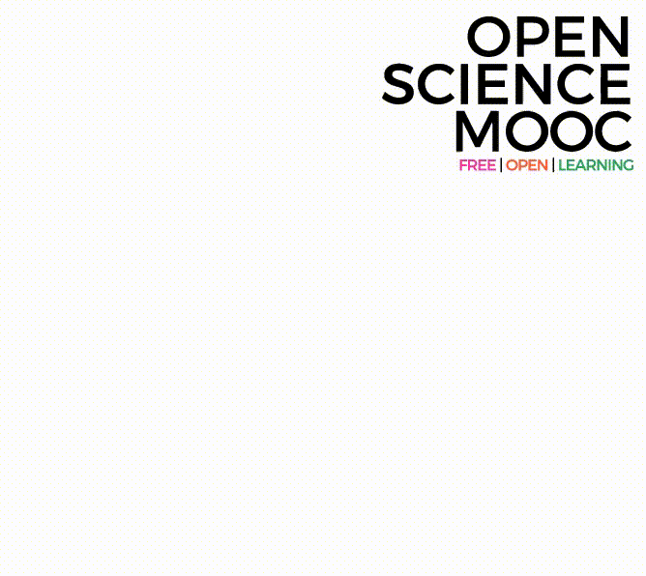
Introducing the Open Science MOOC*
A peer-to-peer value-based *Community that works towards better science for society
@OpenScienceMOOC

Slide 53
Our vision of the future
To help make ‘Open’ the default setting for all global research.
We want to help create a welcoming and supporting community, with good tools, teachers, and role-models, and built upon a solid values-based foundation of freedom and equitable access to research.
@protohedgehog

Slide 54
The way we do research has changed for good
We now have new expectations
Transparency
Not secrecy
Collaborative
Not solo
Continuous
Not discretised
@protohedgehog

Slide 55
We should be training ourselves
Sustained community engagement across disciplines
Being active both politically and at a community level
Rethinking our mindset (academic vs scientist)
Changing the defective incentive system
@protohedgehog

Slide 56
How do we get to where we want?
Imagine a future defined by the values of Open Science:
        Freely available public good
        Rigorous and reproducible
        Open to ALL
        Isn’t that just GOOD science?
@protohedgehog

Slide 57
The best researchers have already reinvented themselves into Openness
We need everyone to be collaborating together if we are going to help solve the challenges humanity faces.
#OpenScience
@protohedgehog

Slide 58
What do researchers care about?
Saving time and effort
Problem solving
Advancing research
We empower them with the knowledge and skills to do this
@protohedgehog

Slide 59
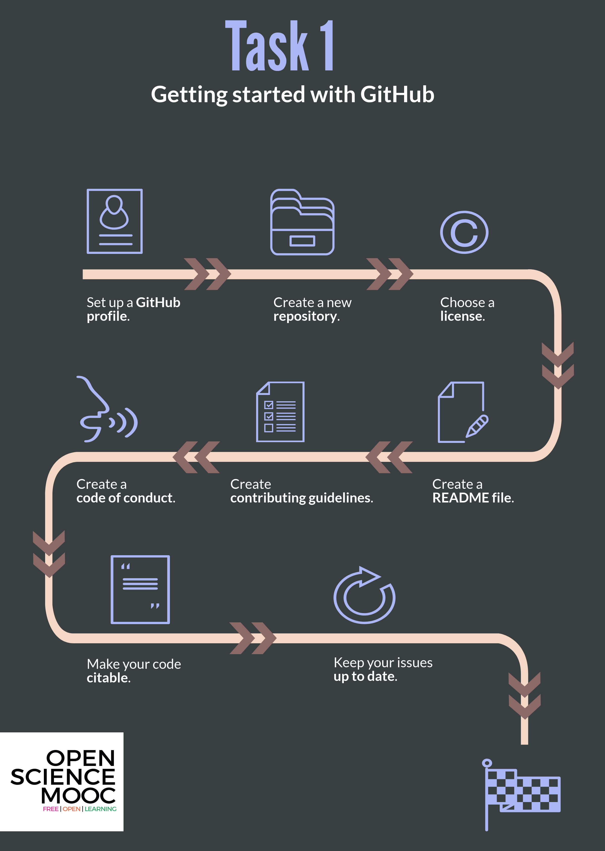
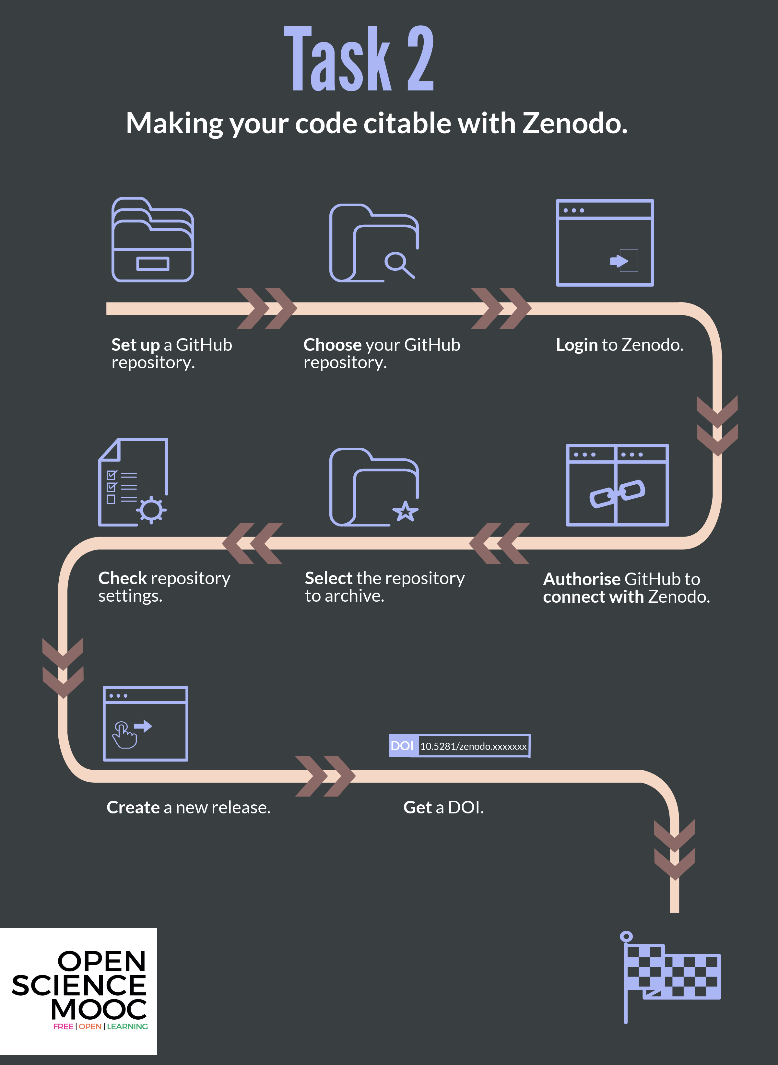

Slide 60

A fully interactive learning style
This allows learners to actually edit the MOOC content for this module. Nice.
Learning is based on participation and collaboration.

Slide 61

Modular learning
Designed by: Mike Morrison
@protohedgehog

Slide 62


Open for re-use

Slide 63

We are not alone

Slide 64

Some of our Production Team

Slide 65

We are guided by passion

Slide 66
Skeptical? You should be.
But it’s not as new as you think.
Science was founded on openness.
We closed it down.
It’s time to open it up again.
@protohedgehog

Slide 67
Status
@protohedgehog
In development
260+ Slack community members
3100+ Twitter followers
45+ strategic partnerships
Agile development so people are already using content
Iterative feedback is our design

Slide 68
Can you join in? YES!!
Open Slack channel:
https://openmooc-ers-slackin.herokuapp.com/
Open GitHub project:
https://open-science-mooc-invite.herokuapp.com/
We are ridiculously open
@protohedgehog

Slide 69
How do you want to shape your identity as a scientist?
Researchers can be world-changing heroes.
We will give them the power to achieve that.
@protohedgehog

Slide 70
Some small future challenges
Working models exist and show ‘Open Science’ is a more effective process.
Simultaneous uptake of new behaviours across the whole scholarly ecosystem.
Standardised communication between a range of key participants.
Interoperability between specific and diverse communities.
Increasing the role and recognition of ‘Open Science’ across the board.
Getting research funders (and researchers..) interested.
@protohedgehog

Slide 71

How to build an Open Science community
Building a community is not easy and it takes time
You need sustained engagement
If you know someone with money or a room for events, that helps!
Messaging is key
Play to your strengths
Communities are a space for reciprocal learning
https://www.meetup.com/Berlin-Open-Science-Meetup/
@protohedgehog

Slide 72
Promising initiatives in this space
Open Science Coalition
Political and public activism
Tools, services, and infrastructure
Community engagement, training, and education
Open Scholarship Initiative
Cross-national initiatives in this space (e.g., Plan S, SciELO, OCSDnet, DOAJ, OpenAIRE)
Joint Roadmap for Open Science Tools
Open Science MOOC and Open Scholarship Strategy
Scholarly Commons (Force11)
http://elephantinthelab.org/do-we-need-an-open-science-coalition/
@protohedgehog

Slide 73
What could the future of scholarly communication look like?
Imagine if we were to rebuild it from scratch in 2018…
@protohedgehog

Slide 74



Welcome to the networked 21st century
Everywhere we are using networks to evaluate information on the Web. Why not in science? Use the power of professional networks to evaluate scientific results.
http://journals.plos.org/plosone/article?id=10.1371/journal.pone.0193148
@protohedgehog

Slide 75




We have the tools to blow things wide open
https://doi.org/10.1093/femsle/fny204
@protohedgehog

Slide 76

Three core aspects for success of any platform
Quality control/moderation
Certification/reputation
Engagement incentives
HARMONY
So, how..?
@protohedgehog

Slide 77
Quality control and moderation
Traditional
Future
Gatekeeping function as a content filter (varying selectivity criteria)
QC incredibly difficult to measure, little evidence of actual success
Typically closed system with a secretive and selective process
Organised around journals (“papers” – it’s 2018..)
Non-accountable editor-controlled “black box of peer review”
Structurally limited (2-3 people)
Collaborative, constructive PR as ‘issues’ or comments
QC achieved via consensus and evaluated based on engagement
Self-organised, open and unrestricted communities
Unrestricted content types and formats
Elected ‘moderators’ accountable to communities (QC & engagement)
Semi-automated matching of content to reviewers
@protohedgehog

Slide 78
Certification and reputation
Traditional
Future
Poorly recognised and rewarded activity for researchers
Difficult to effectively measure due to opacity of process
Often inappropriate journal-level proxies
Issues surrounding identification within closed process
High reviewer turn-down rates for various reasons
A bit shit, really…
But getting better!
Performance metrics based on nature and quality of engagement
Open, continuous community-based evaluation tied to reputation
Revealed at object and individual levels
Fully transparent by default (e.g., via ORCID)* and portable
Reviewer pool greatly expanded with low barrier to entry
Potential for engagement filters
Appealing for those in charge of assessment
@protohedgehog

Slide 79
Incentives for engagement
Traditional
Future
Shared sense of duty as a natural, altruistic incentive
Researchers generally feel they receive too little credit
Incentives only for engagement, not for high quality engagement
Incentives not tied to academic reputation or career progress
‘Prestige’ obtained by journals
Virtual rewards such as points, ‘karma’, badges or abilities
Creates incentive loop incentivised to maximise engagement
‘Reviewing the reviewers’ system incentivises high quality PR
Can be tied to academic records and career advancement
Establishment of individual prestige
@protohedgehog

Slide 80
The ultimate goal
Pooling knowledge and resources to create a decentralised scholarly infrastructure, with communities as the focus.
Inclusivity
Equality
Accountability
Freedom
Fairness
Justice
Truth
Rigour
Transparency
Reproducibility
SCIENCE AS A PUBLIC GOOD FOR THE BETTERMENT OF SOCIETY
http://elephantinthelab.org/do-we-need-an-open-science-coalition/
@protohedgehog

Slide 81

Thanks!
GitHub: https://github.com/OpenScienceMOOC
Website: https://opensciencemooc.eu
Twitter: @OpenScienceMOOC
Email: info@opensciencemooc.eu
@protohedgehog

Slide 82

Questions?

